Slide 1
Lecture 12.
Enzymes in food processing.
Food biochemistry and food processing. 2012. Simpson B.K. (Ed.) 2nd edition, John Wiley & Sons, Inc.

Slide 2
Enzymes in food processing. Advantages.
Enzymes are proteins with powerful catalytic function.
Enzymes have a number of distinct advantages over conventional chemical catalysts:
High productivity and catalytic efficiency; Active in low concentrations;
High specificity – able to discriminate between structurally similar molecules, for example-optical isomers (stereospecificity). Their action on food components other than their substrates are negligible, thus resulting in the formation of purer products with more consistent properties;
They are more environmentally friendly and produce less residuals (or processing waste that must be disposed of at high costs) compared to traditional chemical catalysts.

Slide 3
Advantages, Cont.
Work under mild conditions of temperature, pressure and pH. It helps to preserve the integrity of heat-labile essential nutrients.
Control of enzyme activity and reaction rate.
Most of them are quite heat labile and therefore can be readily inactivated by mild heat treatments after they have been used to achieve the desired transformation in foods;
They are natural and relatively innocuous components of agricultural materials that are considered “safe” for food and other nonfood uses;
Some disadvantages: High cost, Low stability.

Slide 4
Undesirable effects:
Enzymes like proteases, lipases, and carbohydrases break down biological molecules (proteins, fats, and carbohydrates, respectively) which, if not controlled, may adversely impact flavor, texture, overall product quality.
Decarboxylases and deaminases degrade biomolecules (e.g., free amino acids, peptides, and proteins) to form undesirable and/or toxic components, e.g., biogenic amines in foods.
Polyphenol oxidases (PPO) and lipoxygenases (LOX) promote oxidations and undesirable discolorations and/or color loss in fresh vegetables and fruits.
Ascorbic acid oxidase cause destruction of essential components (vit. C) in foods.

Slide 5
Sources of food enzymes (plant, animal, microbial, and recombinant).
Enzymes have been used inadvertently or deliberately in food
processing since ancient times to make a variety of food products, such as:
breads,
fermented alcoholic beverages,
fish sauces,
cheeses.
Enzymes have been traditionally produced by
extraction and fermentation processes from plant and animal sources,
from a few cultivatable microorganisms.

Slide 6
Sources of food enzymes (plant, animal, microbial, and recombinant). Cont.
Industrial enzymes have traditionally been derived from:
Plants: α-amylase, β-amylase, bromelain, β-glucanase, ficin, papain, chymopapain, and lipoxygenase
Animals: trypsins, pepsins, chymotrypsins, catalase, pancreatic amylase, pancreatic lipase, and rennin (chymosin)
Microorganisms: α-amylase, β-amylase, glucose isomerase,
pullulanase, cellulase, catalase, lactase, pectinases, pectin lyase, invertase, raffinose, microbial lipases, and proteases.

Slide 7
Enzymes used in food industry have mainly microbial origin.
Advantages of microorganisms as a source for enzyme production:
Easy and fast grow.
Take small space to cultivate.
Relatively cheep culture compounds.
Their use as enzyme source is not affected by seasonal changes and climatic conditions and are thus more consistent.
Possibility for tight control of culture conditions.
Their use as sources of enzymes is not affected by various political and agricultural policies or decisions that regulate the slaughter of animals or felling of trees or plants.

Slide 8
Even though all classes of enzymes are expected to occur
in all or most microorganisms, in practice, the great majority
of industrial microbial enzymes are derived from only a very
few GRAS (generally recognized as safe) species.
The predominant microorganisms used for industrial production of enzymes for food purposes are:
Aspergillus species,
Bacillus species,
Kluyveromyces species.
Limited use is due to: co-production of harmful toxins.
There is a need for stringent evaluation for safety at high cost before they can be put to use for food production.

Slide 9
Selected examples for food enzymes and their application.

Slide 10
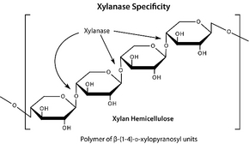
Use of enzymes in baked goods manufacturing
Baked goods are prepared from flours such as wheat flour, which
has starch as its main constituent.
Amylolytic enzymes break down flour starch into small dextrin pieces that become better substrates for yeast to act upon in the bread-making process.
Xylanase – preferred are those that act on the non-water soluble arabinoxylan fraction. It interferes with the formation of gluten network. Removal of not-extractable with water arabinoxylan fraction results in increase of high molecular weight solubilized in water arabinoxylans that in turns increase viscosity and dough stability; provide better crumb texture and increased loaf volume.

Slide 11
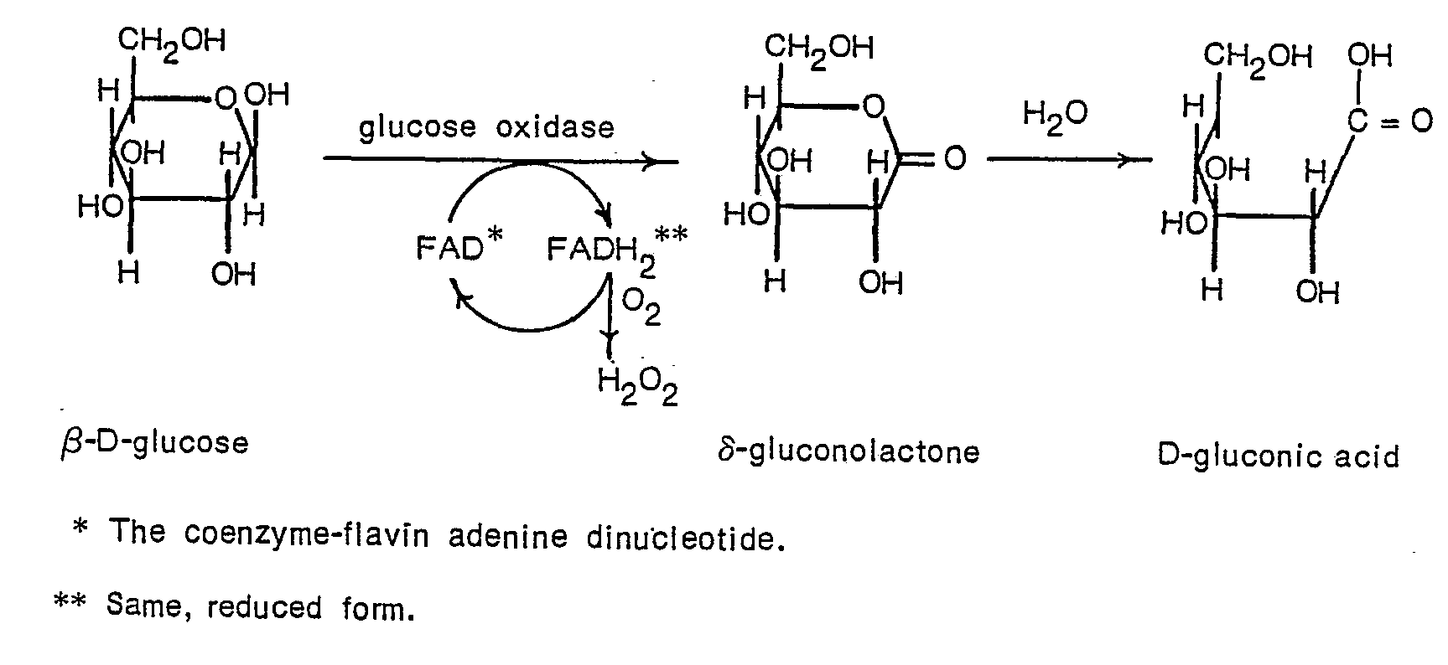
Broader application of enzymes in the baking industry is replacement of chemicals that are conventionally used in bread making.
For example, an enzyme like glucose oxidase (GOX) is used in baked goods to strengthen dough texture and enhance elasticity in place of chemicals such as potassium bromate (flour improver - E number E924).
Potassium bromate - 2B carcinogen (possibly carcinogenic to humans). Banned for use in EU; Allowed for use in the USA.

Slide 12
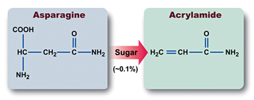
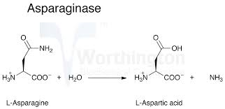
Proteases:
To break down protein molecules in the dough and improve dough
handling;
Enhance flavor development;
May be used to degrade gluten and protect individuals that are gluten intolerant.
Asparaginase breaks down asparagine in the flours to reduce its availability for reaction with reducing sugars to form acrylamide at high temperature.

Slide 13
Horváthová et al. Biologia, Bratislava, 55/6: 605|615, 2000
Enzymes in starch modification
Biologia, Bratislava, 55/6: 605|615, 2000
Fig. 1. Action of starch-degrading enzymes. () Reducing -D-glucose residue; () non reducing -D-glucose residue. Arrows indicate the -1,6-branching points in the starch molecule.

Slide 14
Major steps of starch conversion

Slide 15
Enzymes in starch modification: Liquefaction
Bacterial thermophilic α-amylase: an endo-amylase which hydrolyses the α- 1,4-linkages in starch (amylose and amylopectin) almost at random. The breakdown products formed are mainly soluble dextrin and oligosaccharides. In a concentrated solution of starch, the hydrolysis results in a rapid viscosity reduction. In consequence the bacterial thermophilic α-amylase is often referred to as a 'liquefying amylase'. The process is called liquefaction.
Starch liquefaction results in formation of maltodextrin (Dextrose equivalent (DE) = 15-25 means partial hydrolysis.
Enzymes in food technology. 2002. Whitehurst R.J., Law B.A. (Eds.), Sheffield Academic Press Ltd., Sheffield, UK

Slide 16
Saccharification of liquefied starch
Maltodextrin is commercially available and used for its rheological properties. They are used in the food industry as fillers, stabilizers, thickeners, pastes and glues.
Further degradation of maltodextrins is known as saccharification. Depending on the degree of hydrolysis and enzymes used variety of sweeteners can be produced which differ by their carbohydrate composition and rheological properties.
Dextrose equivalent (DE) = degree of hydrolysis. Expresses the reducing power as a percentage of pure dextrose, calculated to dry weight basis.

Slide 17
Saccharification enzymes
Production of maltose syrup:
Fungal α-amylase: exo-amylase, which hydrolyses the alpha-1,4-linkages in liquefied starch (amylose and amylopectin); A prolonged reaction results in the formation of large amounts of maltose.
The Fungal alpha-amylase is used for production of
high maltose syrups or high conversion syrups.
β-amylase are exo-enzymes, which attack amylose chains resulting in maltose production. β-Amylase is used for the production of maltose syrups.

Slide 18
Maltose syrups (maltose content from 50 to 80%) are produced by saccharifying liquefied starch with maltogenic exo-enzymes - fungal α-amylase or barley β-amylase, also known as malt extracts.
Properties of maltose syrups:
Low glucose content and a high maltose content.
Because of the low glucose content, high maltose syrups show a low tendency to crystallize.
They are relatively non-hygroscopic.

Slide 19
Production of glucose syrup:
Glucoamylase (amyloglucosidase): (exo-amylase) which hydrolyses alpha-1,4-linkages as well as alpha-1,6-linkages in liquefied starch (amylose and amylopectin).
The breakdown product formed is glucose (as β-glucose), which has been split off from the non-reducing end of the substrate molecule.
Eventually, almost complete conversion of starch into glucose can be obtained.

Slide 20
Glucose syrups (95-97% glucose) may be produced from most starch raw materials (corn, wheat, potatoes, tapioca, barley and rice).

Slide 21
Isoamylase and pullulanase (de-branching enzymes)
Isoamylase and pullulanase hydrolyse alpha-1,6-glycosidic bonds of starch, which has been partly hydrolyzed by alpha-amylase.
Treatment of amylopectin with pullulanase generates linear amylose fragments.
Using heat-stable and acid-stable pullulanase in combination with saccharification enzymes makes the starch conversion reactions more efficient.

Slide 22
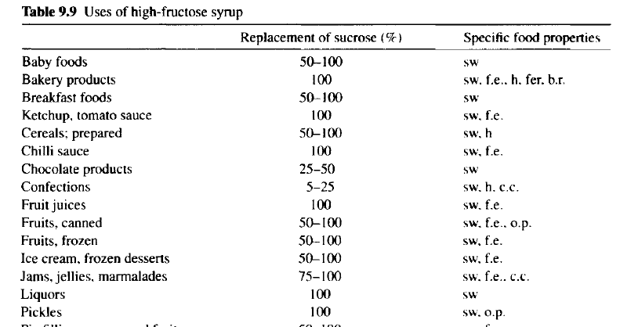
Fructose syrup
High-fructose corn syrup (HFCS): contain 42% or 90% fructose based on dry substance.
A sweetener alternative to white sugar (sucrose) produced from sugar cane or beets.

Slide 23
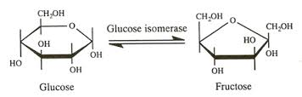
Produced by the use of the enzyme glucose isomerase.
Glucose can reversibly be isomerized to fructose. The equilibrium conversion for glucose to fructose is 50% under industrial conditions.
The isomerization reaction can only be economically efficient by using immobilized enzyme.

Slide 24
This is done by using an immobilized isomerase in a fixed-bed reactor process in a column through which glucose flows continuously.
The enzyme granules must be rigid enough to prevent compaction during the operation.
Sweetzyme IT (Novozymes A/S) is produced by a mutant of a selected Streptomyces murinus strain. The immobilization procedure consists of a disruption of a cell concentrate through with a homogenizer. The cells are then cross-linked with glutaraldehyde. The concentrated aggregate is extruded and finally fluid-bed dried and sieved.
Depending on parameters such as temperature, pH, feed purity, and so on, the operating lifetime of this isomerase will typically be 200–360 days.

Slide 25
Saccharification products and their application

Slide 26
Use of enzymes in dairy products manufacturing
Proteases: To act on milk proteins to modify texture and solubility properties of milk and other dairy products; accelerate cheese ripening and improve flavor intensity.
Rennet is the stomach extract that contains the enzyme chymosin in a stabilized form that is usable for cheese making. It is a coagulant which degrade kapa-casein to produce cheese curds.
For the manufacture of traditional rennet, calves, lambs, or kids that are no more than about 2-weeks-old and fed only milk are used.

Slide 27
Genetic technology has been used for the commercial production
of a 100% pure chymosin product from microbes. This type
of chymosin is often called fermentation-produced chymosin.
The microbes used for the production of this type of rennet include nonpathogenic microorganisms
Escherichia coli K-12,
Kluyveromyces marxianus var. lactis
Aspergillus niger var. awamori.
Pro-chymosin genes obtained from young calves are transferred
through DNA plasmid intervention into microbial cells. Fermentation
follows to produce pro-chymosin, cell destruction, activation
of the prochymosin to chymosin (by cleavage of 42 amino acids), and harvesting/producing large yields of pure, 100% chymosin.

Slide 28
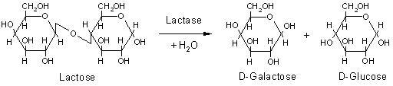
Lactase
Lactose is present in milk (about 4.7% (w/v)) and remains in the whey (supernatant) left after the coagulation stage of cheese-making. Lactose has low solubility resulting in crystal formation at concentrations above 11 %.
If lactase is added to milk or liquid whey (2000 U kg⁻¹) and left for about a day, about 50% of the lactose is hydrolyzed, giving a sweeter product which will not crystallise if condensed or frozen. Therefore, it can be used in the production of ice cream and sweetened flavored and condensed milks to prevent “sandy” taste.
Hydrolyzed lactose is 4 times sweeter than non-hydrolyzed lactose.
It also improves the 'scoopability' and creaminess of the product.

Slide 29
Use of lactase protect individuals that are lactose intolerant.
Of the Thai, Chinese and Black American populations, 97%, 90% and 73% respectively, are reported to be lactose intolerant.
Some individuals suffer from inborn metabolic lactose intolerance (lactase deficiency).
Severe tissue dehydration, diarrhea and even death may result from feeding lactose containing milk to lactose-intolerant children and adults.

Slide 30
Lipases
Lipases are used to break down milk fats and give characteristic flavors to cheeses. Stronger flavored cheeses, for example, the Italian cheese, Romano, are prepared using exogenous lipases.
The flavor comes from the free fatty acids produced when milk fats are hydrolyzed.
Animal lipases are obtained from kid, calf and lamb.
Microbial lipase is derived by fermentation with the fungal species Mucor meihei.
Microbial lipases are readily available for cheese-making, but less preferred, since they are less specific in what fats they hydrolyze.
Animal enzymes are more partial to short and medium-length fats. Hydrolysis of the shorter fats is preferred because it results in the desirable taste of many cheeses. Hydrolysis of the longer chain fatty acids can result in either soapiness, or no flavor at all.

Slide 31
Bio-protective enzymes (preservatives)
Bio-protective enzymes offer a natural means to improve food safety and reduce costs associated with microbial contamination during storage.
Lysozyme: An antimicrobial enzyme that limits the growth of Clostridia in aged cheese. These bacteria can cause swelling of the cheese shape and/or development of unpleasant taste and smell.
Nisin: An antimicrobial peptide effective against Gram-positive and spore-forming bacteria in cheese. Useful in non-thermally processed dairy products. No widespread agreement on the
maximum level application.

Slide 32
Use of enzymes in meat and seafood products manufacturing
Proteases- heat stable forms preferred , e.g., papain, ficin, and bromelain (mixture of enzymes found in pineapples)
To modify texture and induce tenderness in meats and squid,
To improve chewability and digestibility,
To reduce bitterness and improve flavor as well as nutritive value,
Produce hydrolysates from meat scraps, underutilized fish species and fish processing discards;
Enhanced flavors in fermented herring (fish).

Slide 33
Transglutaminase:
To improve texture in meats and seafood products,
Form restructured meats from trimmings and surimi-type products,
Form “umami” flavors for use as additives to meat products (After cross-linking treatment the content of 1000–5000 Da peptides increases, 2012, Food Chemistry 136 (1), Pages 144–151)
Umami taste – the fifth taste of food (basic tastes: sweet, sour, salty and bitter). It can be described as a pleasant "meaty" taste with a long lasting, mouthwatering and coating sensation over the tongue.
Umami taste represents the taste of the amino acid L-glutamate and 5’-ribonucleotides such as guanosine monophosphate (GMP) and inosine monophosphate (IMP).
GMP and IMP amplify the taste intensity of the sodium glutamate.

Slide 34
Use of enzymes in fruit, vegetable and cereal processing
Pectolytic enzymes (pectinase): a collective name for several enzymes that degrade pectin;
Cellulolytic complex;
Hemicellulases.

Slide 35
Enzymatic mash treatment: why are exogenous enzymes needed?
Cell walls contain high-molecular weight compounds.
Protopectin is insoluble and inhibit the extraction of the juice
from the fruit and keep solid particles suspended in the juice.
In addition, polymers of xylose, galactose, and arabinose (hemicelluloses) form a link with cellulose. The entire system forms a gel that retains the juice in the mash.
The goal:
Enzymatic mash treatment (for example, in juice production) is performed to: improve the pressabiliy of the mash and, respectively juice yield.

Slide 36
What happens?
Pectinase pretreatment acts mainly on the cell wall, breaking the structure and freeing the juice. Pectinases with a high proportion of pectinesterase and liquefying polygalacturonases are suitable for mash treatment.
The hydrolysis of the protopectin that binds the cells weakens the fruit tissue, causing the protopectin to dissolve thus increasing the juice viscosity. More juice can be released from the mash.
The high content of pectin esterase (PE) causes the formation of de-esterified pectin fragments, which have a low water-binding capacity and reduces the slipperiness.
Greater yield and press capacity.

Slide 37
Cellulases and hemicellulases
The use of cellulases and hemicellulases in fruit processing is not allowed in the EU.
They are, however, allowed without any legal restrictions for vegetable processing.
However, cellulases and hemicellulases can in fact be detected in commercially available pectinase, amylase and protease products as secondary activities. Their proportion depends on the strain used for the enzyme production.
Cellulolytic enzymes are usually used in combination with pectolytic enzymes. These enable further viscosity reduction and facilitate solid/liquid separation.

Slide 38




Thank you!!!

