Slide 1
Lecture 11.
Biochemical alteration of food during postharvest and storage.

Slide 2
1. Indigenous Enzymes in Milk
General overview:
About 60 indigenous enzymes have been reported in normal bovine milk.
Physiological role of most of them unknown.
The indigenous enzymes are constituents of the milk as excreted.
Some of them are inactive due to lack of substrate or unsuitable environmental conditions such as pH.
Handbook of Food Enzymology. 2003. Whitaker J.R., Voragen A.G.J. , Wong D.W.S. (Eds.)

Slide 3
Why are indigenous milk enzymes technologically significant?
Deterioration (proteinase, lipase, acid phosphatase and xanthine oxidase) or preservation (lactoperoxidase, sulfhydryl oxidase, superoxide dismutase) of milk quality.
2. As indicators of the thermal treatment of milk; these include alkaline phosphatase, γ-glutamyl transpeptidase, lactoperoxidase, and perhaps others.
3. As indicators of mastitic infection; the concentration of several enzymes increases on mastitic infection, especially catalase, and acid phosphatase.
4. Antimicrobial activity, such as lysozyme and lactoperoxidase.
5. As commercial source of enzymes; these include ribonuclease and lactoperoxidase.

Slide 4
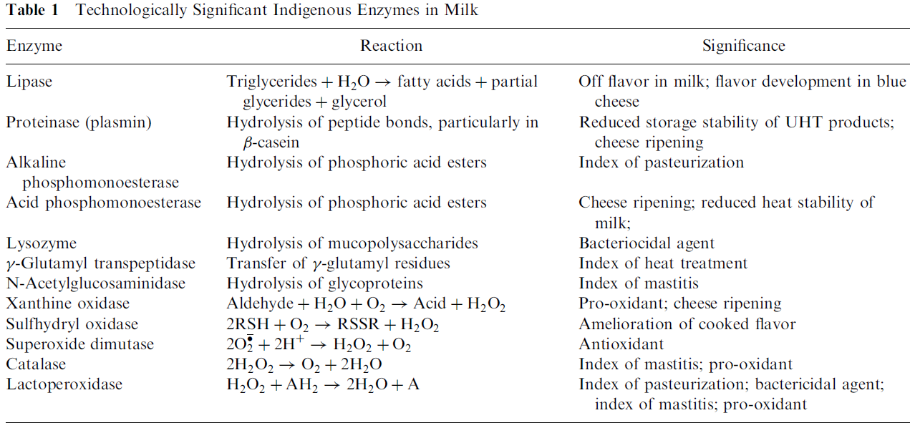
Handbook of Food Enzymology. 2003. Whitaker J.R., Voragen A.G.J. , Wong D.W.S. (Eds.)

Slide 5
With a few exceptions (e.g., lysozyme and lactoperoxidase), the indigenous milk enzymes do not have a beneficial effect on the nutritional or organoleptic attributes of milk, and hence their destruction by heat is one of the objectives of many dairy processes.

Slide 6
MILK DETERIORATION
1. PROTEINASES
Two major indigenous proteinases
Plasmin (alkaline milk proteinase)
Cathepsin D (acid milk proteinase)

Slide 7
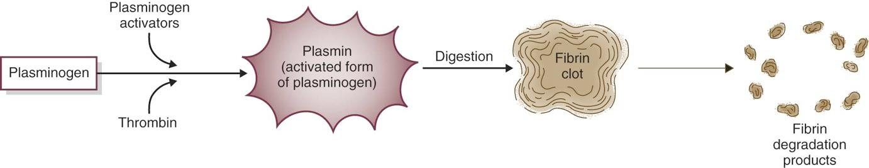
Plasmin (alkaline milk proteinase)
The physiological function of plasmin is to dissolve blood clots.
Plasmin is secreted as plasminogen which is the inactive plasmin precursor .
In milk, there is about four times as much plasminogen as plasmin.

Slide 8
Plasmin activity
Plasmin is a serine proteinase with a high specificity for peptide bonds to which lysine or arginine supplies the carboxyl group.
β-casein is the most susceptible milk protein to plasmin action.
α-casein in solution is also hydrolyzed very rapidly by plasmin.

Slide 9
κ-casein contains several Lys and Arg residues but it is quite resistant to plasmin, probably due to its secondary and tertiary structures.
Whey proteins are quite resistant to plasmin, probably due to their compact, globular structures.
In fact, β-lactoglobulin, especially when denatured, inhibits plasmin, presumably via sulfhydryl-disulfide interactions which rupture the structurally important elements.

Slide 10
SIGNIFICANCE OF PLASMIN ACTIVITY IN MILK
In vitro studies with casein as a substrate demonstrate that that there is sufficient plasmin in milk to cause substantial proteolysis. Does not account the presence of plasmin inhibitors.
Plasmin is thermostable.
Plasmin and plasminogen accompany the casein micelles on the chymosin coagulation of milk in cheese making.
Plasmin remains active even after milk cooking at high temperature.
Plasmin hydrolyzes of the caseins results in large polypeptides. This proteolysis alters three-dimensional protein network of the cheese to form a less firm and less elastic cheese.

Slide 11
SIGNIFICANCE OF PLASMIN ACTIVITY IN MILK Cont.
Plasmin is considered responsible for some undesirable changes in the rheological properties (flavor, texture) of cheese. The large polypeptides do not have a direct impact on flavor but do function as a substrate for the proteases associated with the starter and nonstarter bacteria. However, if the primary proteolysis is extensive, bitter peptides, with a high percentage of hydrophobic amino acids predominate.
Plasmin activity may contribute to the age gelation of ultra-high-temperature processed milk produced from high-quality raw milk (no bacterial activity involved).
Reduced yields of cheese and casein since resulted peptons from plasmin proteolytic activity are soluble at pH 4.6 and are not incorporated into acid- or chymosin-produced casein curd.

Slide 12
2. Cathepsin D
Acid proteinase (optimum pH 4.0).
It is relatively heat labile (inactivated by 70°C for 10 min).
At least some of the indigenous acid proteinase is incorporated into cheese curd.
Over all, cathepsin D activity is similar to that of chymosin, but it has very poor milk clotting activity.
It may contribute to proteolysis in cheese, but its activity is probably overshadowed by chymosin, which is present at a much higher level in cheese.

Slide 13
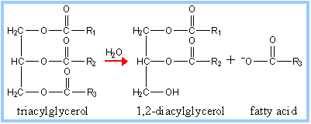
Lipase
Milk lipase is lipoprotein. It catalyzes the breakdown of lipids. The process is called lipolysis.
Lipase action produces free fatty acids but also diacylglycerol and monoacylglycerol.

Slide 14
Importance for dairy industry
Free fatty acids, especially short chain acids (i.e. butyric (C4), caproic (C6), caprylic (C8) have strong flavors and low flavor thresholds which lead to flavor defects – rancid (unpleasant smell or taste), astringent, „bitter‟.
But also may impart desirable flavors to some cheeses like parmesan.
Partial glycerides (and free fatty acids) are surface active - cause steam foaming problems in cappuccino coffee making.

Slide 15
Milk lipase
Originates from the blood.
Present in all raw milk.
Inactivated by pasteurization.
Therefore it causes no lipolysis in milk or dairy products after pasteurization.

Slide 16
Milk lipase in raw milk
Raw milk contains enough lipase to hydrolyze all the fat in milk (~ 1 mg can be isolated from 1 L). But it does not happen. Why not?
It cannot attack fat in intact milk fat globules (due to protection of the milk fat globule membrane).
Lacks some activators: as a “lipoprotein lipase”, it is activated by lipoproteins as found in the blood – this can be demonstrated by adding some blood serum to raw milk; lipolysis proceeds rapidly.
Contains some substances which inhibit lipase action.

Slide 17
Lipolysis in raw milk
By spontaneous lipolysis - at farm.
Initiated in milk of some cows just by cooling to < 10°C.
In this type of milk after cooling, lipolysis occurs during refrigerated storage and reaches a maximum after 12-16 hrs.
Occurs mostly in milk of :
cows in late lactation
cows on poor feed
certain cows only
Spontaneous lipolysis is greatly reduced when „spontaneous‟ milk is mixed with „normal‟ milk.

Slide 18
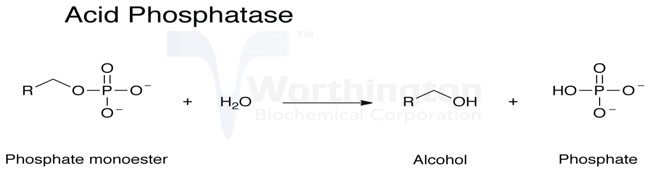
Acid phosphomonoesterase (phosphatase)
Acid phosphatase is found free in skim milk, in membrane material in skim milk and in the fat globule membrane.
Milk acid phosphatase has a pH optimum at 4.0.
Very heat stable. Low temperature, long time (LT) pasteurization (63°C, 30 min) causes only 10–20% inactivation. Full inactivation at 88°C, 30 min.
The level of acid phosphatase activity in milk is only 2% that of alkaline phosphatase.
It catalysis the hydrolysis of phosphoric acid esters.

Slide 19
Technological significance
Although acid phosphatase is present in milk at a much lower level than alkaline phosphatase, its greater heat stability and lower pH optimum may make it technologically significant.
Dephosphorization of casein reduces its ability to bind Ca²⁺ ions and form micelles.
Dephosphorization may be rate limiting for proteolysis in cheese ripening since most proteinases and peptidases are inactive on phosphoproteins or phosphopeptides.

Slide 20
Milk preservation
Lactoperoxidase (LPD)
Catalytic function: oxidation of inorganic and organic substrates by hydrogen peroxide as an oxidizing agent.
It is one of the most heat-stable enzymes in milk.
Its inactivation is used as an index of Super-High Temperature Short-Time pasteurization, e.g., temperatures > 76°C for 15 sec.

Slide 21
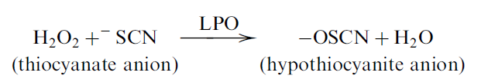
Bactericidal effect of Lactoperoxidase (LPD)
It is based on the peroxidation of ⁻SCN to products which are nontoxic to mammalian cells but which kill or inhibit the growth of many species of microorganisms.
⁻SCN occur naturally in milk , a product of the enzymatic hydrolysis of plant thio-glycosides.
Handbook of Food Enzymology. 2003. Whitaker J.R., Voragen A.G.J. , Wong D.W.S. (Eds.)

Slide 22
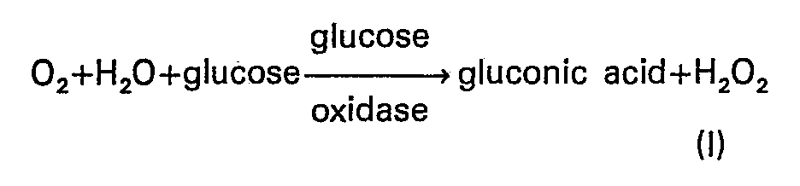
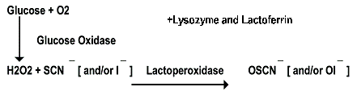
Milk does not contain indigenous H₂O₂ but can be generated metabolically by catalase-negative bacteria, or produced in situ through the action of exogenous glucose oxidase on glucose which may be added to milk.

Slide 23
Microbial membranes are permeable for –OSCN.
⁻OSCN oxidizes sulfhydryl groups:
Any reaction involving a sulfhydryl group, e.g., thiol enzymes, will be inhibited by this oxidation.

Slide 24
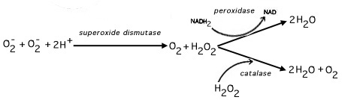
Superoxide dismutase (SOD)
Superoxide dismutase (SOD) scavenges superoxide radicals O₂⁻, according to the reaction:
The H₂O₂ formed may be reduced to H₂O or O₂ by catalase, peroxidase or suitable reducing agents.
Superoxide radicals O₂⁻ are produced as a by-product of oxygen metabolism and, if not regulated, causes many types of cell damage.

Slide 25
Milk contains trace amounts of SOD which is present exclusively in the skim milk fraction.
SOD inhibits lipid oxidation in model systems.
Exogenous SOD can be used to retard or inhibit lipid oxidation in dairy products. Improvement in the oxidative stability of milk containing high level of linoleic acid was achieved by adding low levels of SOD.

Slide 26
2. Indigenous Enzymes in Meat

Slide 27
Proteolysis: Muscle Proteases
Proteases are characterized by their ability to degrade proteins (peptide bonds).
Endoproteases or proteinases,
when they are able to hydrolyze internal peptide bonds.
Exopeptidases, when they hydrolyze external peptide bonds, either at the amino termini or the carboxyl termini.

Slide 28
Some of the endogenous proteolytic enzymes cease their functions shortly after animal death.
Others remain active throughout the entire postmortem ageing process and contribute either to flavor (exopeptidases) or to tenderness
(endopeptidases) of meat.
Two well-studied enzyme systems that are implicated in meat tenderization are calpain and cathepsins.

Slide 29
Calpain
Calpain is a calcium-dependent protease located around the myofibrils.
It exists in two forms, i.e., µ-calpain and m-calpain, so designated due to their micromolar (M) and millimolar (mM) range of calcium concentration requirements for maximal activity.
The µ-calpain and m-calpain are isomers with a high degree of sequence homology.
Since the calcium concentration in cytosol is in the micromolar range, only µ-calpain would be active and play a significant role in the degradation of the specific myofibrillar proteins, and hence, meat tenderization.

Slide 30
Mode of action
Disrupt peripheral structure of the myofibrils but does not affect myosin and actin.
Optimal pH for calpain is 7.0±7.2 but the enzyme still retains a significant amount of activity at post-rigor muscle pH (5.5±5.6).
Regardless, meat that is subjected to a normal postmortem ageing process rarely becomes mushy. The reason:
calpain is susceptible to autolysis and is regulated by its endogenous inhibitor calpastatin.
The low pH condition (pH 5.5±5.6) in post-rigor muscle tissue would also limit the activity of the enzymes.

Slide 31
Cathepsins
A group of acidic proteases located in the lysosomes.
Like calpain protease system, cathepsins are believed to be involved in the postmortem degradation of selective myofibrillar components. These proteases are capable of degrading most of the same substrates affected by calpain.
In addition, they are active against collagen, myosin and actin (as shown in model systems).

Slide 32
However, the role of cathepsins in meat postmortem ageing is contradicting because:
First, cathepsins in intact muscle tissue are confined within the lysosomal membrane, i.e., they are not in direct contact with myofibrils.
Second, these proteases have a very low pH requirement for optimal activity (1 to 2 pH units lower than postrigor meat pH).
Third, electrophoresis of aged meat does not show any appreciable change in myosin nor in actin, both of which are favored substrates by cathepsins as shown in model systems.
This last evidence is perhaps the strongest indication of minimal involvement of this group of enzymes.

Slide 33
However, under postmortem ageing conditions lysosomal
membrane could rupture, and the released cathepsins would then diffuse to the intermyofilamental space to initiate protein degradation.
A disruption of the lysosome compartment appears to be a prerequisite for cathepsin activity.
This is supported by the findings that in surimi, a crude protein concentrate prepared by washing macerated fish muscle tissue, cathepsins B, L, and an L-like protease are highly active, causing rapid degradation of myosin, actin, and other myofibrillar proteins, thereby weakening of surimi gels.

Slide 34
3. Indigenous enzymes in fruit and vegetables.
Fresh Fruits/Vegetables are high value crops, with high consumer demand and high export potential.
Under postharvest and storage conditions fruit and vegetable quality may alter.
Enzymes are responsible for most of the reactions determining the quality of fresh fruit and vegetables.
Enzymes which are endogenous to plant tissues can exert undesirable or desirable consequences.

Slide 35
Major physiological processes that occur during handling and storage of fruit and vegetables
1. FRUIT RIPENING AND SOFTENING
Fruit ripening is a physiological event that results from a very complex and interrelated biochemical changes that occur in the fruits.
Food biochemistry and food processing. 2012. Simpson B.K. (Ed.) 2nd edition

Slide 36
Ethylene production
A key initiator of the ripening process is the gaseous plant hormone ethylene.
In general, all plant tissues produce a low, basal, level of ethylene.
Based on the pattern of ethylene production and responsiveness to externally added ethylene, fruits are generally categorized into climacteric and non-climacteric fruits.
During ripening, the climacteric fruits (apple, pear, banana, tomato, avocado, etc.) show a burst in ethylene production (30–500 ppm) and respiration (CO₂ production).
Non-climacteric fruits (orange, lemon, strawberry, pineapple, etc.) show a considerably low level of ethylene production (0.1–0.5 ppm).

Slide 37
Ethylene biosynthesis.
A series of reactions.
The amino acid methionine used as a precursor.
Final step of ethylene production is catalyzed by an oxidase which requires an atmospheric oxygen.
Control of ethylene production: atmosphere with very low oxygen levels (1–3%) for long-term storage of fruits such as apples to reduce the production of ethylene.

Slide 38
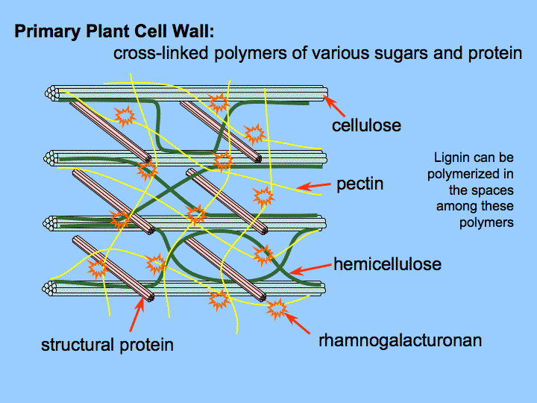
Cell Wall Degradation
Cell wall degradation is the major factor that causes softening of several fruits.
This involves the degradation of cellulose components, pectin components or both. Degradation of hemicelluloses (xyloglucans, glucomannans and galactoglucomannans) is also considered an important feature that leads to fruit softening.

Slide 39
Examples:
Both cellulase and pectinase activities have been observed to increase during ripening of avocado fruit (an example).
Polygalacturonase (pectin depolymerase) are major enzymes involved in softening of tomato (an example).

Slide 40
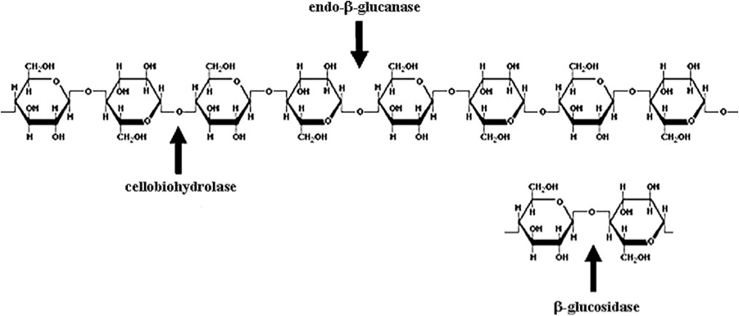
Cellulose is partially degraded by the enzyme cellulase or endo-β-1,4-glucanase.
cellulolytic complex

Slide 41
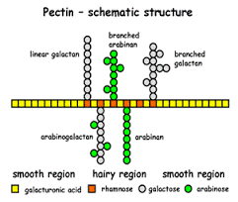
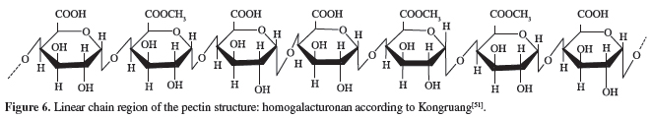
Pectins are complex branched heteropolysaccharides primarily containing an α-(1-4) polygalacturonic acid backbone which can be randomly acetylated and methylated.

Slide 42
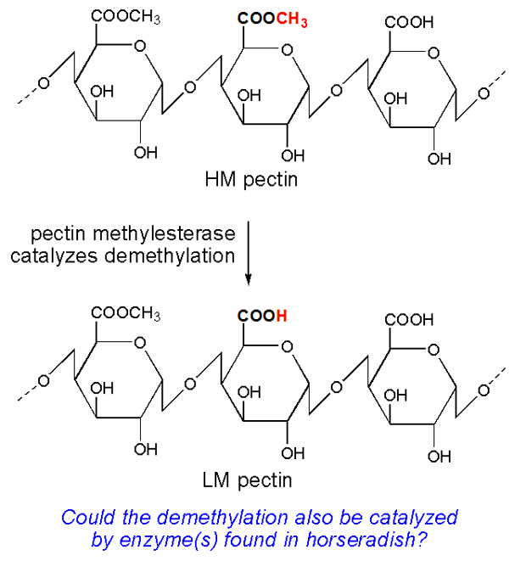
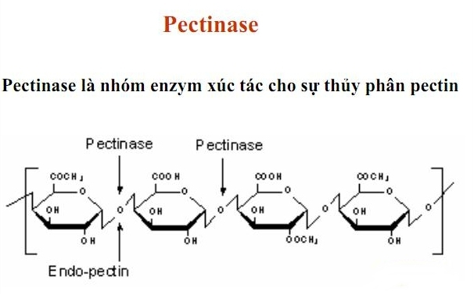
Partial pectin degradation involves the enzymes:
Pectin methylesterase
Pectinase

Slide 43
The degradation of cell wall can be reduced by the application of calcium as a spray.
Calcium binds and cross-links the free carboxylic groups of polygalacturonic acid components in pectin.
Calcium treatment, therefore, also enhances the firmness of the fruits.

Slide 44
Starch Degradation
Starch is the major storage form of carbohydrates.
During ripening, starch is catabolized into glucose and fructose, which enters the metabolic pool where they are used as respiratory substrates or further converted to other metabolites.
In fruits such as banana and mango the breakdown of starch into simple sugars is associated with fruit softening.

Slide 45
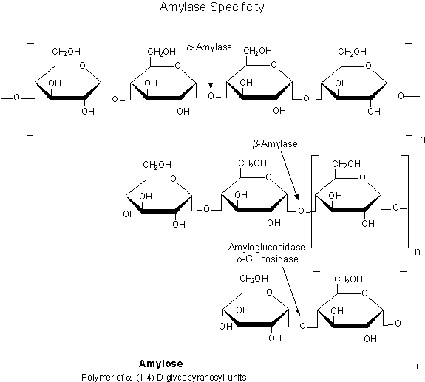
There are several enzymes involved in the catabolism of starch (amylolytic enzymes).
α-amylase hydrolyses amylose molecules by cleaving the α-1,4-linkages between sugars providing smaller chains of amylose termed dextrins.
β-amylase is another enzyme that acts upon the glucan chain
releasing maltose, which is a diglucoside.
The dextrins as well as maltose can be further catabolised to simple glucose units by the action of
α-glucosidase (α- glucose).
Glucoamylase – product β- glucose

Slide 46
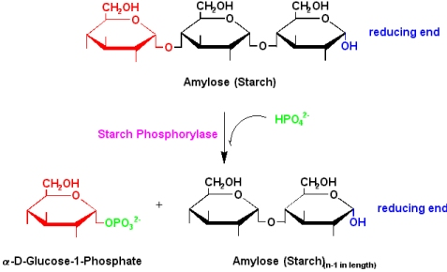
Starch phosphorylase is another enzyme, which mediates the phosphorolytic cleavage of terminal glucose units at the non-reducing end of the starch molecule using inorganic phosphate, thus releasing glucose-1-phosphate.

Slide 47
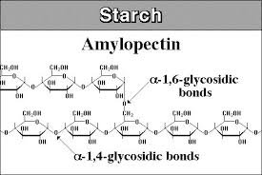
Degradation of amylopectin molecule is not only degraded in a similar manner to amylose but also involves the action of de-branching enzymes which cleaves the α-1,6-linkages in amylopectin and releases linear units of the glucan chain.

Slide 48
Proteolysis and Structure Breakdown in Chloroplasts
During senescence, the chloroplast structure is gradually disassembled with a decline in chlorophyll levels.
The degradation of chloroplasts and chlorophyll result in the unmasking of other colored pigments. Decrease in the intensity of green vegetables such as green bean, peas is not well accepted by customers.
Chlorophyll degradation is initiated by the enzyme chlorophyllase which splits chlorophyll into chlorophyllide and the phytol chain.

Slide 49
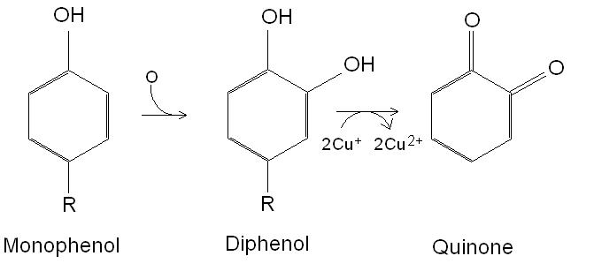
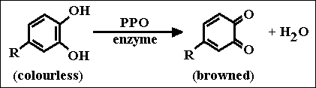
Polyphenol oxidase (PPO)
Polyphenol oxidase is responsible for oxidative browning, also called enzymatic browning. It is a bi-functional, copper-containing oxidase.
Two reactions catalyzed:
Hydroxylation of a monophenol to a diphenol.
Oxidation of a diphenol to a quinone.

Slide 50
PPO is normally compartmentalized in tissue such that oxygen is unavailable.
Injury or cutting of plant material, especially apples, bananas, pears and lettuce, results in decompartmentalization, making O2 available for the reaction.
The action of PPO can be desirable in various food products, such as raisins, prunes, dates, cider and tea.
Or undesired for salads, potatoes etc.

Slide 51
Control of enzymatic browning.
The most widespread anti-browning treatment used by the food
industry was the addition of sulfiting agents (sulfur dioxide, sodium sulfate, sodium and potassium bisulfites, and metabisulfites); however, due to safety concerns (e.g. allergenic-type reactions), other methods have been developed, including the use of other reducing agents (ascorbic acid and analogues, Cys, glutathione).
Chelating agents (phosphates, EDTA) – interact with Cu –ions of the active site of the enzyme.
Acidulants (citric acid, phosphoric acid) – pH < 4.5 sharply reduce the activity of PPO.
Enzyme inhibitors (sodium benzoate) – compete with the substrate for the active site of PPO.
Application of these PPO activity inhibitors is strictly regulated in different countries.

Slide 52
4. Indigenous Enzymes in Cereal Seeds
During dormancy the proteins, and other components, e.g., lipids and starch, in the cereal seeds are not mobilized from the protein bodies because:
presence of a low amount of water,
the cellular section separation
presence of different enzyme inhibitors.
During germination the enzymatic machinery starts to work and the protein composition of the seed changes.
The enzymes present in the cereal kernel are necessary for seed development, but also play a role in the processing or are responsible for reactions correlated with the quality of cereal products.
Proteins in food processing. 2004. Yada R. Y. (Ed.)

Slide 53
α- and β-amylases are present in all cereals. Associated with starch degradation.
In mature kernels, the amount of α- amylase is lower, while it increases abruptly during sprouting or germination. In wheat and rye amylases have an important role to produce sugars from starch for the yeast in bread making, but their presence must be controlled.
Unfavorable harvest conditions favor sprouting, the amount of
α- amylase rises and the quality of the wheat decreases. Higher amounts of this enzyme determine an extensive starch degradation during baking that produces a sticky and poor development of the baked goods.
Eighty percent of the β-amylases in the wheat flour is associated with glutenins.
Both α- and β-amylases are heat labile.
In triticale higher amylase and often protease activity is reported. These enzymes are partially responsible for the limited use of this cereal in bread-making.

Slide 54
In all cereals lipases and lipoxygenases are present and are located in the germ and in the bran.
Oats contain significant levels of lipase compared to other cereal.
An activation of lipoxygenases in pasta products produces an oxidation of carotenoids and lead to a loss of yellow color.

Slide 55
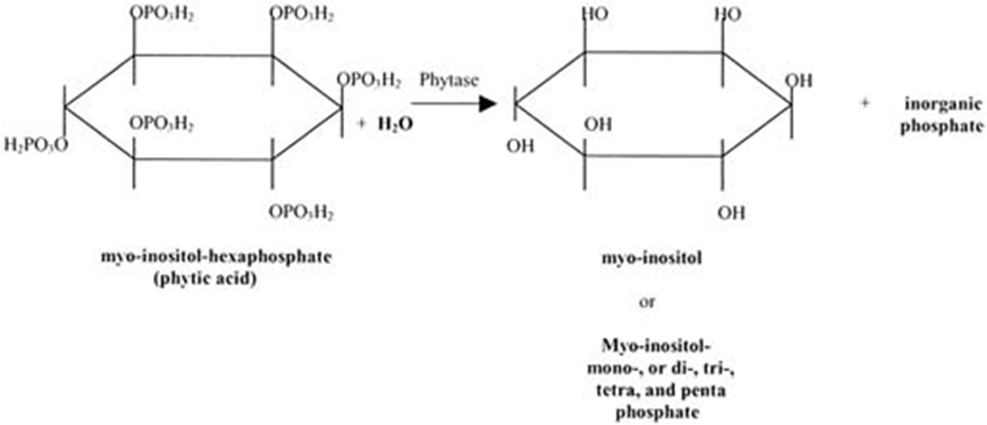
Phytase
About 70% of phosphorus in wheat is bound to phytate (Ca/Mg salts of phytic acid).
This reaction is nutritionally desirable since phytate inhibits the intestinal absorption of iron and calcium ions.

Slide 56
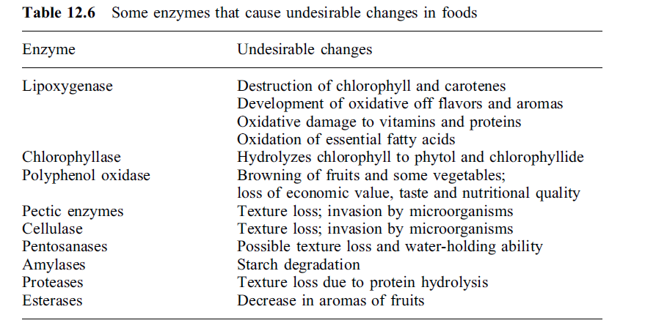
Summary
Proteins in food processing. 2004. Yada R. Y. (Ed.)

