Slide 1
Lecture 10.
Protein-carbohydrate and protein-lipid interactions in food.

Slide 2

I. Protein-carbohydrate interactions in food
Why study?
Proteins and carbohydrates are in substantial amounts in many food systems:
grains (wheat, corn, rice), legumes (beans, peas) and tubers (potatoes) – consumed after cooking (minor treatment)
bakery, baked goods, pasta products, snacks – processed food
High molecular weight polysaccharides are used as stabilizers in protein rich processed food.
Potential for partial substitution of more expensive or not so easily available materials.
Influence quality, texture, and stability of the food systems.
Biochemistry of Food Proteins. 1992, Hudson B.J.F. (Ed.) Elsevier Applied Science, Essex, England

Slide 3
Protein-starch interaction is cereals
Protein content in cereals varies from 12 to 14%
Starch content in cereals , %
Corn flour 92.0
Oatmeal (quick cook,raw) 64.9
Rye flour (whole) 75.9
Soya flour (full fat) 12.3
Tapioca (raw) 95.0
Wheat flour (brown) 66.8
(white,breadmaking) 73.9
(white,plain) 76.2
Rice
Brown rice (raw) 80.0
Savoury rice (raw) 73.8
White rice (easy cook,raw) 85.8

Slide 4
Protein-starch interaction is the most studied model
When two or more biopolymers are mixed together, the mixtures behaved differently from when they are present individually in a single phase.

Slide 5
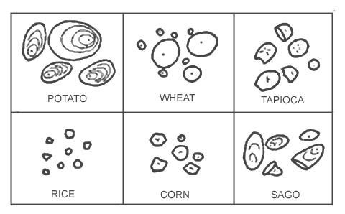
Location of protein and starch in cereal grains.
Storage proteins (in seeds) are organized either in specialized spherical membrane bound protein bodies or packed in the cytosol of the cells.
Starch (amylose and amylopectin) is organized in starch granules, which are localized in the grain endosperm. For this reason, when speaking of starch it usually comes to the starch granules.
Shape of six common starch granules

Slide 6
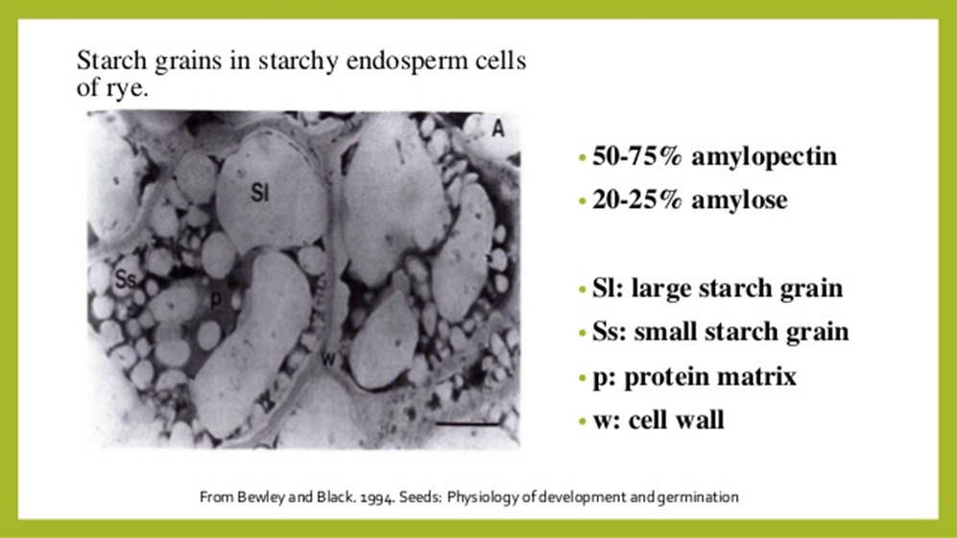
Location of protein and starch in cereal grains.

Slide 7
Interaction protein-starch models
Early perceptions: two colloids interacting directly via electrostatic forces.
However, proteins have differently charged amino acid radicals on the surface of molecule.
Amylose and amylopectin are uncharged polysaccharides. They can be charged at very high or very low pH values, but in food systems such conditions are not very probable. Can electrostatic forces occur?
Later perceptions: protein-starch interaction is not direct and is mediated by lipids.
Unprocessed wheat grain starch granules contain lipids both inside and on the surface of granule membranes. These are mainly phospholipids, which are (-) charged. Starch granules of different origin have different membrane composition, but independently of the surface, there are (-) charged lipids that can interact with (+) charged amino acid side groups of the proteins.

Slide 8
Something more about interaction protein-starch models
Theoretically,
Due to the polar character of carbohydrates hydrogen bonds may be formed between polar side chain groups of amino acid residues and hydroxyl groups of carbohydrates.
A covalent binding of carbohydrates by O or N - glyosidic bond is also possible.
Ionic binding may not be excluded if oxidized carbohydrate derivatives are present.
High molecular weight complex of glutenin and a significant quantity of carbohydrates has been experimentally obtained.
PERIODICA POLYTECHNICA SER. CHEM. ENG. VO£. 40, NO. 1-2, PP. 29-40 (1996)
http://www.pp.bme.hu/ch/article/viewFile/2580/1685

Slide 9
Factors influencing protein-starch interactions
Influence of pH
In a two-component model system,
Protein-starch interaction requires (+) charge of protein molecules which decline in alkaline medium (pH > 6.5).
The results are consistent with data obtained from a bread-making study:
Bread with a maximum volume is obtained at pH 5.7, decrease is observed in the acidic range and it is smallest at pH 7.

Slide 10
Temperature and high moisture content
Very often heating is a part of food processing.
When moisture content is not limited (boiling rice or other cereal grains) high temperatures denature proteins. As a result, they can undergo cross-linking through the –S-S- bonds and form a continuous protein network.
Under the same conditions, starch granules swell and collapse. Starch gel is formed.
In a contact of the both polymers, protein-starch matrix is generated which contain high amounts water molecules. After cooling of the system, protein-starch gel is formed.
Covalent and hydrogen bonds in addition to electrostatic forces may participate.
The role of starch granules is to withdraw water from the system as they swell and imbibe water during gelatinization (65 °C). As a consequence, effective concentration of the protein solution increases and a strong protein matrix is formed around gelatinized starch.
However, excess of starch favors phase inversion and formation of a weak matrix of gelatinized starch resulting in a weaker gel.

Slide 11
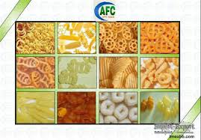
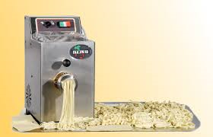
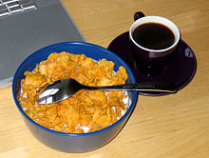
Temperature and low moisture content
Observed at extrusion. The extrusion is a technological process which combine high temperature, low moisture content (15-40%), high pressure and shear to produce food products with specific texture.
Examples:
snack
pasta,
Breakfast cereals

Slide 12
Features:
Starch forms gels at higher temperature than at the food systems with higher moisture content.
High variability in protein behavior (due to high variability in protein structure and properties) in food system is observed.
Under extrusion conditions starch fragmentation and protein denaturation cause stronger interaction between both polymers and formation of inter- and intramolecular bonds.

Slide 13
I. Protein- lipid interactions in food
The texture and organoleptic properties of many foods arise as a consequence of their multiphase nature.
Emulsion - a liquid and an oil phase – found in sauces, gravies, and spreads.
The two phases are naturally immiscible and the successful stabilization of the dispersed phase within the continuum results in very different structural and rheological properties to those of the individual phases.
Grasas y Aceites, Vol. 51. Fasc. 1-2 (2000), 50-55

Slide 14
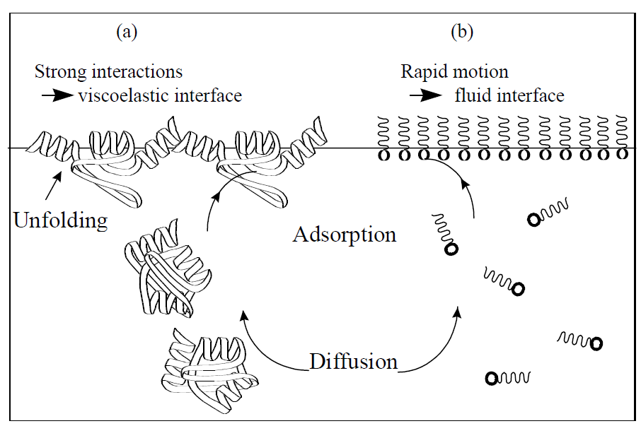
Mechanism of interfacial stabilization

Slide 15
Proteins versus small molecule surfactants/emulsifiers
Surfactants
Form a very dense, fluid interfacial layer
Can reduce the interfacial tension between the two
phases to very low values (large increases in surface area).
Proteins
After unfolding, proteins adsorb at the interface as a viscoelastic film.
It is a result of the interactions of neighboring protein molecules via electrostatic, hydrophobic and covalent bonds.
The mechanical strength of the viscoelastic adsorbed layer created by proteins is extremely efficient at preventing coalescence in emulsions.

Slide 16
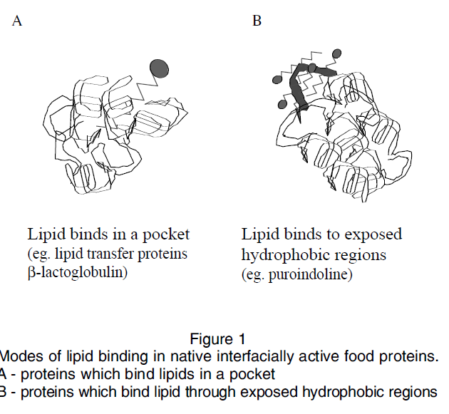
THE NATURE OF PROTEIN-LIPID INTERACTIONS
Native proteins are able to bind lipid in two main ways:
In a cavity or “a pocket”; binding site;
Less well defined hydrophobic patches which lie close to the surface of the protein.
Both types of proteins have been found to be interfacially active.
Grasas y Aceites, Vol. 51. Fasc. 1-2 (2000), 50-55

Slide 17
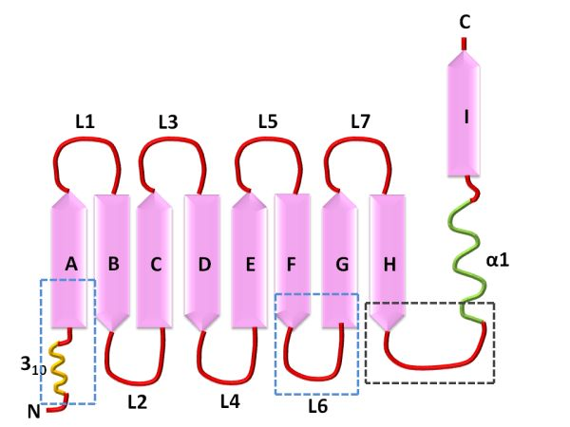
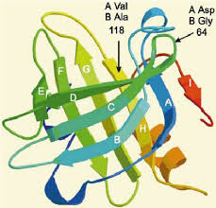
β-lactoglobulin (a whey protein) can bind a wide variety of aliphatic components.
β-lactoglobulin - 9 β-folded structures, 8 of which form β-barrel, a specific structure resembling a cup with a hydrophobic interior, which can bind lipid molecules. Therefore, the limited proteolysis of whey proteins, where the structure of the barrels is retained leads to improved emulsion properties. Hydrophobic interaction.

Slide 18
Puroindoline (wheat protein) have tryptophan rich regions that are able to bind a variety of lipids.
Puroindoline - Tryptophan rich hydrophobic regions close to the surface of protein molecule. Hydrophobic interaction.
Except by tryptophan-rich areas, puroindoline may interact with polar lipids of the membrane of the starch granules through ionic bond. They are basic proteins and bind to the negatively charged membrane phospholipids.

Slide 19
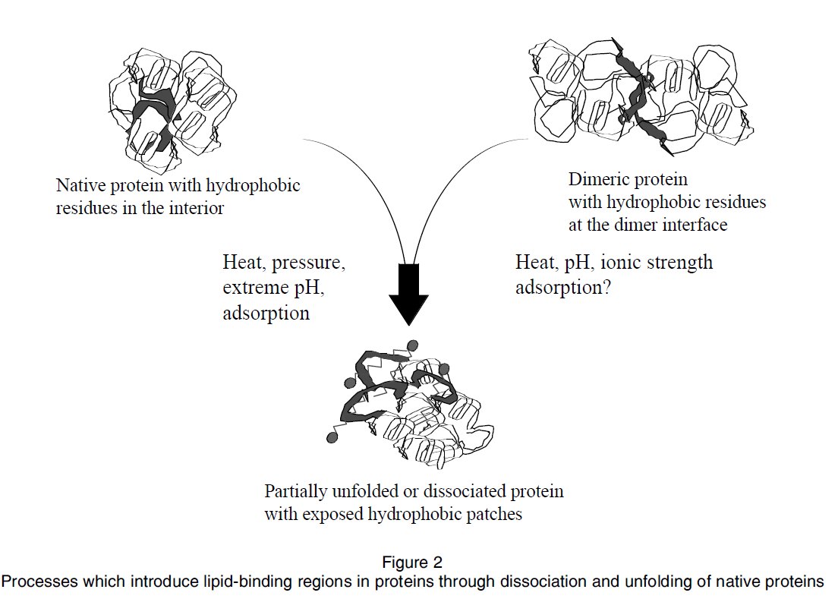
New lipid-binding sites can be induced by processing using heat or pressure, or as a consequence of the pH and ionic strength of a food system.

Slide 20


