Slide 1
Lecture 8.
Interactions of proteins with other food substances: protein-water and protein-protein interactions.

Slide 2
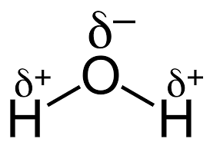
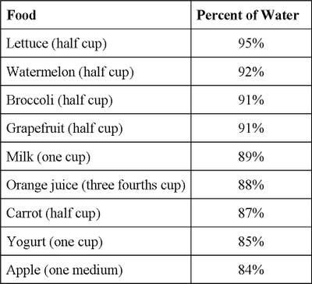
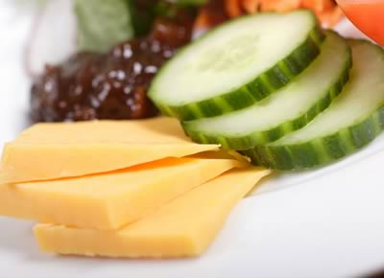
I. Protein-water interactions in food
Water:
Water is abundant in all living organisms and consequently, in almost all foods, unless steps have been take to remove it.
Most natural foods contain water up to 70% of their weight or greater unless they are dehydrated.
Fruit and vegetables contain water up to 90% or greater.

Slide 3
Protein-water interactions: Overall considerations
Important for understanding the structure of protein molecule and the functional properties of the protein molecule in food system.
Difficult to study: different mode of interaction in diluted or single-component model systems and more complexed and concentrated food.
Lack of consensus among researchers in terms of the mechanism of the interaction and the type of bound water.
Biochemistry of Food Proteins. 1992, Hudson B.J.F. (Ed.)

Slide 4
Types of water in food: some properties
All foods contain at least some water
Free water: can be extracted easily from foods by squeezing, cutting or pressing.
-free flowing
-great solvent for food components
-can be removed by pressure
Bound water: cannot be extracted easily.
-It is not free to act as a solvent for salts and sugars
-It can be frozen only at very low temperatures (below the freezing point of water).
-It exhibits essentially no vapor pressure
-Its density is greater than that of free water
An example: water present in cactus

Slide 5
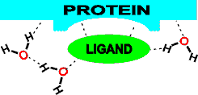
Types of bound water:
All water found in tissue is bound water
Structural water:
Small portion of total bound water
Found inside protein macromolecule
Not available for chemical reactions.
Bound directly to protein molecule by hydrogen bonding
Stabilize the native conformation of the protein molecule; determine the three-dimensional conformation of the protein.
Structural water molecules may act as prosthetic groups indispensable for proper protein function
(Proc Natl Acad Sci U S A. 2009,106(34):14367-72).
Participate in the formation of enzyme
active site (http://www1.lsbu.ac.uk/water/protein_hydration.html)

Slide 6
Monolayer water:
Bound to the surface of the protein molecules by hydrogen bonding or dipole interactions.
It represents 4-9% of the water associated with the protein.
It has kinetic and thermodynamic properties which are different from that of the pure water.
Not available as solvent.
May be available for certain reactions.
Hard to remove from food.
Multilayer Water:
Additional layer of water around food particle.
Not as hard to remove as the monolayer.

Slide 7
Capillary ("absorbed") water:
Water included in crevices, gaps or capillaries in the protein molecule through surface or capillary forces.
Act as a solvent.
Available chemical reactions.
Can be removed only by force.
Much of the water found in meat and cheese is an example of capillary water.
Hydrodynamic water:
Transported along with protein molecule.
Has the physical properties of pure water but influences protein viscosity and diffusion.

Slide 8
Factors affecting protein hydration:
Amino acid composition
Surface polarity / hydrophobicity
Protein conformation (size, shape)
Ionic strength
Ion species, anion or cation
pH
Temperature
Food proteins. 1982. Fox P.F.; Condon J.J. (Eds.)

Slide 9
Amino acid composition. Surface polarity.
At low content of hydrophobic amino acids (below 30%) :
Hydrophobic amino acids are located predominantly inside the globule thus determining low surface hydrophobicity. More polar and charged amino acids are located on surface which have a higher tendency to bind water molecules.
At higher content of hydrophobic amino acids (above 30%):
Protein molecules are more reluctant/unfolded, higher surface hydrophobicity, lower hydration level.

Slide 10
Predicting the level of protein hydration
Kuntz’s formula:
А = fe + 0.4fp + 0.2fn
A – g bound water/g protein
fe – fraction of charged amino acid side chains
fp - fraction of polar amino acid side chains
fn - fraction of nonpolar amino acid side chains
Disadvantage: overestimation of the level of protein hydration due to unequal accessibility of amino acid side chains by water molecules

Slide 11
Protein conformation. Denaturation.
Denaturation – altered protein conformation.
Hydration may increase slightly due to exposure of additional hydrophilic amino acid chains to water molecule.
An example: denaturation of bovine serum albumin with carbamide increases the hydration level with 10%.
Complete protein denaturation may decrease hydration level due to increased surface hydrophobicity.

Slide 12
Influence of salts and pH on WHC.
Functional properties of myosin and actin
Water-holding capacity (WHC)
Myosin and actin –the main water binding components of muscle tissue
97% of WHC is attributed to myofibrillar protein fraction
High content of acidic and basic amino acid; high hydration level of amino acid side chains
Capability of entrapment of water molecules in the lattice in acto-myosin complex.
WHC is strongly dependent on pH, NaCl and phosphate salt concentrations
Chemical and Functional Properties of Food Proteins, Zdzislaw E. Sikorski, CRC Press, 2001
http://www.crcnetbase.com/doi/abs/10.1201/9781420042177.ch11

Slide 13
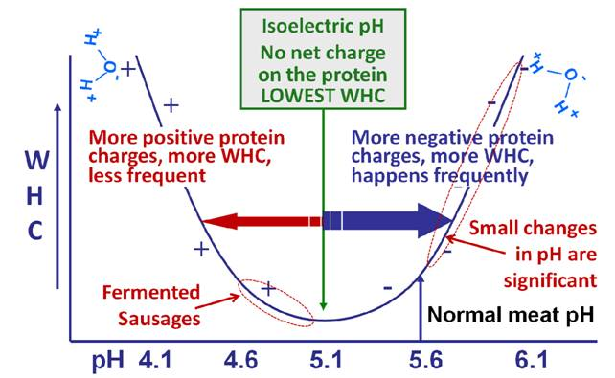
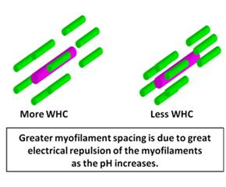
Influence of pH on WHC
Minimum WHC occurs at isoelectric pH of acto-myosin complex (pH 5).
http://qpc.adm.slu.se/6_Fundamentals_of_WHC/page_21.htm

Slide 14
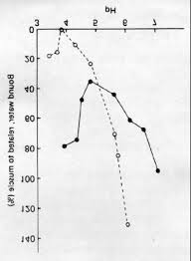
Influence of monovalent salts (NaCl, KCl) on WHC:
The isoelectric pH of the muscle proteins shifts to a more acidic pH. Thus, meat with a normal pH (5.6) will be farther from the isoelectric pH which increases WHC.
Meat proteins preferably interact with Cl⁻ .
http://www.tdx.cat/bitstream/handle/10803/6675/13MusculIntroduccio.PDF;jsessionid=54B2D15A88DCA9F58E7C101DE3872E23.tdx1?sequence=13

Slide 15
Salt increases muscle filament spacing by providing ions that are attracted to charges on the protein surfaces. Meat proteins preferably interact with Cl- . This widens the structural spacing between filaments, and allows the filaments to swell, providing more room for water molecules to flow into the spaces.
Monovalent sodium ions may replace some tightly bound divalent positive ions, thus increasing the ability of the filaments to swell.

Slide 16
Phosphates are commonly used in processed meats to help bind water. They do this by several mechanisms:
Alkaline phosphates will elevate the pH 0.2 to 0.5 pH units higher than normal.
At the higher pH, the negative phosphate ions (usually a negative 3 valence charge) contribute to higher charge on the muscle proteins.
The negative phosphate ions can counter some of the divalent positive ions in meat.
Some phosphates may help break some of the contraction cross bridges which increases WHC.
Salt and phosphates act synergistically to increase WHC more than the either salt or phosphate alone.
http://qpc.adm.slu.se/6_Fundamentals_of_WHC/page_22.htm

Slide 17
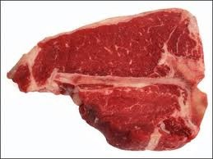

Phosphate salts (in combination with NaCl) are frequently used in food processing to make food proteins bind and hold more water
Salt brine
Salt brine
some phosphate
⬆⬆ phosphate
Cook
Cook
Cook
30% reduction
10% reduction
100% reduction

Slide 18
II. Protein-protein interactions in food
Why study protein-protein interactions in food?
Altered functional properties of proteins – solubility, water- and oil holding capacities, gel- and foam making capacities and stability.
Altered food texture and overall sensory properties of food.

Slide 19
Covalent bonds in protein-protein interactions
Intermolecular disulfide bond
Tyrosine derived bond
Ester- and amide bonds (Glutamyl-lysine cross-link)
Lysine based bond (collagen)
Lysinoalanine formation
Will be discussed on a separate lecture.

Slide 20
Non-covalent bonds in protein-protein interactions
Hydrogen bonds
Hydrophobic interactions
Ionic bonds
Electrostatic repulsion
Steric repulsion forces – occur when proteins are within atomic distances of each other.
Hydration repulsion forces - may occur between hydrated polar side chains of the polypeptides.

Slide 21
Gels:
“form of matter intermediate between a solid and a liquid”
“soft solids”
“inclusions or matrices in composite foods”
Some microstructural features that distinguish them from other biomaterials:
A continuous network of interconnected material (molecules or aggregates), that spans the whole volume;
The presence of a few restriction points in the network that hold the chains together avoiding flow;
A large proportion of liquid phase that swells the polymeric network.
Protein-protein interaction in gel formation.

Slide 22
Food protein gels may be classified in various ways. According to the supramolecular structure they may be either true cross-linked polymer networks or particle gels consisting of strands or clusters of aggregated protein.
Proteins in food processing. 2004. Yada R. Y. (Ed.)

Slide 23
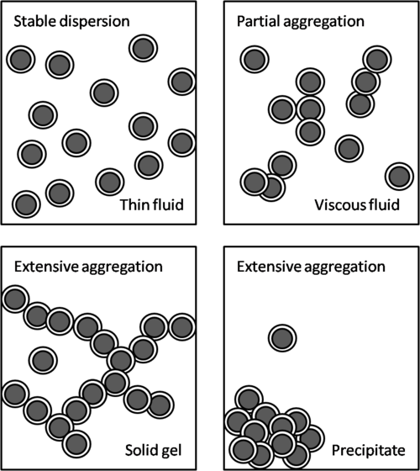
Simple model for protein gel formation
Partial destabilization of protein dispersion so the protein particles, rather than repelling one another, become somewhat “sticky” and aggregate.
Stages of gel formation:
(i)denaturation (unfolding) of native proteins;
(ii) aggregation of unfolded molecules;
(iii) association of aggregates into a network.
http://johncoupland.tumblr.com/post/19294280558/food-protein-gels

Slide 24
Gel formation versus precipitation
As destabilization proceeds, the aggregates become larger and larger and the suspension becomes more viscous.
Eventually the aggregates will become so large that they span the container giving an overall solid-like texture while trapping large amounts of water, i.e., a gel.
If the associations between the proteins are too strong or too extensive then they may precipitate as a way of maximizing protein-protein interactions at the expense of the protein-water interactions needed in a gel.

Slide 25
Common methods for destabilization:
Heat –protein denaturation, hydrophobic protein core exposure (e.g., cooking eggs);
pH alteration to protein isoelectric point to minimize inter-protein electrostatic repulsion (e.g., yogurt);
Ion addition- or in some cases adding calcium to bind certain amino acid residues (e.g., forming a tofu gel);
Intermolecular covalent bonds formation (e.g., forming gluten while kneading bread).

Slide 26
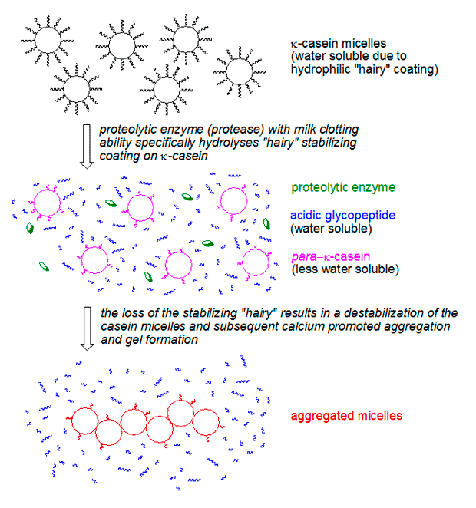
Some more popular food proteins and their gels
Casein gels
Casein gels caused by chymosin cleavage gels are particle gels consisting of strands of more or less spherical casein micelles.
The thickness of the network strands is approximately five times the diameter of casein micelles (Fox and Mulvihill, 1990).
Regularity and pore size of the
network is determined by the rate of the enzymatic reaction and the aggregation process.
The caseins are very heat stable at their physiological pH (>6.5) and therefore, do not normally form thermally-induced gels.
Proteins in food processing. 2004. Yada R. Y. (Ed.)

Slide 27
Whey protein gels
β-lactoglobulin and α-lactalbumin comprise almost 50 and 20% of the total protein content in whey, respectively.
Solutions of whey proteins can form rigid irreversible gels when heated above 75 °C via series of transitions: (i)denaturation (unfolding) of native proteins; (ii) aggregation of unfolded molecules; (iii) strand formation from aggregates, and (iv) association of strands into a network.
Structurally, most whey protein gels are particle gels in which the units forming network are protein aggregates (0.5±2 µm in diameter) associated as a string of beads or in clusters.
It is not yet clear which forces stabilize the gel structure but it appears that disulfide bonds, hydrophobic interactions and ionic interactions play a significant role.

Slide 28
Egg protein gels
Both fractions of liquid eggs (67±70% egg white (albumen) and 30±
33% egg yolk) have the capacity to form gels upon heating. Nevertheless for heat-induced gel preparation egg white has been preferred over egg yolk one reason being that egg white is more stable because it contains no lipids.
Gel formation of egg white is similar to whey proteins.
At temperatures above 61 °C egg white begins to lose fluidity initiated by the denaturation of conalbumin (the least stable protein fraction at native pH).
Denaturation of ovalbumin (the predominant protein fraction in egg white) determines the optimum temperature for gel formation and contributes to the increase of gel strength at temperatures above 80 °C. Exposure
to higher temperatures leads to higher rates of gelation resulting in stronger gels.
However, temperatures above 90 °C or excessive heating times may lead to over-processing resulting in a decrease in gel strength, shrinkage of the gel and syneresis.

Slide 29
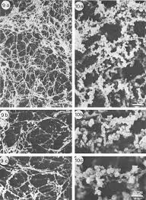
Myosin gels
Heat-induced gelation of myofibrillar proteins (myosin and actin) plays a major role in the water and fat retention capacity during meat processing, directly affecting process yields and sensory properties.
The gelling of myosin is induced by heating above 60 °C, and it
strongly depends on pH and ionic strength.
Fine stranded gel structures are formed at low ionic strength (0.25M KCl), whereas coarsely aggregated gel structures are formed at high ionic strength (0.6M KCl). The fine stranded structure had a higher rigidity than the coarsely aggregated structure.
Actin does not gel when heated but when added to
myosin it enhances the strength of heat-induced gels.
http://onlinelibrary.wiley.com/doi/10.1111/j.1541-4337.2010.00137.x/pdf

Slide 30
Fig. 2–Representation of gel network formation by myosin. Actin contributes to viscosity, but does not appear to be involved in network structure. Myosin heads become joined by disulfide bonds and may lose shape during denaturation. The helical myosin rod forms β-sheets and random coils during acid and heat denaturation. The light rod may detach from the head and be involved in network formation.
http://onlinelibrary.wiley.com/doi/10.1111/j.1541-4337.2010.00137.x/pdf

Slide 31
Soybean protein gels
Although legumes and oilseeds play an important role as foods worldwide, only soybeans proteins are consumed as food gels to a major extent. Tofu, a highly hydrated soy protein gel, is the most important of the soybean products in the Orient.
Gelation in tofu manufacture is achieved by heating soybean milk followed by addition of salt (e.g., Ca2++ or Mg²⁺) to form a curd, although acidification (e.g., with glucono-lactone) also induces aggregation of denatured protein molecules as negatively charged groups become neutralized by protons.

Slide 32
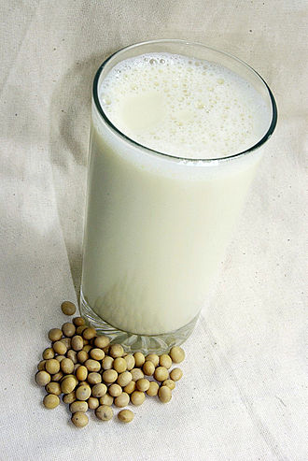
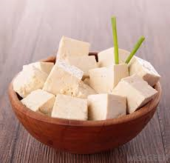
Heat-induced gels from soybeans – a result of the interaction of two globulin fractions (accounting for more than 50% of the protein in soybeans):
Glycinin and β-conglycinin
Individual fraction can form heat-induced gels but mixtures of both fractions or soy protein isolates perform better in gelling than the individual fractions.
gelation

Slide 33


