Slide 1
Lecture 7.
Proteins with animal origin:
proteins of milk, meat and eggs.

Slide 2
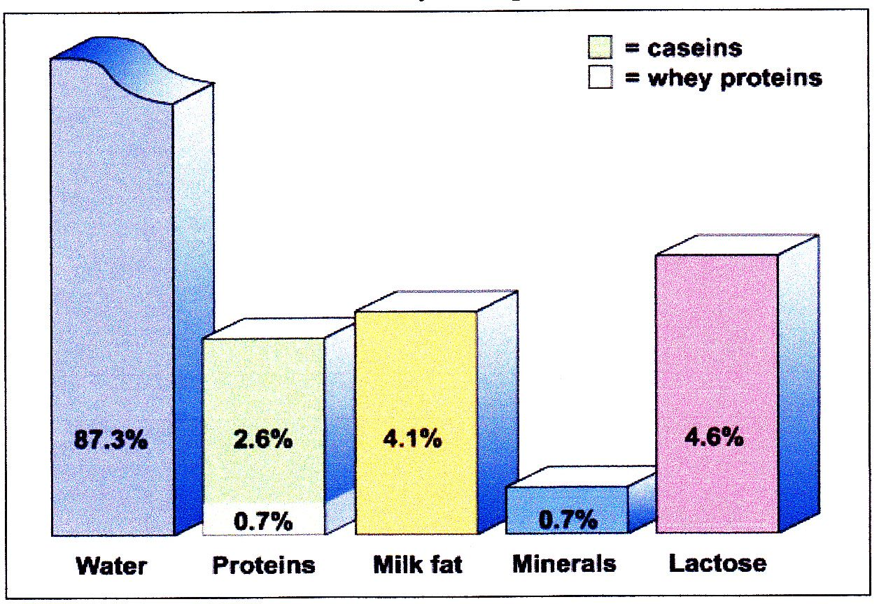
Milk composition
Deficient in iron and vitamin C

Slide 3
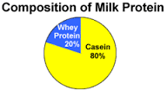
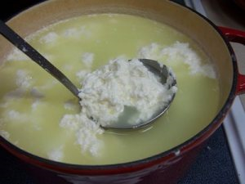
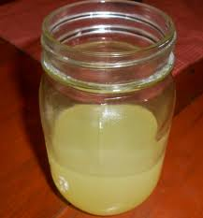
Milk proteins
Total protein content in milk – 2.9 – 3.5%
Two major types of milk protein
Caseins (80%)
Whey proteins: (20%)
Whey (milk serum) is the liquid remaining after milk coagulation and curds removal. It contains water, lactose and soluble non-casein proteins.
http://ansci.illinois.edu/static/ansc438/Milkcompsynth/milkcomp_protein.html

Slide 4
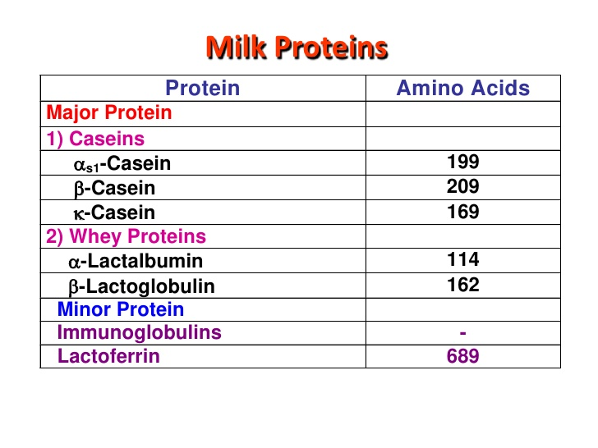
Milk protein fractions

Slide 5
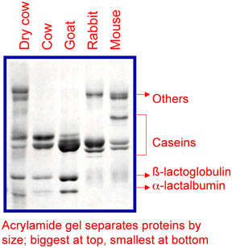
Milk proteins
Milk proteins separation by polyacrylamide gel electrophoresis (by molecular weight).
Caseins (~25-35 kDa) move more slowly than major whey proteins ß-lactoglobulin (18 kDa) and α-lactalbumin (14 kDa).
Others include primarily lactoferrin (~80 kDa) and serum albumin (~66 kDa).
Larger proteins migrate more slowly in the gel and remain nearer the top of the gel. Smaller proteins migrate more rapidly toward the bottom of the gel.

Slide 6
Casein: Casein structure
Casein is a mixture of at least three similar proteins (α-casein, β-casein, and κ-casein) which differ primarily in molecular weight and amount of phosphorus they contain (number of phosphate groups).
Casein fractions differ from each other by charge distribution along the polypeptide chain, the content of proline and sensitivity to precipitation Ca ²⁺.
All casein proteins except κ-caseins are phosphoprotein, which has phosphate groups attached to some of the amino acid side chains (mainly serine and threonine).

Slide 7
α-caseins are the major casein proteins. Its containing 8-10 phosphate groups. It is poorly soluble in water.
β- caseins contains about 5 phosphate residues, it is more hydrophobic than α-caseins and κ-casein. It is poorly soluble in water.
Because α-caseins and β-caseins are highly phosphorylated, they are very sensitive to the concentration of calcium salts, that is, they will precipitate with excess Ca²⁺ ions.

Slide 8
κ-caseins are glycoproteins. They contain carbohydrate part which is negatively charged. Hydrophilic part.
Do not precipitate in the presence of Ca²⁺ ions.
Protect other caseins from precipitation and make casein more soluble forming casein micelles.
In milk, κ-casein combine with α-caseins and β- caseins to form micelle.

Slide 9
The word “micelle” describes structure not a single compound. Casein micelles consist of water, protein, and salts.
The non-protein component of the micelles include calcium (37.5%) and phosphates (50%)

Slide 10
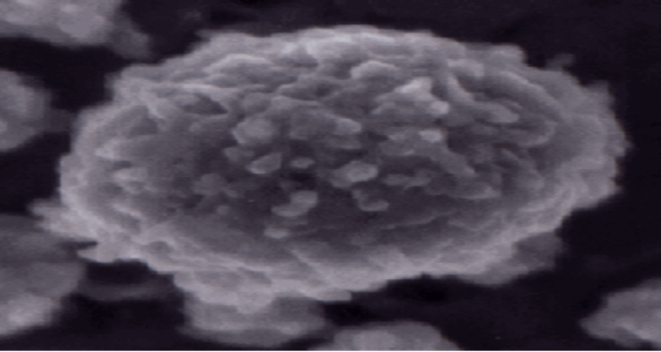
Due to the large size, micelles are not considered to be truly soluble in water. They are rather dispersed in water and remain suspended in the form of colloidal suspension.
Casein micelle
under electron microscope.

Slide 11
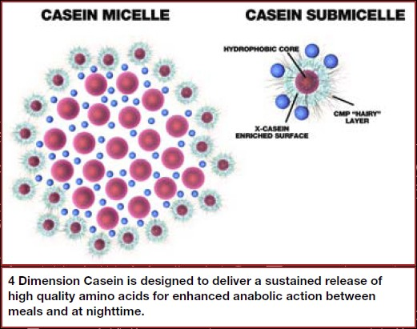
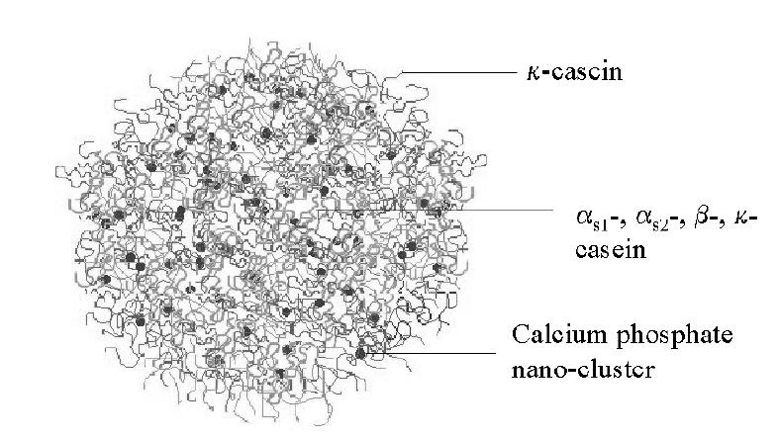
Hydrophilic casein molecules (κ-caseins) that have an affinity for water form the outer part of the micelle (hairy part).
Hydrophobic casein molecule (α-caseins and β- caseins) form the inner core of the micelle sphere.
In some proposed models α- and k-casein are on the outside.
http://crystal.che.ncsu.edu/pdfs/Coll_Surf_b_casein_Chen.pdf

Slide 12
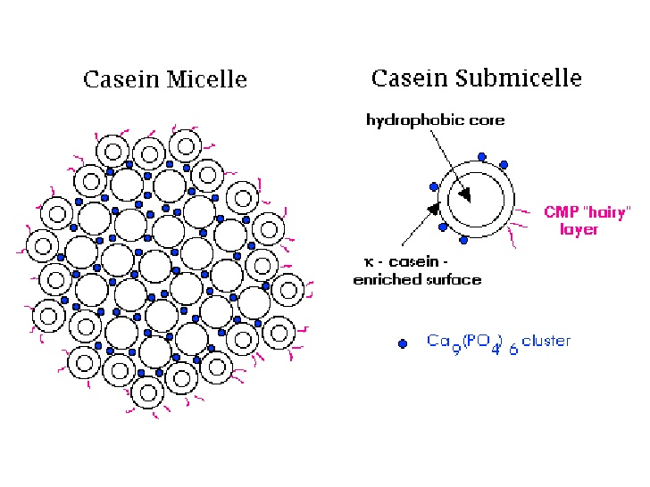

Slide 13
Micelles aggregation
Casein can be precipitated:
HCl
2. Enzymatically (renin)
http://nzic.org.nz/ChemProcesses/dairy/3E.pdf

Slide 14
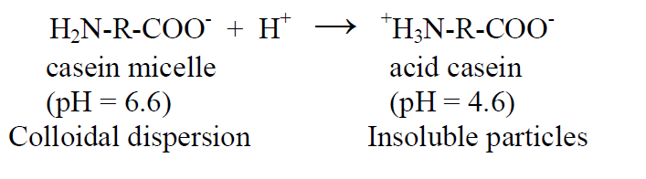
1. HCl
The acidity of the medium increases the solubility of the minerals so that organic Ca-P contained in the micelles start to dissolve in the aqueous phase.
Acidification of milk leads to destabilization of the casein micelles and aggregation due to the reduction of electrostatic interactions in their iso-electric point (pH 4.6).
http://nzic.org.nz/ChemProcesses/dairy/3E.pdf

Slide 15
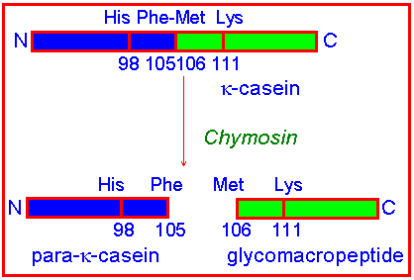
2. Renin (chymosin) enzyme :
It is produced by newborn ruminant animals in the stomach to curdle the milk they ingest, allowing a better absorption.
It is widely used in cheese production.
It cleaves the peptide bond between Phe 105 and Met 106 in the kappa-casein chain.
κ-caseins stabilizes the micelles and after cleavage, the casein proteins precipitate under the influence of the calcium ions.
Use of pepsin or microbial proteinases may lead to higher degree of hydrolyses thus producing small peptides with bitter taste.

Slide 16
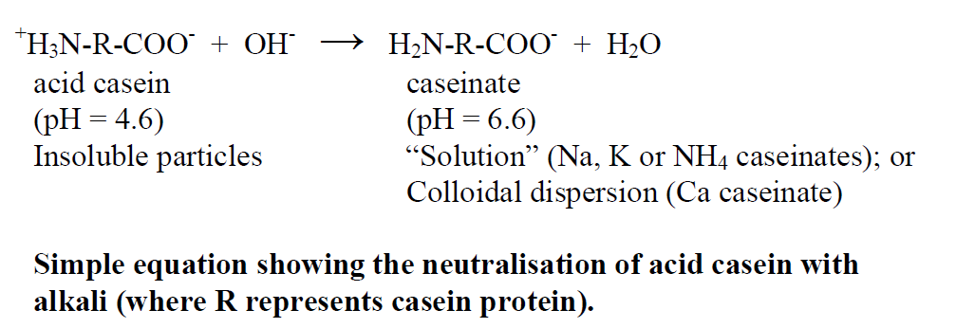
Production of caseinate
Production of acid casein (by reduction of pH with HCl)
Addition of dilute alkalis
http://nzic.org.nz/ChemProcesses/dairy/3E.pdf

Slide 17
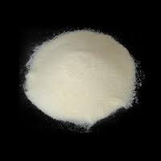
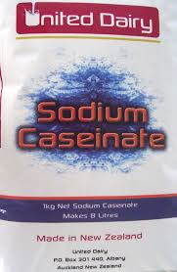
Sodium caseinate: properties
Properties
White to light yellow color, particles and powders, odorless, tasteless or with slight peculiar fragrance and taste. Easily soluble in water.
Performance
Very good water solubility, water absorbability, viscosity, emulsification characteristic, stabilization of emulsion and foaming capability.
Toxicity
LDs50 400-500g/kg; FAO/WHO (1985) ruled that there is no limit on acceptable daily intake (ADI). Besides, FDA also lists it as GRAS (generally recognized as safe), without toxicity.

Slide 18
Sodium caseinate: Application
E469 food supplement
Sodium caseinate has strong hydrophilicity and thus wider application than casein. It can be used in meat, aquatic meat products, ice cream, biscuit, bread, noodles and other grain products.
Caseinates are mainly used as food supplements – they improve nutrition features, taste and smell, increase the shelf life and enrich products with organic amino-acids. They are used in Meat, Bakery and Confectioner Industry
In meat products (sausages), it can be used to make fat distribution uniform, and enhance the adhesion property of meat. The dosage in sausage is 0.2%-0.3%. In the fish cake, it can improve the elasticity.
In bread, biscuit and noodles, the dosage is 0.2%-0.5%; in foreign pastry, doughnut and chocolate, it is 0.59%-5.0% while in cream milk beverages, it is 0.2%-0.39%.

Slide 19
Whey proteins
The proteins remaining in the supernatant after precipitation of caseins at pH 4.6.
Good source of sulfur containing amino-acids (cysteine and methionine): 8 times more as compared to casein. This is possibly the mode of anticancer activity.
Exceptionally rich in leucine, isoleucine and valine. Contains more leucine than in casein, egg and soy protein.

Slide 20
Globular proteins with a higher water solubility than casein.
Low heat stability and, therefore can be thermally coagulated. Denaturation increases water retention power.
Native whey proteins have good gelling and whipping properties.

Slide 21
The major whey proteins: β-lactoglobulin
Most abundant whey protein.
In vitro, after partial digestion by endopeptidases of pancreas it acts as antimicrobial agent and also inhibits replication of rotavirus in dose dependent manner.
It binds mutagenic heterocyclic amines and exert anti-cancerogenic effect.

Slide 22
The major whey proteins: α-lactalbumin
Recently, a folding variant named “BAMLET”from bovin α-lactalbumin which is lethal to tumor cells has been discovered. It selectively enters into tumor cells and induces apoptosis.
Improve performance of stress-vulnarable individuals by increasing brain tryptophan and serotonin activities.
Improve sleep in human suffering from nutritional disorders.
Suitable for fortifying infant formulae due to richness in essential amino acids.
Clinical trials with α-lactalbumin enriched infant formula exhibited antimicrobial activity as well.

Slide 23

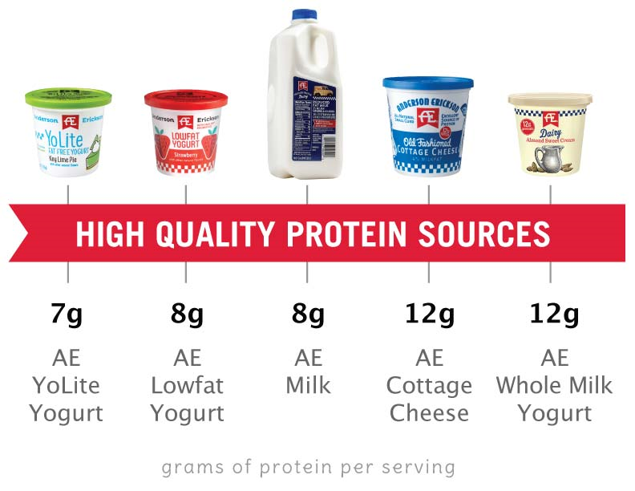
Milk protein quality
Amino acid composition
Digestibility

Slide 24
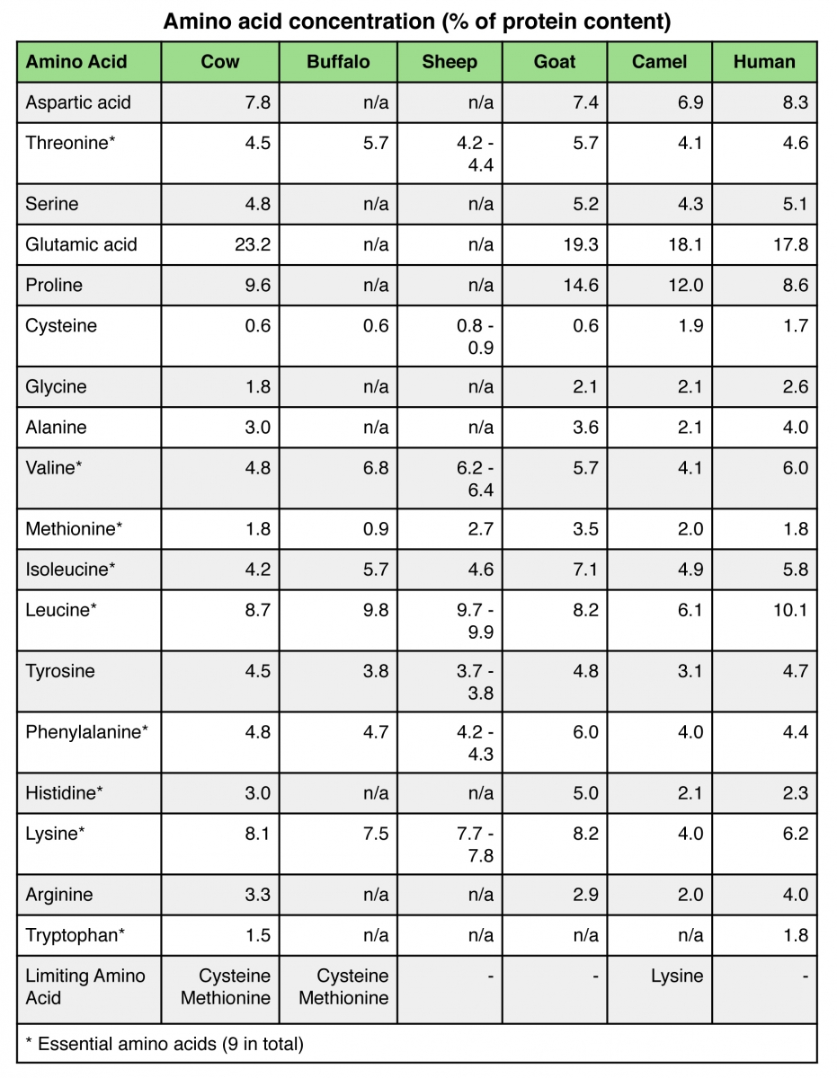
Choose your milk source: Amino acid composition
Milk proteins have a balanced amino acid; high quality protein

Slide 25
Milk protein digestibility
Caseins are highly digestible in the intestine and are a high quality source of amino acids.
Most whey proteins are relatively less digestible in the intestine.
When substantial whey protein is not digested fully in the intestine, some of the intact protein may stimulate a localized intestinal microflora or a systemic immune response. This is sometimes referred to as milk protein allergy and is most often thought to be caused by ß-lactoglobulin (whey protein).

Slide 26
Meat proteins
The content of protein in meat and meat products is 15-22%.
There are three main groups of proteins:
Myofibrillar proteins
Connective Tissue Proteins
Sarcoplasmic Proteins
https://biot409.files.wordpress.com/2014/02/8-food-biochemistry-and-food-processing-2nd-ed-gnv64.pdf

Slide 27
Myofibrillar proteins:
Myosin (55% of muscle proteins) and actin (25% of muscle proteins)
Cytoskeletal proteins which are responsible for contraction–relaxation of the muscle.
Balanced amino acid composition
Complete protein food
Their functional properties are the main determinants for the quality of meat and meat products.
https://biot409.files.wordpress.com/2014/02/8-food-biochemistry-and-food-processing-2nd-ed-gnv64.pdf

Slide 28
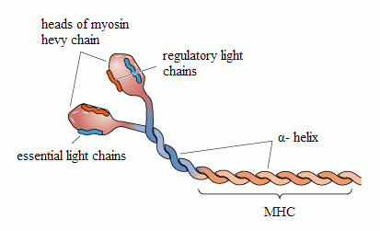
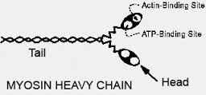
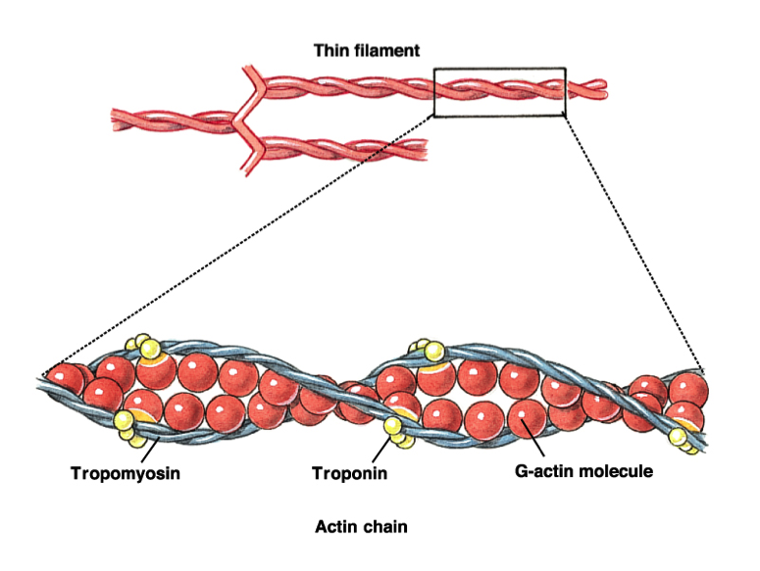
Myosin and actin
Actin exists in two forms - G- and F-actin.
G-actin is a monomeric globular protein. In the presence of Mg G-actin polymerizes to form a double strand chain called F-actin.
Muscle contraction is carried out by reacting of the globular heads of myosin with actin chains.
Process requires the breakdown of one molecule of ATP.
This process is supported by many other proteins, but in small quantities.
http://www.pansportmedical.ro/english/sports_medicine/articles/Muscle_fiber_a_bidirectional_approach.html

Slide 29
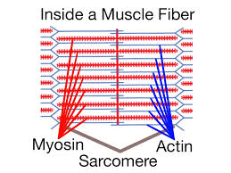
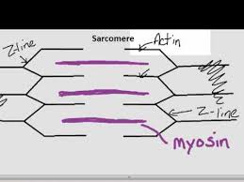

Slide 30
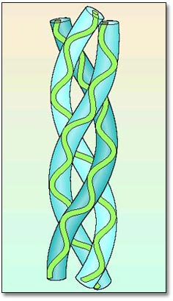
Connective Tissue Proteins
Collagen
The basic unit of a collagen molecule is a triple-helical structure composed of three polypeptide chains that are stabilized via hydrogen bonds.
Individual tropocollagen monomers, in turn, are cross-linked to form fibrils via hydrogen and covalent bonds.

Slide 31
Connective Tissue Proteins
Collagen does not contain tryptophan, thus its chemical score is 0. High level of proline and glycine.
Incomplete protein
A raw material for gelatin making
There are a high number of cross-linkages in the collagen fibers that increase with age making meat tougher in older animals.

Slide 32
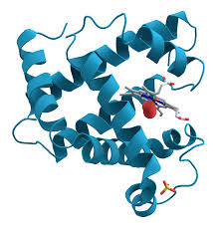
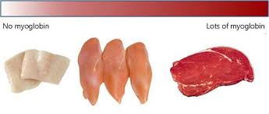
Sarcoplasmic Proteins
metabolic enzymes and myoglobin
Myoglobin
Oxygen-binding protein, back up supply of oxygen, temporarily store oxygen.
Conjugated protein containing a polypeptide chain and a non-protein hem molecule
Myoglobin and more particularly the oxidation state of Fe 2+/3+ are responsible for meat color.

Slide 33
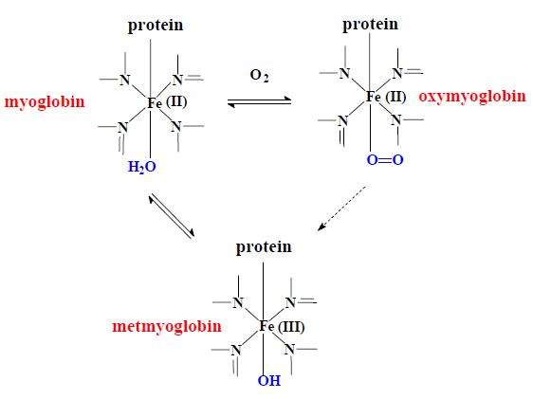
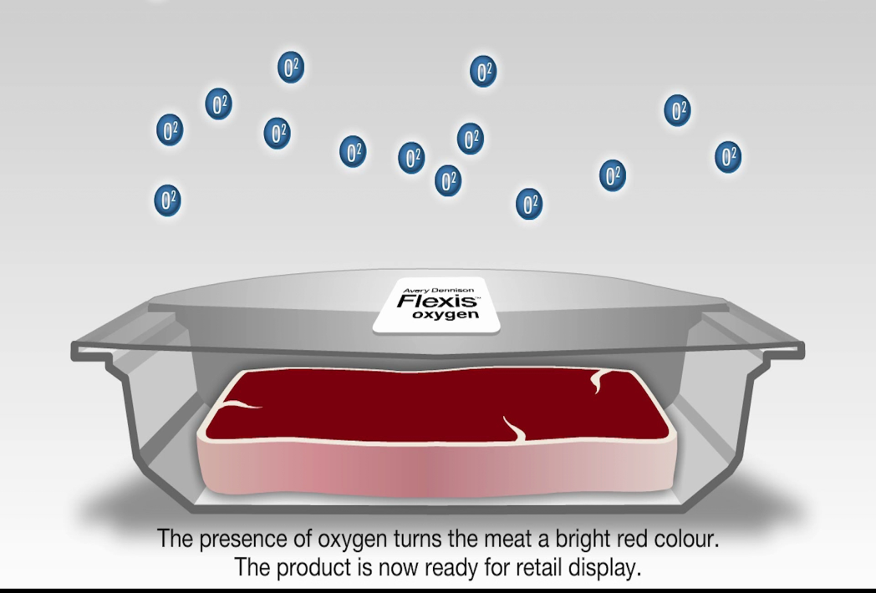
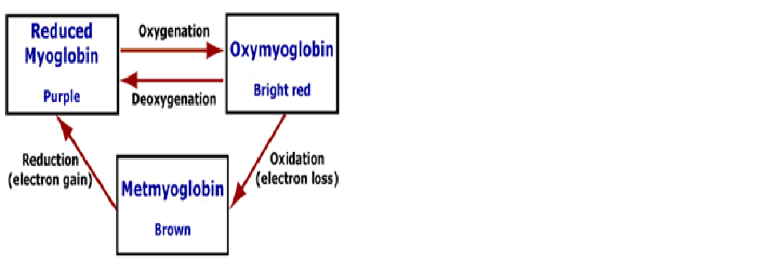

Slide 34
The role of Nitrates and Nitrites in Cured Meat Products
Compound | Chemical Symbol | Molecular weight
Nitrate | NO₃ | 62
Nitrite | NO₂ | 46
Potassium and sodium salts of the nitrate and nitrites are the most extensively used of all food additives.
Sodium nitrite, rather than sodium nitrate, is the most commonly used for curing (although in some products, such as country ham, sodium nitrate is used because of the long aging period)
http://simplyhealthylifemagazine.blogspot.bg/2012/02/nitrates-nitrites-meat-and-meat.html

Slide 35
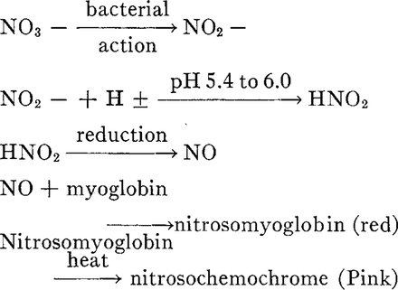
http://ps.oxfordjournals.org/content/48/2/668.full.pdf+html
When sodium nitrite is added with the salt, the meat develops a red, then pink color, which is associated with cured meats such as ham, bacon, hot dogs, and bologna.
Nitrite (NO₂) is reduced to nitric oxide (NO) in acidic environment.
NO reacts with meat myoglobin to the unstable nitrosomyoglobin (bright red). After heating, it is converted to a more stable nitrosohemochrome, a pink pigment.

Slide 36
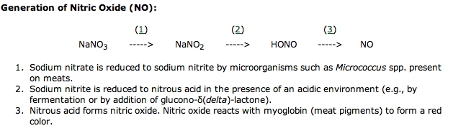
During curing added nitrate is ultimately reduced to nitrite by nonpathogenic organisms.

Slide 37
Proteins in food processing. 2004. Yada R. Y. (Ed.)

Slide 38
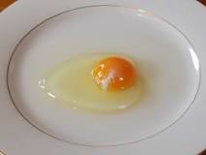
Egg proteins
Egg yolk proteins
Egg yolk contains 15-16% protein.
Complex protein mixture which contain glycoproteins, phosphoglycoproteins, lipoproteins and phosphoglycolipoproteins.
Egg yolk proteins are much less studied than the proteins of egg white.

Slide 39
Proteins of Egg White
Egg white (albumen) consist of approximately 40 proteins.

Slide 40
Ovalbumin
The predominant protein in albumen (54% of albumen).
• Classified as a phosphoglycoprotein since carbohydrate and phosphate moieties are attached to the polypeptide.
• MW of about 45,000, and made up of 3 components, A1, A2, and A3, which differ in phosphorous content.
• Ovalbumin A1 has two phosphate per molecule, A2 has one, and A3 has none.
• Ovalbumin in solution is readily denatured by exposure to new surfaces (e.g., shaking) and heat.

Slide 41
Ovalbumin
It has high biological value.
There is no deficiency of essential amino acids. It is one of few pure proteins that can adequately meet human nutritional requirements for amino acids.
In high purity crystalline form- as a standard in the investigation of composition, physical properties,
and structure of proteins.
As a protein standard in molecular weight determination by SDS-PAGE and size exclusion chromatography.

Slide 42
Ovotransferrin
A major egg white protein (12% of total egg white protein)
• A monomeric glycoprotein consisting a single polypeptide chain.
• Possess antiviral and antibacterial activities
• Iron binding protein, transport of iron in a soluble form to target cells (reversible, two iron atoms/molecule, as Fe3+).
• The most heat liable in egg white: forming aggregation by heating at 60 °C, resulting in milky white gel.

Slide 43
Lysozyme
A small (Mm 14 kDa), relatively stable protein with a positive charge, pI ≈ 10.4.
About 3.5% of the total protein in the egg white.
It possesses enzymatic activity – hydrolizates bacterial cell wall polysaccharide thus exhibiting antimicrobial activity.
Due to its relatively high positive charge electrostatically interact with negatively charged proteins - ionic bond formation.

Slide 44
Ovomucin
Glycoprotein - about 3.5% of total egg protein.
Negatively charged - pI 4.5-5.
It has good functional properties - especially foaming and emulsifying properties.
Responsible for the gel characteristics of the egg white. Ovomucin interact by ion bonding with lysozyme as well as positively charged albumin and globulins of wheat and this affects foaming in foods (cakes type).

Slide 45


