Slide 1
Lecture 6.
Plant proteins:
proteins of cereals and legumes.

Slide 2
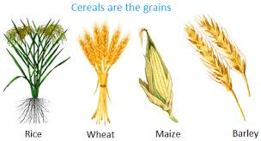
Cereals
Cereals are the most important crops in the world. Basic food in European countries.
A total annual grain yields exceed 2000 million tones (compared to 250 million tones of legume seeds including soybean and groundnut).
Most economically important cereal crops are:
Maize,
Wheat,
Rice
Together they account for over 70% of the total cereal production.
http://jxb.oxfordjournals.org/content/53/370/947.full.pdf+html

Slide 3
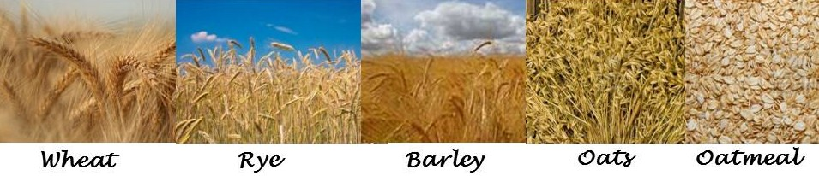
Other cereals include
Barley,
Sorghum,
Oats,
Rye

Slide 4
Protein content of cereals
Protein content varies from 6 to 14% depending on cultivar.
Wheat – 12-14%
Some varieties rye and barley – up to 20%
Amino acid profile of cereal proteins
In all cereals lysine is deficient: First limiting amino acid,
Amino acid score (AAS) – 40 to 50%
Wheat – threonine deficiency
Maize – tryptophan deficiency
Rye, barley and rice – the most balanced amino acid composition

Slide 5
Wheat proteins
Proteins are the principal factors of wheat quality for bread making.
Bread-making quality depends on the quantity and quality of wheat proteins.
http://pub.epsilon.slu.se/4083/1/malik_a_091030.pdf

Slide 6
Classification of wheat protein fraction
Osborne fraction | Solubility behaviour | Composition | Biological role | Functional role
Albumin | Water and dilute buffers | Non-gluten proteins (mainly monomeric) | Metabolic and structural proteins | Protection from pathogens
Globulin | Dilute salt | Non-gluten proteins (mainly monomeric) | Metabolic and structural proteins | Providing food reserve to embryo
Gliadin | Aqueous alcohols | Gluten proteins (mainly monomeric gliadins and low molecular weight glutenin polymers) | Prolamins-type seed storage proteins | Dough viscosity/plasticity
Glutenin | Dilute acetic acid | Gluten proteins (mainly HMW glutenin polymers) | Prolamins-type seed storage proteins | Dough viscosity/plasticity
Residue | Unextractable in water and dilute buffers but extractable with Urea+ DTT+SDS SDS+ Phosphate buffers+ sonication etc | Gluten proteins (high molecular weight polymers) and polymeric non-gluten proteins (triticins) | Prolamins-type (gluten) and globulin-type (triticin) seed storage proteins
http://pub.epsilon.slu.se/4083/1/malik_a_091030.pdf

Slide 7
Albumin and globulin
The amount of albumin and globulin fractions does not depend on climate conditions. It is a variety dependent feature.
Albumins and globulins are considered to have nutritionally better amino acid compositions because of their higher lysine and methionine contents as compared to the rest of the proteins in the wheat grain.
Serve as nutrient reserves for the germinating embryo.
Do not have any impact on bread-making properties of wheat proteins.

Slide 8
Gliadins and Glutenins are gluten proteins
Gluten: The rubbery mass that is left when wheat flour is washed with water to remove starch, non-starchy polysaccharides, and water-soluble constituents.
Dough
  Gliadin and Glutenin are two fractions of Gluten , a major wheat protein.
Wash out starch granules
Gluten
Mix with alcohol/water
Insoluble
Soluble
Glutenin
Gliadin

Slide 9
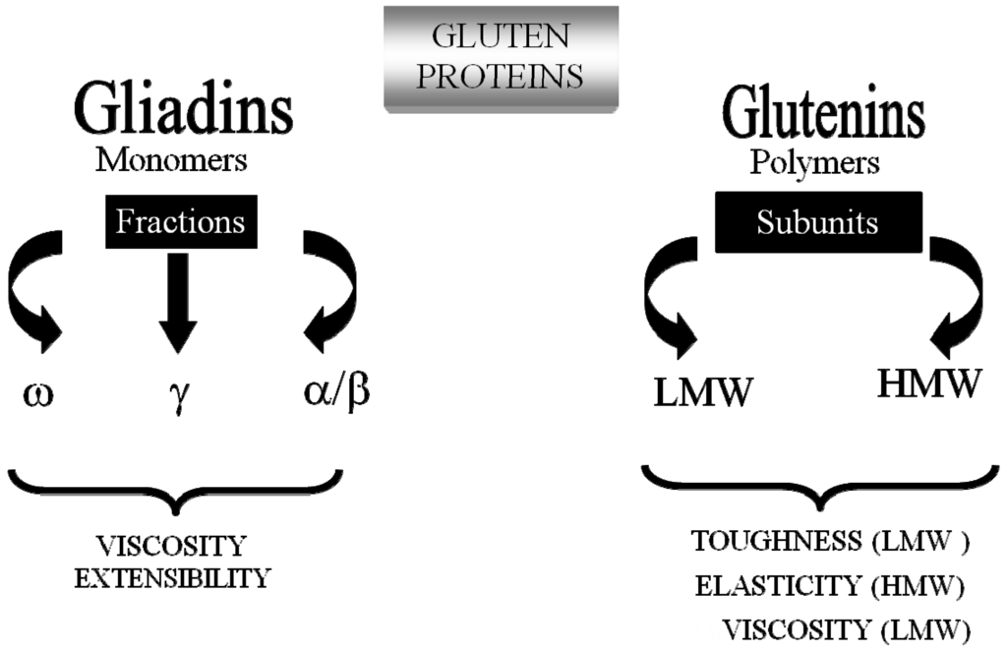
Gluten proteins
Unbalanced amino acid composition
Good technological functionality

Slide 10
Gliadins: characteristics
Constitute 30 to 40% of total flour protein content.
Monomeric proteins that consist of a single polypeptide chain.
Gliadins are polymorphic mixture of proteins soluble in 70% alcohol.
Rich in proline and glutamine.
Overall low level of charged amino acids.

Slide 11
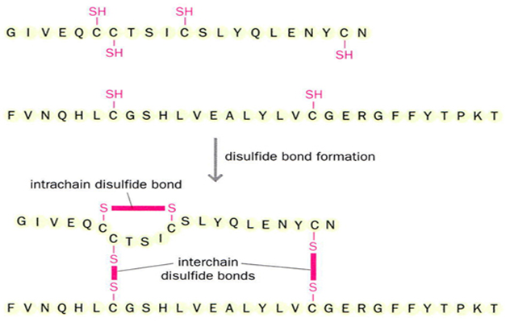
Intra-chain cysteine di-sulfide bridges in the gliadins resulting in less or more globular structure.

Slide 12
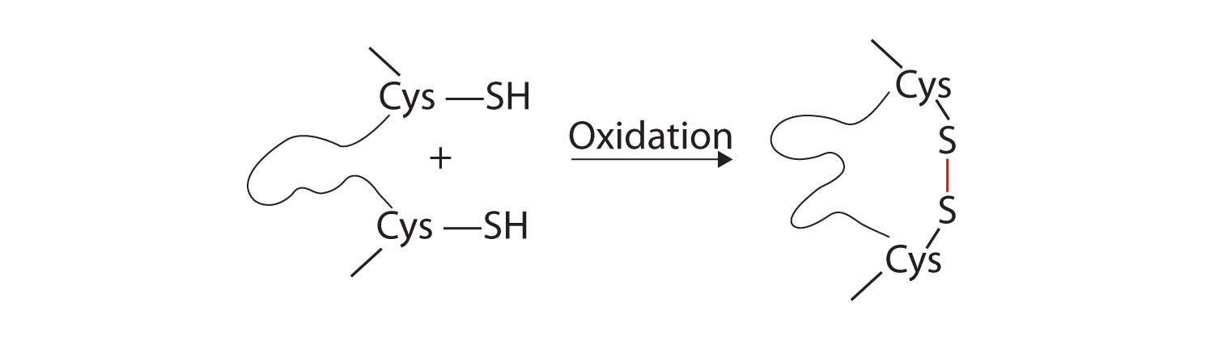
Gliadins: classification
Divided into four groups based on their molecular mobility in polyacrylamide gel electrophoresis: α, β, γ and ω
α, β, and γ gliadins contain intra-chain disulfide bonds. A major component of gliadins.
ω-gliadins lack cysteine residues and do not form disulfide bonds. A minor component of gliadins.
Gliadins may associate with one another or with glutenins through hydrophobic interactions and hydrogen bonds.
They contribute mainly to the viscosity of dough system.

Slide 13
Glutenins : characteristics
Glutenin is a highly heterogeneous mixture of polymers consisting of a number of different high- (HMW) and low-molecular-weight (LMW) glutenin subunits linked by disulfide bonds.
Extractable in dilute acetic acid.
Glutenin have high levels of glutamine and proline and low levels of charged amino acids (similar to gliadins).
Glutenins have the ability to form the largest and most complex protein polymers in nature with molecular weights of more than 10 millions.
Crit Rev Food Sci Nutr. 2002;42(3):179-208, http://pub.epsilon.slu.se/4083/1/malik_a_091030.pdf

Slide 14
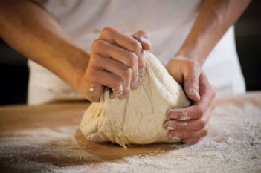
Variations in both quantity and quality of glutenin strongly determine variations in bread-making performance.
Largely responsible for gluten elasticity.
HMW-glutenins constitute no more than 10% of total flour protein; But they are the most important determinants of bread-making quality.

Slide 15
Classification and properties of wheat gluten proteins: Summary
Group | Subunit structure | Total fraction % | Molecular weight, Da | Amino acid composition, mol %
HMW subunits of glutenins | Polymeric | 6-10 | 65 - 90000 | 30 - 35 Gln 10 - 16 Pro 15 - 20 Gly 0.5 - 1.5 Cys 0.7 - 1.4Lys
LMW Subunits of glutenins | Polymeric | 70-80 | 30 - 45000 | 30 - 40 Gln 15 - 20 pro 2 - 3 Cys <1.0 Lys
α-Gliadins β-Gliadins γ -Gliadins | Monomeric Monomeric Monomeric | 70-80 | 30 - 45000 | 30 - 40 Gln 15 - 20 pro 2 - 3 Cys <1.0 Lys
ω - Gliadins | Monomeric | 10-20 | 40 - 75000 | 40 - 50 Gln 20 - 30 Pro 8 - 9 Phe 0 Cys 0 - 0.5 Lys
http://pub.epsilon.slu.se/4083/1/malik_a_091030.pdf

Slide 16
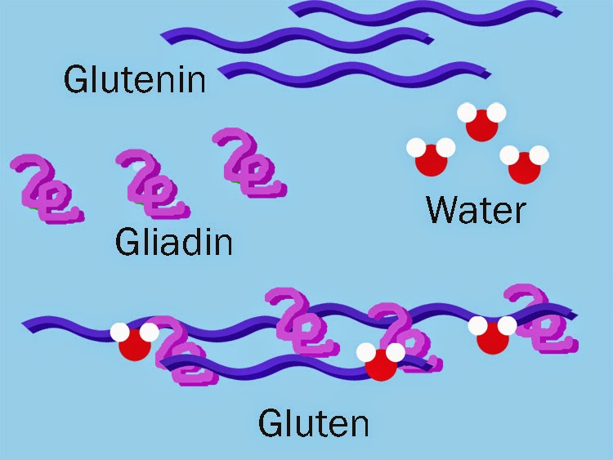
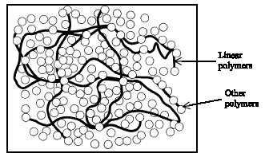
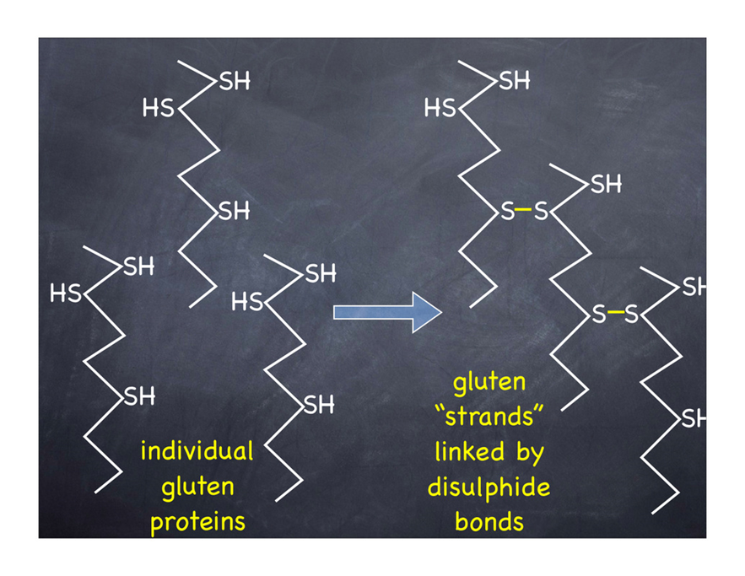
Varieties of gliadin and glutenin cross link together through disulfide, ionic and hydrogen bonds to form gluten.
Fig. 2 A model of molecular structure of gluten. Linear polymers are developed by HMW glutenin subunits. Other polymers are developed by spheres.
http://scialert.net/qredirect.php?doi=jas.2010.2478.2490&linkid=pdf
Belton, P.S., 1999. On the elasticity of wheat gluten. J. Cereal Sci., 29: 103-107.

Slide 17
Gluten is comprised of 80–85% protein and 5% lipids.
Quantity, composition (quality), type and viscoelastic properties of wheat gluten proteins determine bread-making properties of dough.
Play a crucial role in forming the strong, cohesive dough that will retain gas and produce baked products.

Slide 18
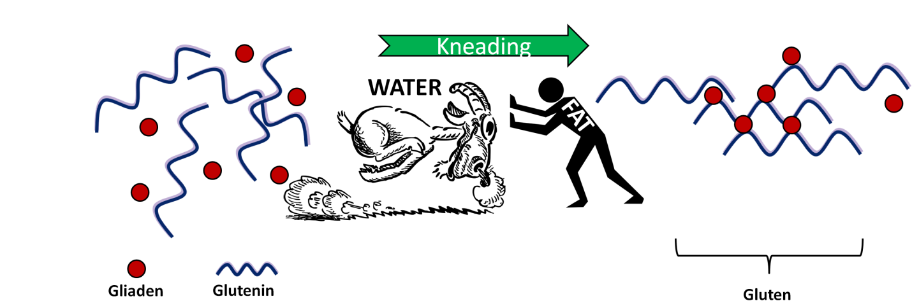
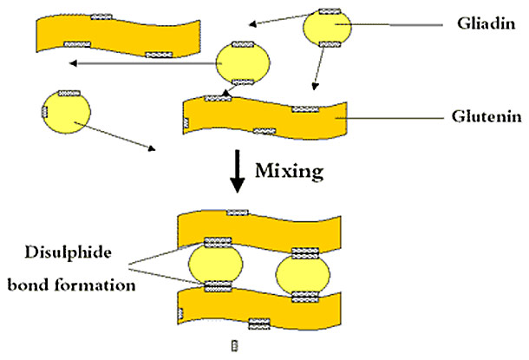
Making high quality dough
Gluten is formed when two classes of water-insoluble proteins in wheat flour (glutenin and gliadin) are hydrated with water and mixed.
Only dough can contain gluten, not the raw flour alone.

Slide 19
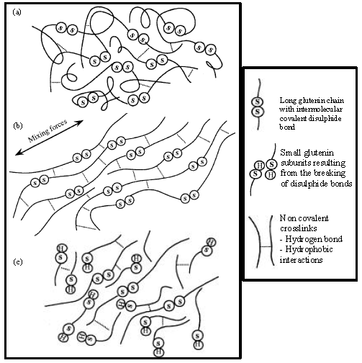
Molecular interpretation of gluten development
http://scialert.net/qredirect.php?doi=jas.2010.2478.2490&linkid=pdf
The mechanical shear causes the gluten bonds to form and become a viscoelastic matrix holding the starch granules and water in the flour.
a) Beginning of mixing; b) optimal mixing; c) overmixing

Slide 20
How much and what quality gluten do we need?
Reduction of intermolecular disulfide bonds lower gluten quality (the amount of HMW fraction)– decreased elasticity.
Less gluten formation is desired in a tender cake (example, soft wheat with lower protein content ), eujournal.org/index.php/esj/article/download/740/791
High-pressure treatment or enzymes like transglutaminase increase HMW fractions in gluten; increased elasticity, higher dough stability.
High amounts of gluten formation is needed for chewy artisan bread (example).
http://muehlenchemie.de/downloads-future-of-flour/FoF_Kap_14.pdf

Slide 21

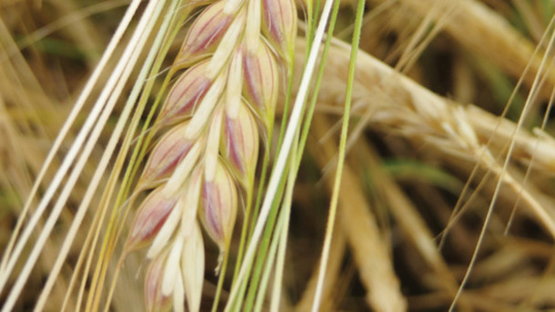
Barley
Barley – raw material for beer brewing
Barley proteins: 8–15%
Main protein fractions:
albumins,
globulins,
prolamins (hordeins)

Slide 22
Beer proteins
The majority of beer proteins are mainly albumins.
Contribute to mouth feel, flavor, color and nutritional value.
Prolamins (hordeins) contributes to foam formation and/or stabilization.
Hordein fraction comprises 35–55% of the total barley grain proteins and is the main barley storage protein. Hordeins exist both in monomeric and aggregated forms.

Slide 23
Barley is less used for bread making because of the high percentage of β-glucan (dietary fibers).
β-glucans binds tightly appreciable amounts of water in dough. This results in suppressing the water availability for the gluten network development thus reducing gas holding capacity.
The result: decreased dough extensibility, loaf height and volume reductions.

Slide 24
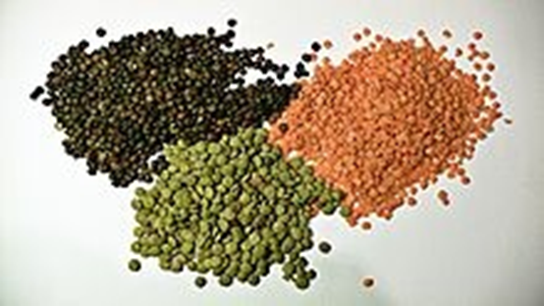
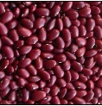
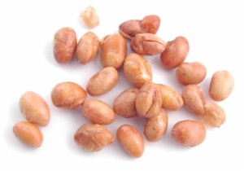
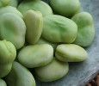



Legumes
All varieties of “Beans”
Lentils
Kidney Beans
(aka Red Beans)
Soy Beans
Fava Beans
And “Peas”
Chick Peas
Pigeon Peas
Split Peas

Slide 25
Legume proteins: General characteristics
Good protein source with plant origin
Contain 20-40% proteins
Better balanced amino acid composition compared to cereals.
Relatively high amount of lysine; deficient in sulfur-containing amino acids, methionine and cysteine
In some varieties - some deficiency of phenylalanine and tryptophan.

Slide 26
Fractional profile of legume proteins
Mainly albumin and globulin
Albumin fraction has more balanced amino acid composition.
Globulin – two fractions.

Slide 27
Soybean proteins
Soybean seeds contain 35-48% protein
Globulin:
glycinin (11S)
β-conglycinin (7S)
These two fractions account for greater than 65% of the total soybean protein.
Glycinin comprises 25–35% of the total seed protein and is the largest single storage protein fraction.
Glycinin is richer in sulfur containing amino acids than β-conglycinin.

Slide 28
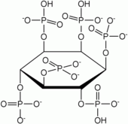
Anti –nutrient compounds in soybean seeds
Anti –nutrient compounds interfere with protein bioavailability and nutrient absorption.
Phytic acid
The degree of interaction between phytic acid and proteins depends on protein net charge, conformation and interactions with minerals at a given pH.
Phytic acid
http://cdn.intechopen.com/pdfs-wm/39380.pdf

Slide 29
At pH, below the isoelectric point of proteins, phytic acid phosphate esters bind to the cationic group of basic amino acids, for example, arginine, histidine and lysine, may form insoluble phytate-protein complexes.
At a pH above the isoelectric point of proteins, the charge of proteins as well as that of the phytic acid is negative – direct interaction would be impossible,
however, interaction may occur
through the formation of complexes with divalent such as Ca2+ or Mg2+.

Slide 30
Protease inhibitors
Protease inhibitors have the ability to
inhibit the proteolytic activity of digestive enzymes such as serine-proteases (trypsin and chymotrypsin).
These serine-protease inhibitors are proteins that form very stable complexes with digestive enzymes, thus preventing their catalytic activity.
http://cdn.intechopen.com/pdfs-wm/39380.pdf

Slide 31
The two main families of protease inhibitors found in legumes are:
Kunitz inhibitor and the Bowman-Birk inhibitor, so named after its isolation.
Both types of proteases are found in soybeans.
Both inhibitors are water soluble proteins (albumin) and constitute from 0.2 to 2% of total soluble protein of legumes.

Slide 32
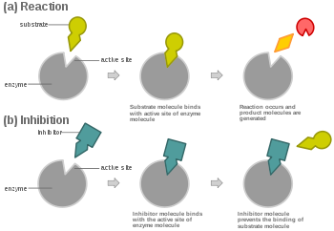
Kunitz type inhibitor
One molecule of inhibitor inactivates one molecule of trypsin.
It is a competitive inhibitor, binds to the active sites of trypsin in the same way the substrate of the enzyme does, resulting in the hydrolysis of peptide bonds between amino acids of the reactive site of the inhibitor or the substrate.

Slide 33
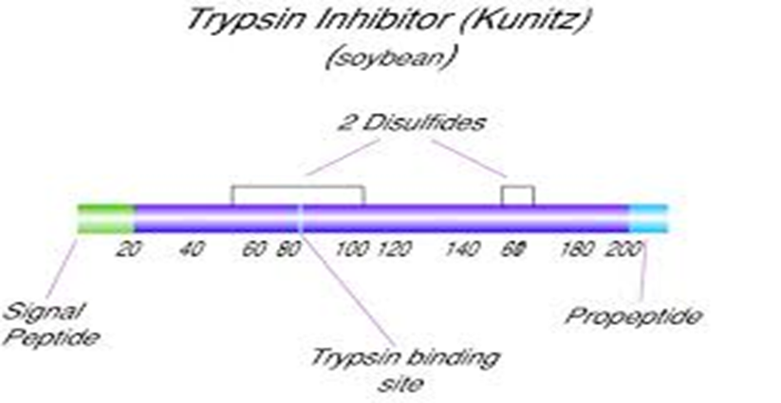
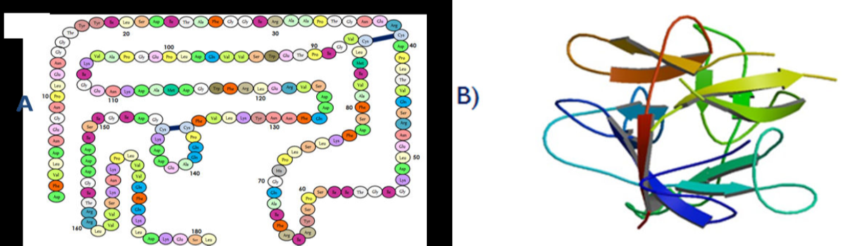
Inhibitors differ from the substrate protein in the reactive site residues, which are linked via disulfide bonds. After hydrolysis, the modified inhibitor maintains the same conformation, due to the disulfide bonds. This generates a stable enzyme-inhibitor complex.
A) Primary structure of the Kunitz inhibitor from soybean . Disulphide bonds are shown in black,B)Tridimentionals tructure of Kunitz inhibitor from soybean .

Slide 34
Bowman-Birk type inhibitors
These inhibitors are low molecular weight polypeptides (60 to 85 amino acid residues).
Have several disulfide bonds which make them stable to heat, acids and bases.
Competitive inhibitors
http://cdn.intechopen.com/pdfs-wm/39380.pdf

Slide 35
In soybean: Bowman-Birk has two heads (two separate sites of inhibition) and can simultaneously and independently inhibit two enzymes, thus, this is trypsin/chymotrypsin inhibitors
It is called dual head inhibitor because it has independent binding sites for trypsin and chymotrypsin. The active site for trypsin is Lys16-Ser17, whereas for chymotrypsin is Leu44-Ser45.
A) Primary structure of Bowman-Birk type inhibitor from soybean. Disulphide bonds and
active sites for trypsin (Lys16-Ser17) and chymotrypsin (Leu44-Ser45) are shown in black B) Tri-dimentional structure of Bowman-Birk inhibitor from soybean.

Slide 36
Protease inhibitors: function
Reduction of free digestive enzymes - reduced proteolysis and amino acid absorption.
Have adverse effects in animals.
Loss of sulfur-containing amino acids: enzyme-inhibitor complexes, which are rich in sulfur amino acids, are excreted.
Overall reduction of essential amino acids.

Slide 37
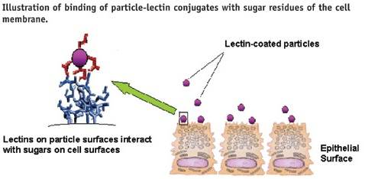
Lectins (phytohemagglutinins)
Proteins or glycoproteins of non-immune origin, which can reversibly bind to specific sugar segments through hydrogen bonds and Van Der Waals interactions, with one or more binding sites per subunit.

Slide 38
Most lectins are not degraded during their passage through the digestive tract. Once bound to the digestive tract, the lectin can cause dramatic changes in the cellular morphology and metabolism of the stomach and small intestine.
Thus, lectins may induce changes of the digestive, absorptive, protective or secretory functions of the whole digestive system.
In general, nausea, bloating, vomiting and diarrhea characterize the oral acute toxicity of lectins on humans exposed to them.

Slide 39


