Slide 1
Lecture 4
Functional properties of proteins.

Slide 2
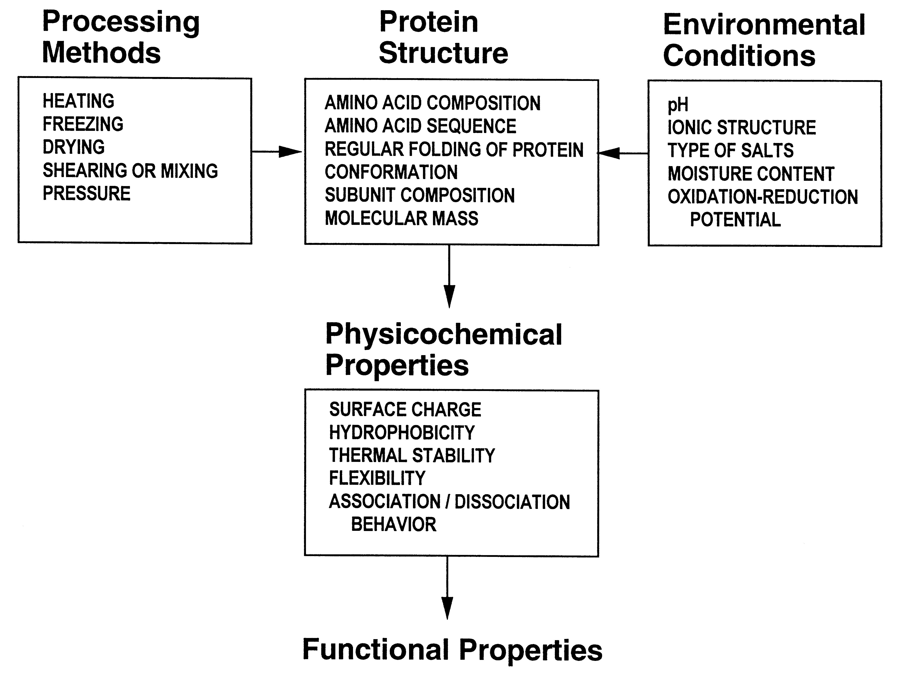
The properties of food proteins are altered by environmental conditions, processing treatments and interactions with other ingredients

Slide 3
Proteins – functional properties
Functional properties defined as:
  “those physical and chemical properties of proteins that influence their behavior in food systems during preparation, processing, storage and consumption, and contribute to the quality and organoleptic attributes of food systems”
Many food products owe their function to food proteins.
It is important to understand protein functionality to develop and improve existing products and to find new protein ingredients.
http://cdn.intechopen.com/pdfs-wm/15717.pdf

Slide 4
Examples of protein functional properties in different food systems
Functional Property | Food System
Solubility | Beverages, Protein concentrates/isolates
Water-binding and holding ability | Muscle foods, cheese, yogurt
Gelation | Muscle foods, eggs, yogurt, gelatin, tofu, baked goods
Emulsification | Salad dressing, mayonnaise, ice cream, gravy
Foaming | Meringues, whipped toppings, angel cake, marshmallows

Slide 5
Functional properties:
Water binding- and holding ability
Water binding
  The ability of foods to take up and/or hold water is of paramount importance to the food industry.
  More H₂O = Higher product yield = Higher financial benefit.
  Product quality may also be better, more juiciness.

Slide 6
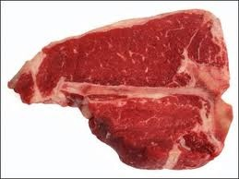

Phosphate salts (in combination with NaCl) are frequently used in food processing to make food proteins bind and hold more water
Salt brine
Salt brine
some phosphate
⬆⬆ phosphate
Cook
Cook
Cook
30% reduction
10% reduction
100% reduction

Slide 7
Factors influencing water binding capacity of proteins
  1. Protein type
    More hydrophobic = less water uptake/binding
    More hydrophilic = more water uptake/binding
  2. Protein concentration
    More concentrated = more water uptake
  3. Protein denaturation (influence of temperature)
    Depends - if a protein forms a gel on heating (which denatures the proteins) then it would get more water binding
      water would be physically trapped in the gel matrix

Slide 8
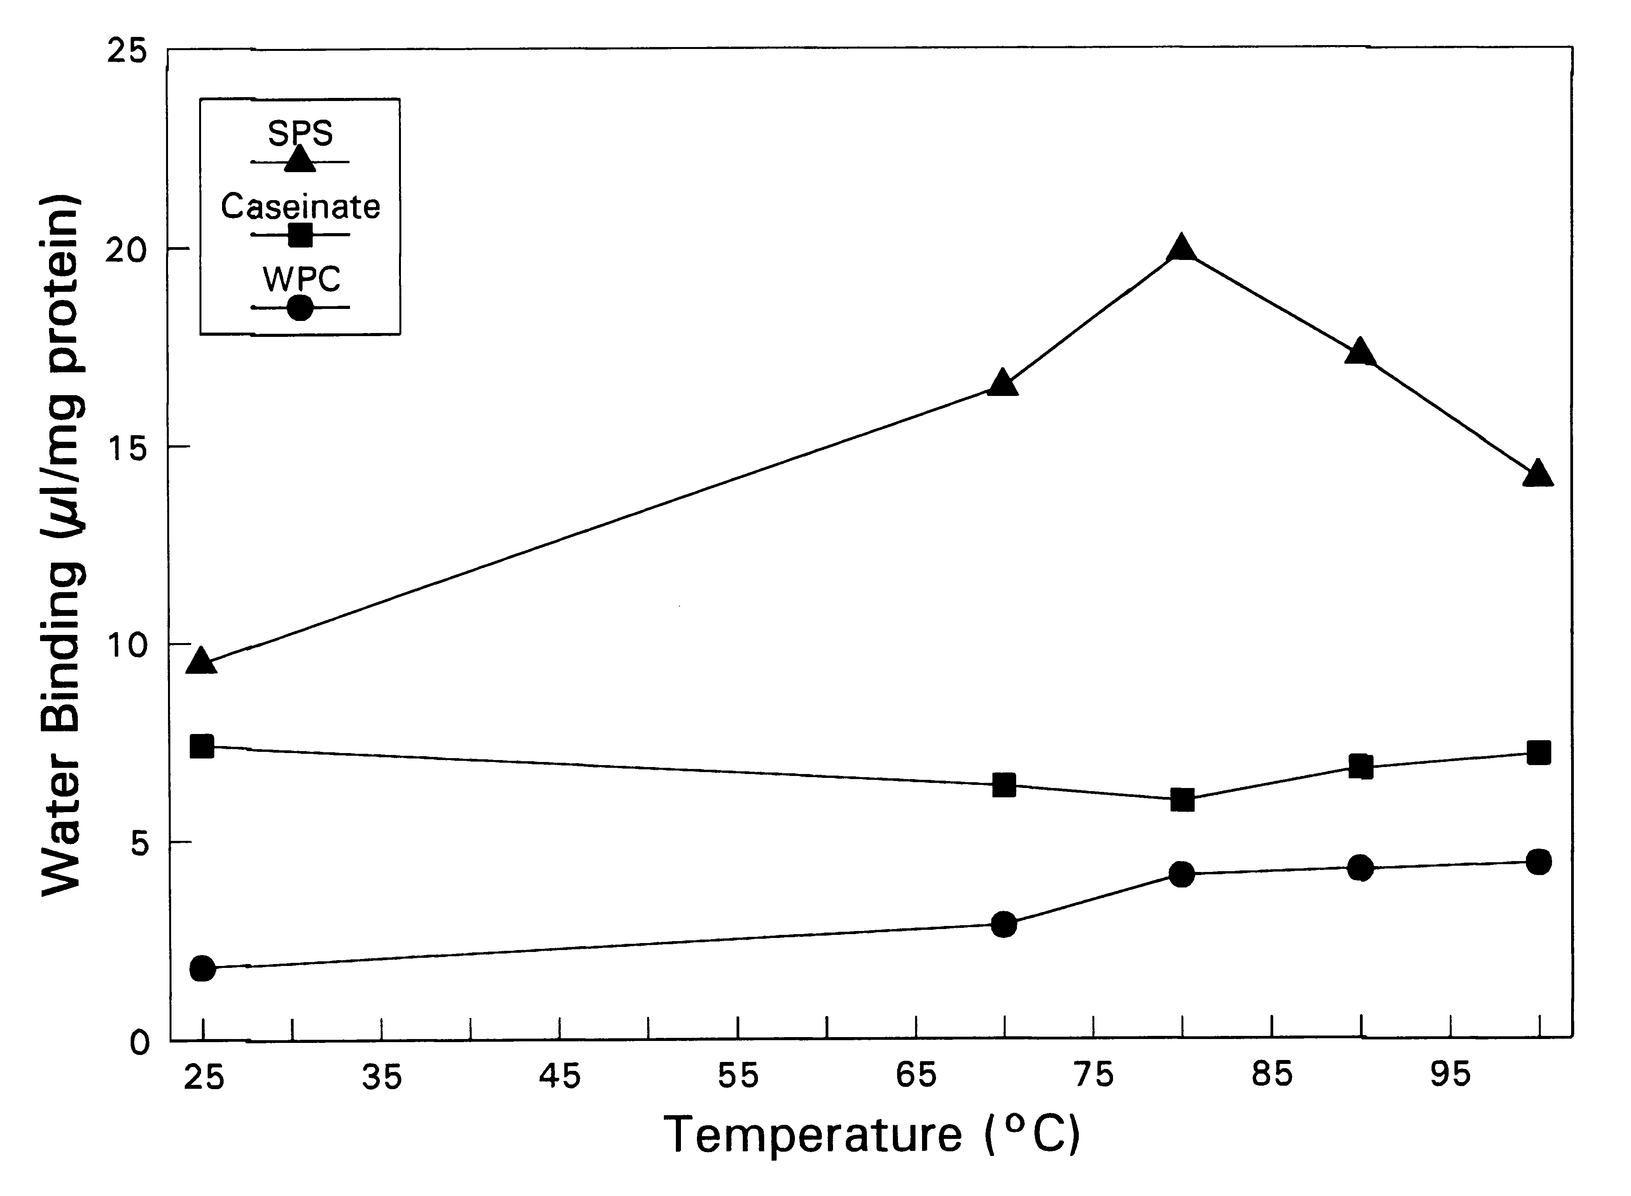
Example how thermal denaturation may have an effect on
water binding
SPS = Soy protein isolate → forms gel on heating
Caseinate = Milk proteins (casein) → does not gel on heating
WPC = Whey protein concentrate → forms gel on heating

Slide 9
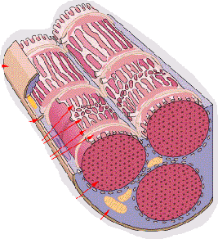
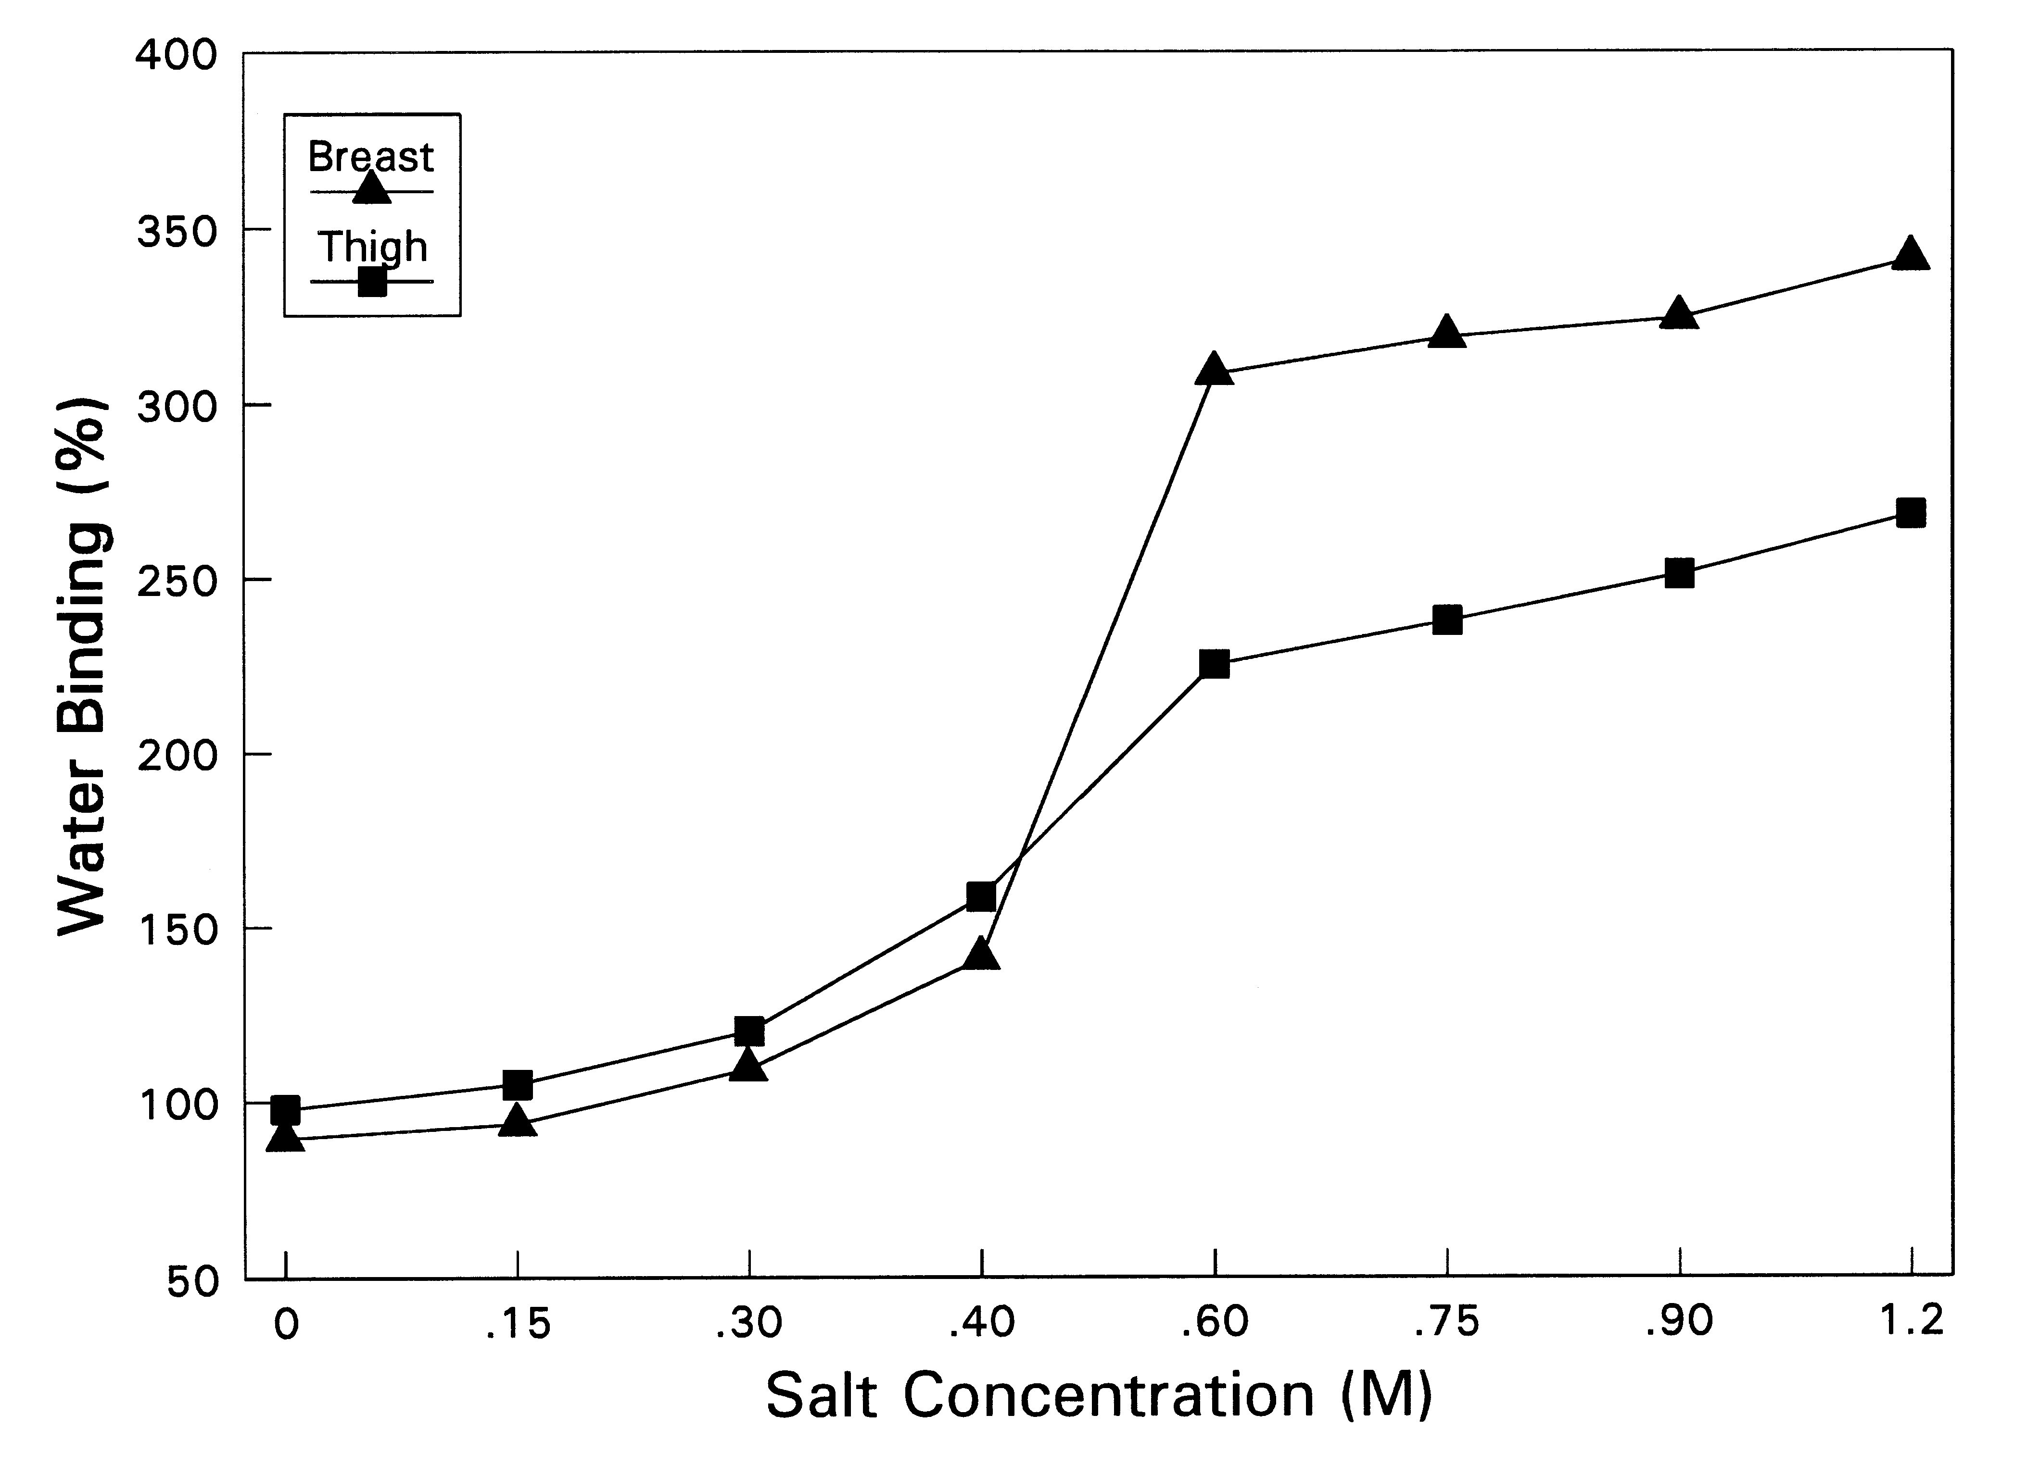
Factors influencing water binding capacity of proteins (Cont.)
4. Salt concentration
    Highly protein dependent
      muscle proteins
NaCl
Na⁺
Na⁺
Na⁺
Cl⁻
Cl⁻
Na⁺
Na⁺
Cl⁻
Cl⁻

Slide 10
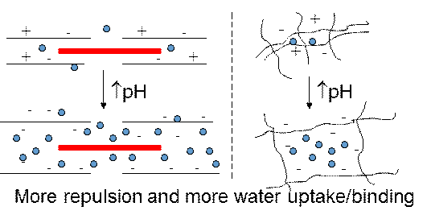
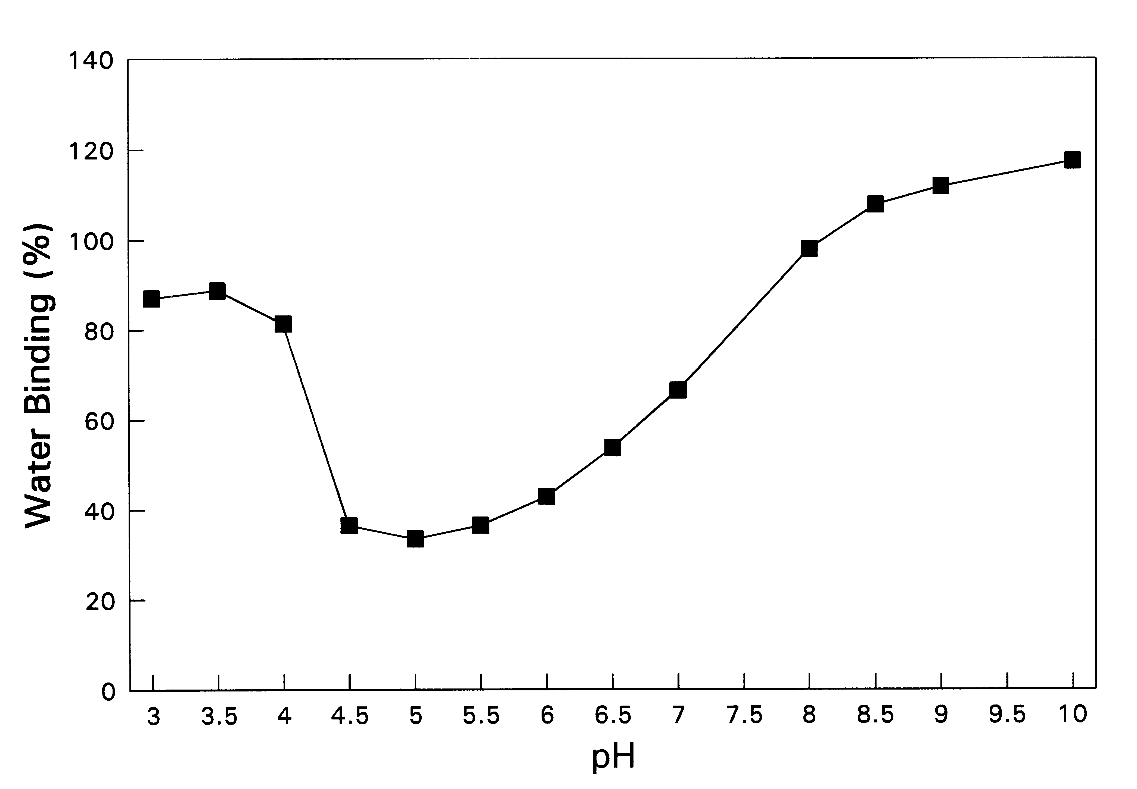
Factors influencing water binding capacity of proteins (Cont.)
5. Influence of pH
  Great influence on the water uptake and binding of proteins
  Water binding lowest at pI since there is no effective charge and proteins typically aggregate.
  Water binding increases greatly away from pI
  Muscle proteins and
  protein gels are a good example
pI

Slide 11
Functional properties: Gelation
Texture, quality and sensory attributes of many foods depend on protein gelation on processing.
  Sausages, cheese, yogurt, custard
Gel; a continuous 3D network of proteins that entraps water
  Protein - protein interaction and protein - water (non-covalent) interaction
A gel can form when proteins are denatured by
  Heat, pH, Pressure, Shearing
Solution
Gel

Slide 12
Factors influencing gel properties
  Temperature
  heating/cooling scheme
  pH
  Salts

Slide 13
Thermally induced food gels
(the most common)
  Involves unfolding of the protein structure by heat which exposes its hydrophobic regions which leads to protein aggregation to form a continuous 3D network
  This aggregation can be irreversible or reversible

Slide 14
Thermally irreversible gels
  The thermally set gel (called thermoset) will form irreversible cross-links and not revert back to solution on cooling.
    Examples; Muscle proteins (myosin), egg white proteins (ovalbumin)
cooling
Denaturation (%)
Gel strength/Viscosity
heating
heating
T

Slide 15
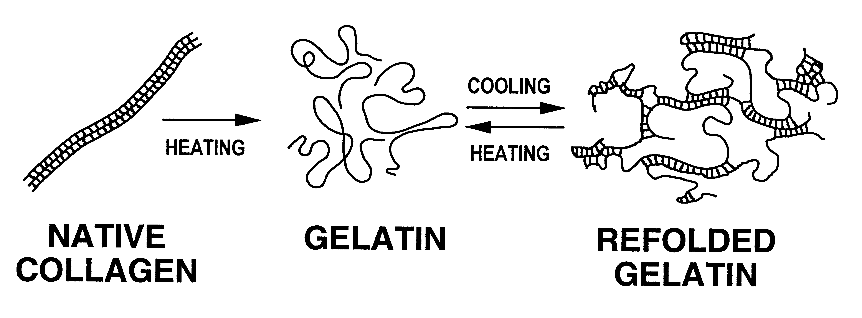
Thermally reversible gels
  These gels (called thermoplastic) will form gels on cooling (after heating) and then revert fully or partially back to solution on reheating (“melt”)
    Example; Collagen (gelatin)

Slide 16
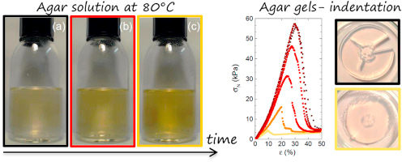
Thermally reversible gels
Example

Slide 17
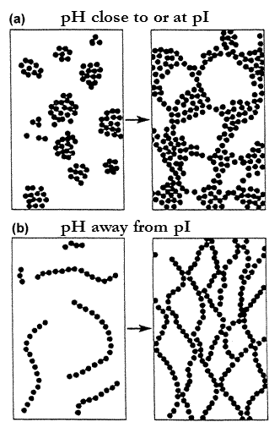
Factors influencing gel properties: pH
  Highly protein dependent
  Some protein form better gels at pI
    No repulsion, get aggregate type gels
    Softer and opaque
  Others give better gels away from pI
    More repulsion, string-like gels
    Stronger, more elastic and transparent
    Too far away from pI you may get no gel → too much repulsion
  By playing with pH one can therefore play with the texture of food gels producing different textures for different foods

Slide 18
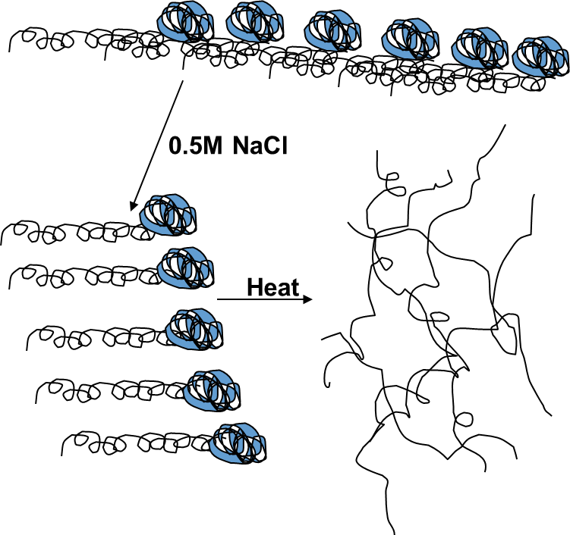
Factors influencing gel properties: Salt concentration
    Highly protein dependent:

Slide 19
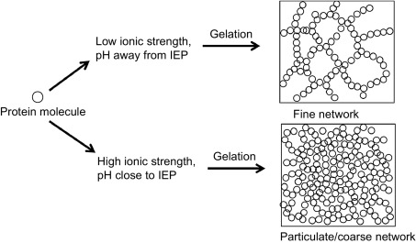
Factors influencing gel properties: Salt concentration

Slide 20
    Some proteins do not form good
    gels in salt because salt will minimize necessary electrostatic interactions between the proteins
+
+
Cl-
NaCl
+
+
+
+
Cl-
Cl-
Loss of repulsion
Loss of gel strength
Loss of water-holding
+
Cl-
+

Slide 21
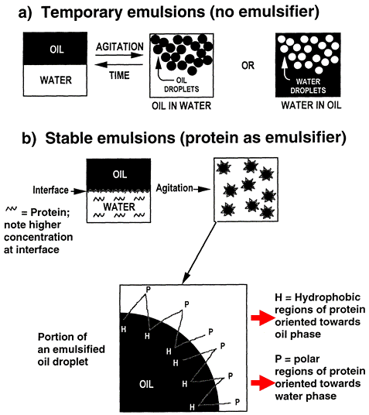
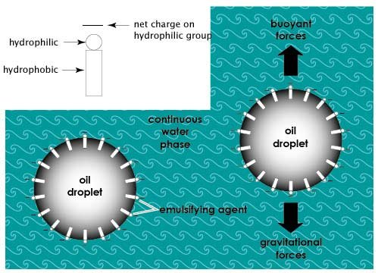
Functional properties: Emulsification
Emulsion: A suspension of small globules of one liquid in a second liquid with which the first will not mix.
Proteins can be excellent emulsifiers because they contain both hydrophobic and hydrophilic groups.

Slide 22
To form a good emulsion the protein has to be able to:
  Rapidly adsorb to the oil-water interface
  Rapidly and readily open up and orient its hydrophobic groups towards the oil phase and its hydrophilic groups to the water phase
  Form a stable film around the oil droplet

Slide 23
Important protein features:
  Distribution of hydrophobic vs. hydrophilic amino acids
    Need a proper balance
    Increased surface hydrophobicity will increase emulsifying properties
  Structure of protein
    Globular is better than fibrous
  Flexibility of protein
    More flexible it is, easier it opens up
  Solubility of protein
    Insoluble will not form a good emulsion (can’t migrate well; pI is not good)
    Increasing solubility increase emulsification ability (up to a point)

Slide 24
Emulsifiers are characterized by:
Emulsification capacity - Oil titrated into a protein solution with mixing and the max amount of oil that can be added to the protein solution measured
Emulsification stability - Emulsion formed and its breakdown (separation of water and oil phase) monitored with time

Slide 25
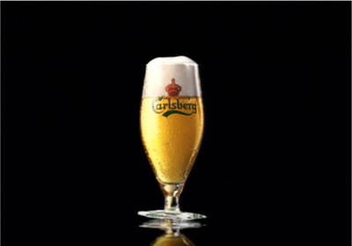
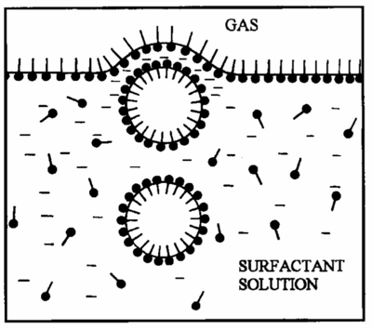
Functional properties: Foaming
Foams are very similar to emulsion where air is the hydrophobic phase instead of oil
Principle of foam formation is similar to that of emulsion formation (most of the same factors are important)
Foams are typically formed by:
  Injecting gas/air into a solution
  through small orifices
  Mechanically agitate
  a protein solution (whipping)
  Gas release in food,
  e.g. leavened breads (a special case)

Slide 26
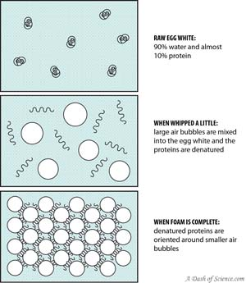
Foaming

Slide 27
Factors that affect foam formation and stability
  Type of protein
    Increased surface hydrophobicity is good
    Partially denaturing the protein often produces better foams
    Globular is better than fibrous

Slide 28
Factors that affect foam formation and stability
pH
Foam formation and stability is often bad at around pI of the proteins. At the isoelectric point, the total charge of protein molecules is close to zero which leads to their aggregation and coagulation.
The higher molecular weight complexes impair the formation of viscoelastic protein film at the boundary of the two phases which is mandatory for stabilization of the foam.

Slide 29
Factors that affect foam formation and stability
Salt: protein dependent
    Egg albumins, soy proteins, gluten
      Increasing salt usually improves foaming since charges are neutralized (they lose solubility → salting-out)
    Whey proteins
      Increased salt negatively affects foaming (they get more soluble – salting-in)

Slide 30
Factors that affect foam formation and stability
Lipids
    Lipids in food foams usually inhibit foaming by adsorbing to the air-water interface and thinning it.
      Only 0.03% egg yolk (which has about 33% lipids) completely inhibits foaming of egg white!
      Cream is an exception where very high level of fat stabilizes foam

Slide 31
Factors that affect foam formation and stability
Stabilizing ingredients
Ingredients that increase viscosity of the liquid phase stabilize the foam (sucrose, gums, polyols, etc.)
  We add sugar to egg white foams at the later stages of foam formation to stabilize
  Addition of flour (protein, starch and fiber) to foamed egg white to produce angel cake (a very stable cooked foam)

Slide 32
Factors that affect foam formation and stability
Energy input
    The amount of energy (e.g. speed of whipping) and the time used to foam a protein is very important
    To much energy or too long whipping time can produce a poor foam
      The foam structure breaks down
      Proteins become too denatured

Slide 33
Foams are characterized by:
      Foam capacity –determined by volume increase immediately after whipping.
      Foam stability - the volume of the foam that remain after time. Can be expressed as a percentage of the initial foam volume.

Slide 34
Protein modification to improve their functional properties.
  Some proteins don’t exhibit good functional properties and must be modified.
  Other proteins are excellent in one functional aspect but poor in another but can be modified to have a broader range of function.

Slide 35
  Chemical modification
  Reactive amino acids are chemically modified by adding a group to them.
    Lysine, tyrosine and cysteine
    Increases solubility and gel-forming abilities.
    Modified protein has to be non-toxic and digestible
      Retain 50-100% of original biological value
      Often used in very small amounts due to possible toxicity

Slide 36
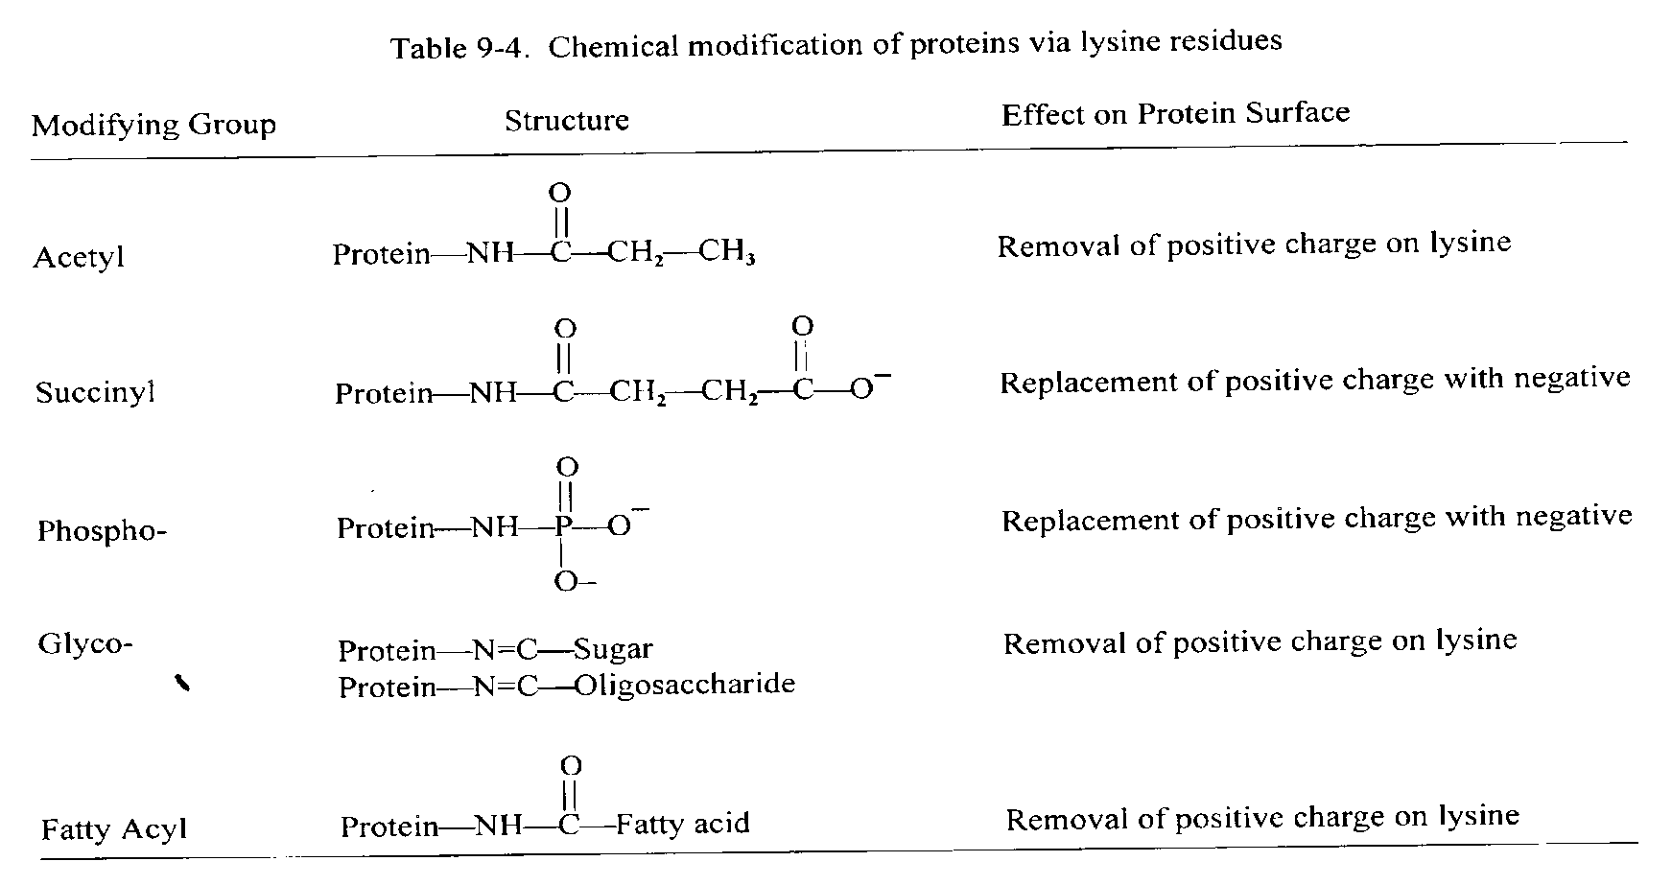
    Examples for chemical modification

Slide 37
  Enzymatic modification
    Protein hydrolysis (proteolytic enzymes)
      Proteins broken down by enzymes to smaller peptides
      Improved solubility and biological value
    Protein cross-linking
      Some enzymes (transglutaminase) can covalently link proteins together
      Great improvement in gel strength

Slide 38
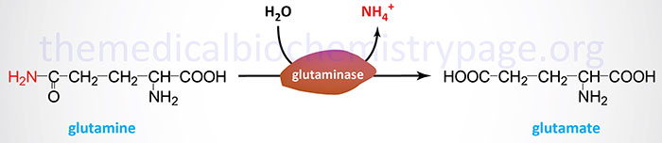
  Enzymatic modification (cont.)
    Amino acid modification
      Peptidyl-glutaminase converts
        Glutamine → glutamic acid (negatively charged)
Can convert an insoluble protein to a soluble protein

Slide 39
Physical modification
  Most of the methods involve heat to partly denature the proteins; alkaline treatment
Texturized vegetable proteins – TVP (e.g. soy meat)
  A combination of heat (above 60C), pressure, high pH (11) and ionic strength used to solubilize and denature the proteins which rearrange into 3D gel structures with meat like texture
  Good water and fat holding capacity
  Cheaper than muscle proteins - often used in meat products

Slide 40
Physical modification (cont.)
Protein based fat substitutes (e.g. SimplesseTM )
  Milk or egg proteins heat denatured and mechanically sheared: On cooling they form small globular particles that have the same mouthfeel and juiciness as fat.
  SimplesseTM is very sensitive to high heat – limits its use in processing

Slide 41


