Slide 1
Lecture 2.
Protein structure: primary, secondary, tertiary and quaternary structure.

Slide 2
Proteins are biopolymers, made of the 20 L- α-amino acids linked by peptide bonds.
Polypeptide backbone is a repeating sequence of
N-C-C-N-C-C…
The side chain or R group is not a part of the backbone or the peptide bond.

Slide 3
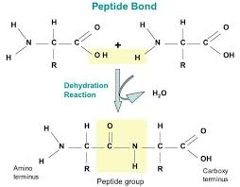
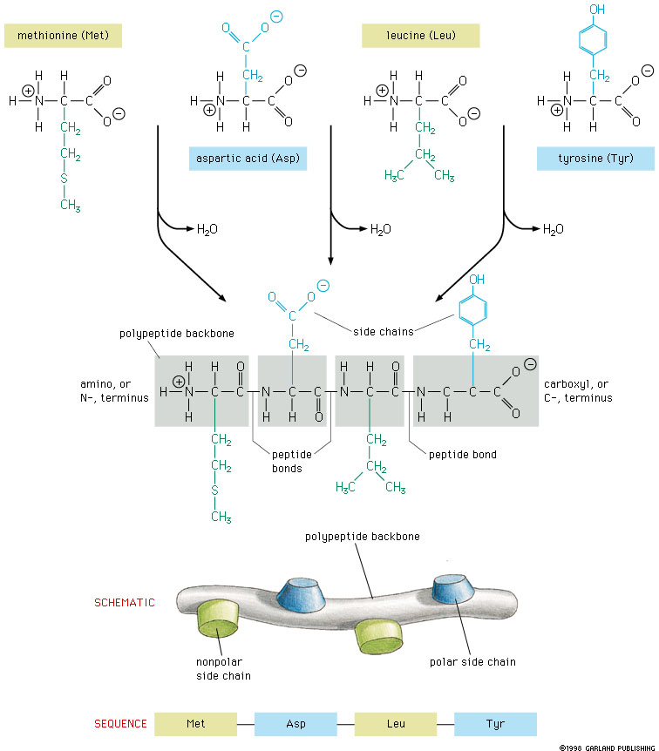
Polypeptide Chain
Peptide bond formation:

Slide 4
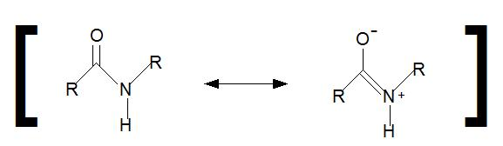
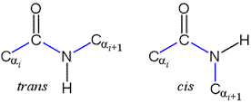
Characteristics of peptide bond:
Covalent, strong bond
Partial double bond character (distance is 1.32 Å (angstroms) which is midway in a single bond 1.49 Å and a double bond 1.27Å)
Rigid and planar
Prevailing trans configuration of neighboring α – carbon atoms.
Side chains are free to rotate on either site of the peptide bond.

Slide 5
Typical bonds in protein molecules
Peptide bond
Covalent bonds
Disulfide bond
Hydrogen bond
Non-covalent bonds
Ionic bond
Hydrophobic interactions

Slide 6
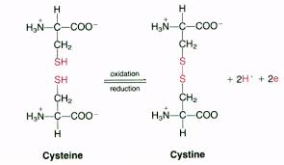
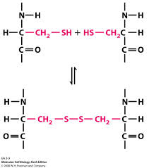
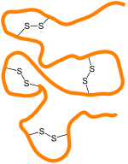
Covalent bond: Disulfide bond
Between two cysteine molecules
Between two cysteine R-groups of polypeptide chains

Slide 7
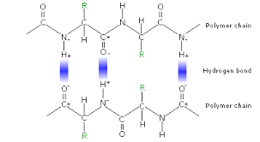
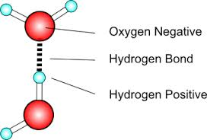
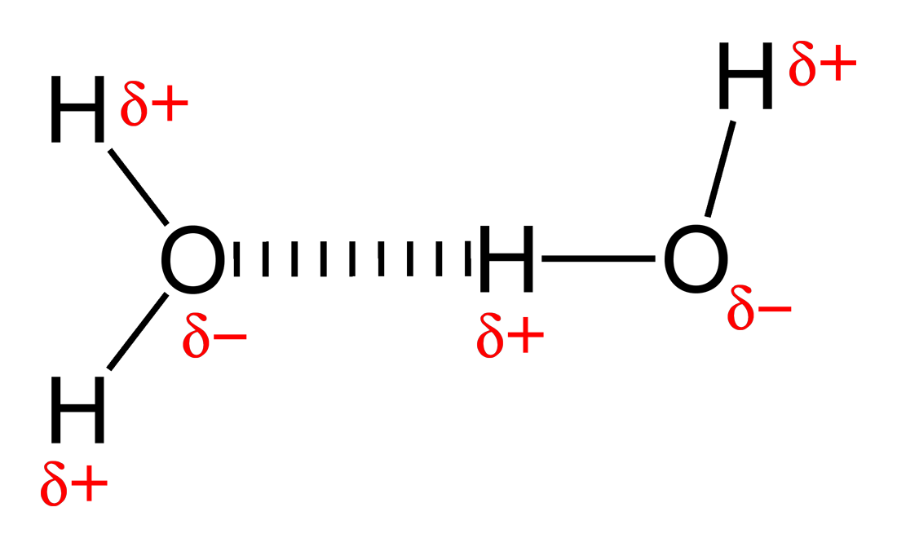
Non-covalent bonds: Hydrogen bond
Hydrogen bond
Hydrogen bond formation
А) between peptide bonds

Slide 8
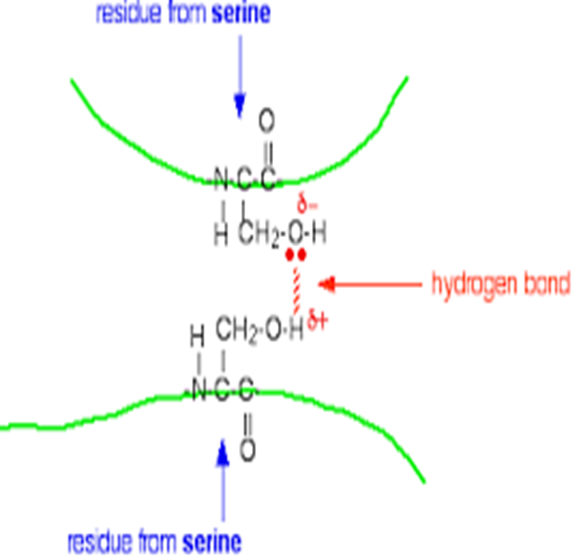
Б) between R-groups of polypeptide chains for example two tyrosine groups or tyrosine and glutamic acid or aspartic acid radicals
В) between peptide bond and a side amino acid radical (for example serine, tyrosine)

Slide 9
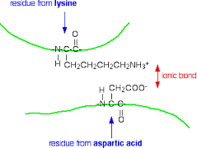
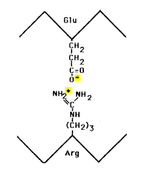
Ion bond (between oppositely charged radicals)
pH influences the strength of ion bonds
In strong acid:
-NH3⁺
-COOH
In strong base:
-NH₂
-COO⁻

Slide 10
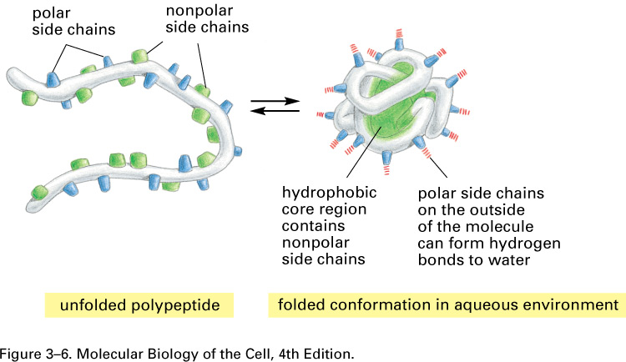
Hydrophobic interactions- between hydrophobic (non-polar) radicals
Hydrophobic interactions in the formation of protein structure
Polar radicals
Non-polar radicals

Slide 11
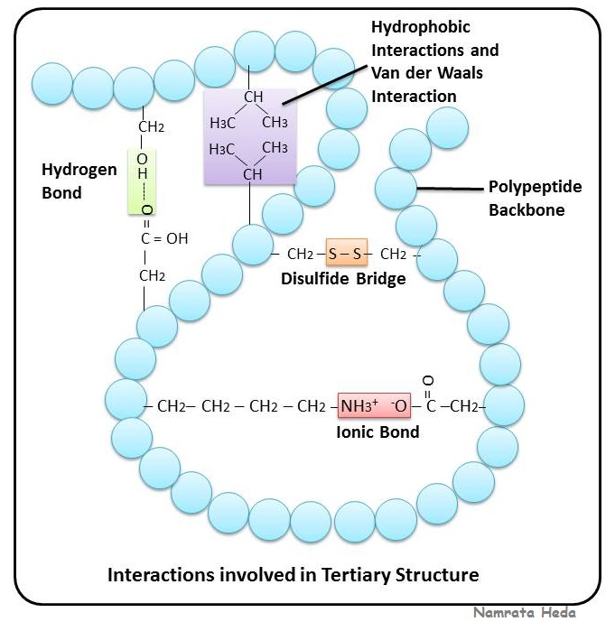
Protein bonds: Summary

Slide 12
Structural organization of proteins
Primary structure
Secondary structure
Tertiary structure
Quaternary structure
Native protein structure is essential for the biological function of a protein.
Loss of structure results in loss of biological function.

Slide 13
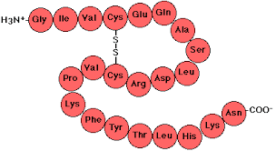
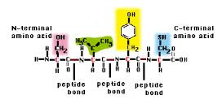
Primary structure
Definition:
The linear sequence of amino acids forming the backbone of a protein.
Peptides: di-, three-, tetra- peptides
Oligopeptides: up to 20 amino acids
Polypeptides: from 20 to 50 amino acids
Proteins: > 50 amino acids

Slide 14
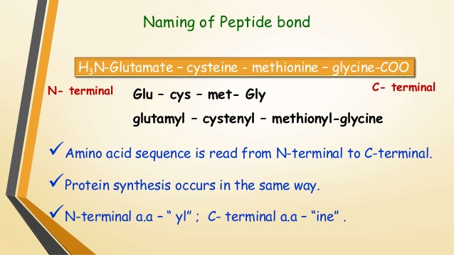
Polypeptide name formation
from “Protein structure” by Dr. N. Sivaranjani

Slide 15
Remember
Every polypeptide chain has a unique amino acid sequence determined by genes.
A single amino acid change in polypeptide chain may change or completely abolish protein function.
Primary structure determines the higher levels of protein organization.
Bonds in primary structure: Peptide bonds.

Slide 16
Secondary structure
Definition: Spatial folding of the polypeptide chain in properly arranged, repetitive structures.
Three types of secondary structures:
α-helix,
β-sheet,
β-turn.

Slide 17
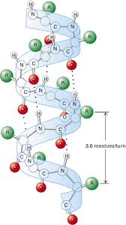
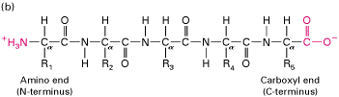
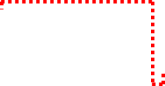
Formed as a result of hydrogen bonds between the carbonyl oxygen (C = O) and
the amide hydrogen (N-H) of the polypeptide chain and does not depend on the side radicals.
Alpha (α) helix
The carbonyl oxygen of each peptide bond is linked to a hydrogen bond with the amide hydrogen of the fourth amino acid towards the C-terminus.

Slide 18
Features of alpha helix
Most common and stable conformation.
Spiral structure: Polypeptide bonds form the backbone of the spiral. R-groups of the amino acids remain outwards of the spiral.
Stabilized by H-bonds: Hydrogen bonds are week but collectively determine the stability of α-helix.

Slide 19
Alpha helix is disrupted by:
Presence of proline.
Crowding of equally charged radicals, for example lysine, arginine, histidine
Crowding of bulk R-groups (leucine, isoleucine, tyrosine). Spatial interference.
Prevailing of amino acids with R-groups which are capable of forming H-bonds.
Presence of chemicals tending to form hydrogen bonds (carbamide).

Slide 20
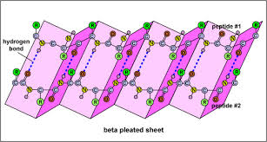
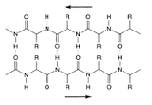
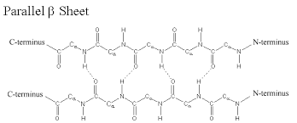
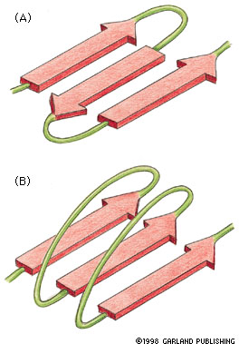
Beta (β) –pleated sheet
N-terminus
N-terminus
  Anti-parallel beta sheets: polypeptide chains run in an opposite direction
Parallel – run in the same direction with longer looping sections between them
Both models are found in proteins, but the antiparallel structure is more stable than the parallel beta-sheet.

Slide 21
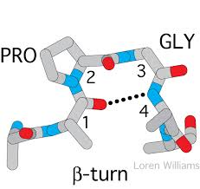
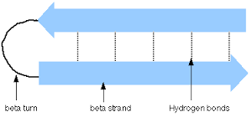
β - turns
Permits the change of direction of the peptide chain to get a folded structure.
Beta-turn loops allow for protein compaction, since the hydrophobic amino acids tend to be in the interior of the protein, while the hydrophilic residues interact with the aqueous environment.

Slide 22
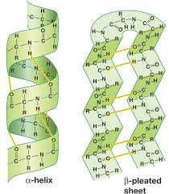
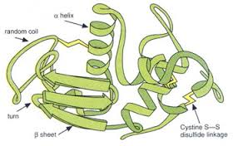
Secondary structures: Summary

Slide 23
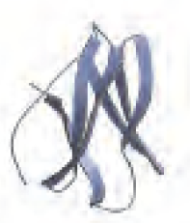
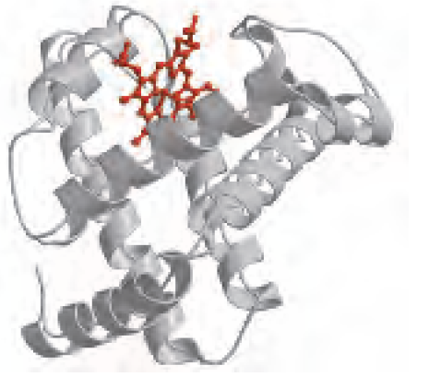
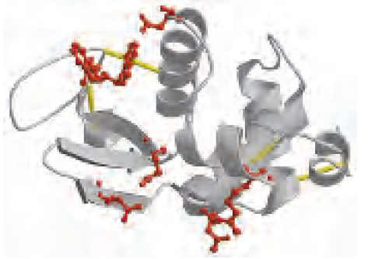
Spatial relationship of the different secondary structures
α – amylase inhibitor
myoglobin
lysozyme
Only β – sheets.
No α – spirals.
40% α – helix.
12% β – sheets.
75% α – helix.
No β – sheets.

Slide 24
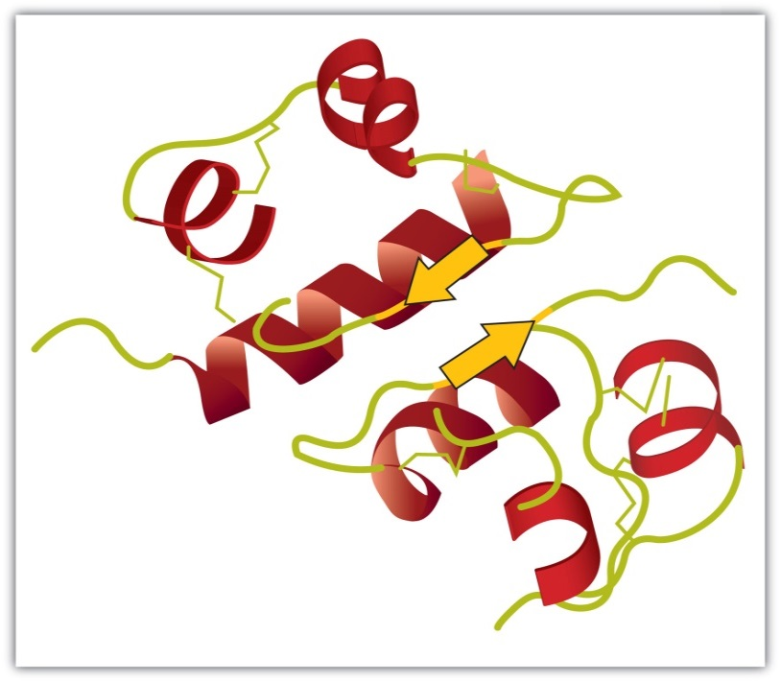
Tertiary structure
Complete three-dimensional shape of a given protein. Conformation.
Represent the spatial relationship of the different secondary structures to one another within a polypeptide chain and how these secondary structures themselves fold into the three-dimensional form of the protein.
The spiral regions represent sections of the polypeptide chain that have an α-helical structure, while the broad arrows represent β-pleated sheet structures.

Slide 25
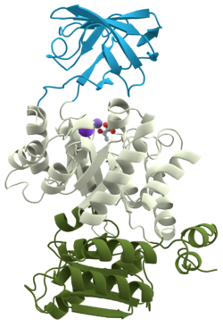
Tertiary structure: Describes the relationship of different domains to one another within a protein.
Protein domain
A domain is a basic structural unit within a protein molecule.
Part of protein that can fold into a stable structure independently.
Different domains can possess different functions.
Proteins can have one to many domains depending on protein size.
A polypeptide with 200 amino acids consists of two or more domains.
Domains are usually connected with relatively flexible areas of protein.
Pyruvate kinase (a monomeric protein):
three domains

Slide 26
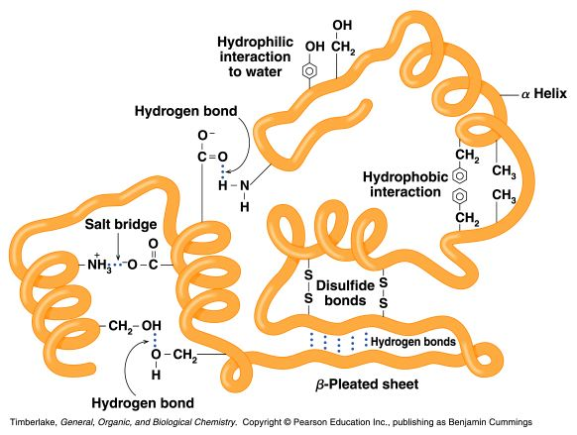
Tertiary structure is based on various types of interactions between the side-chains of the peptide chain.

Slide 27
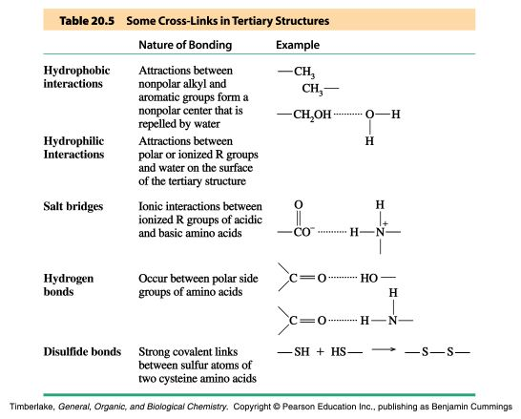
Stabilizing Interactions of Tertiary Structures

Slide 28
Globular Proteins
Globular proteins fold up into compact, spherical shapes.
Their functions are related to cell metabolism: biosynthesis and biodegradation, transport, catalytic function.
Hydrophobic R-groups are oriented into inner part of the protein molecule, while hydrophilic R-groups are pointed towards molecule edges.
Globular proteins are water soluble.

Slide 29
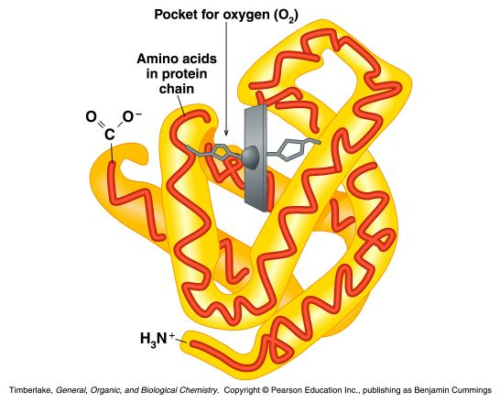
Example: myoglobin
Globular protein that stores oxygen in muscles
A single peptide chain that is mostly α-helix
O₂ binding pocket is formed by a heme group and specific amino acid side-chains that are brought into position by the tertiary structure

Slide 30
Fibrous proteins
Much or most of the polypeptide chain is parallel to a single axis
Fibrous proteins are often mechanically strong and highly cross-linked
Fibrous proteins are usually insoluble
Usually play a structural role

Slide 31
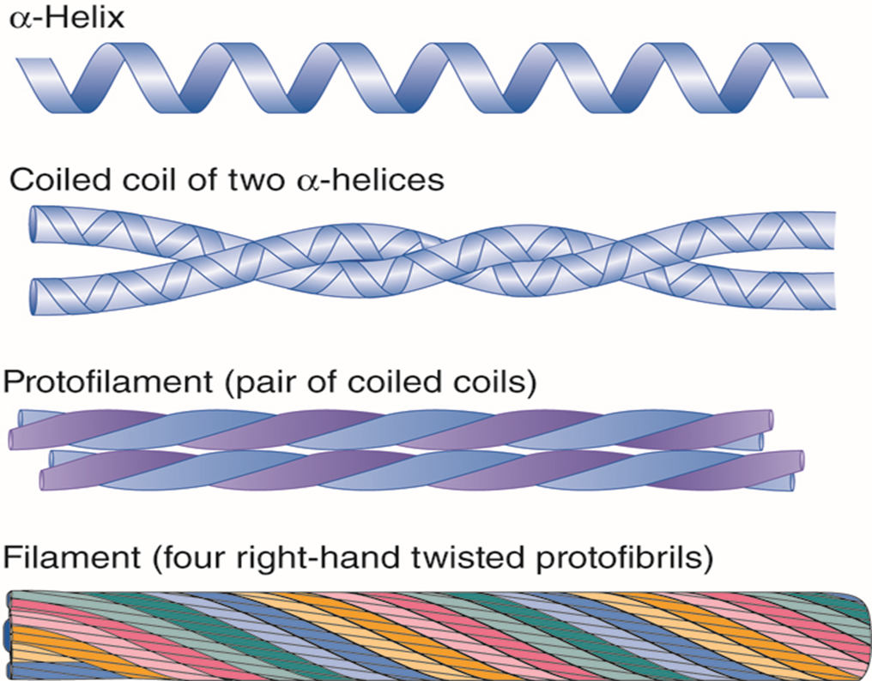
Fibrous Proteins: Keratins
For example, α-keratins are fibrous proteins that make hair, fur, nails and skin
- hair is made of twined fibrils
- the α-helices are held together by disulfide bonds

Slide 32
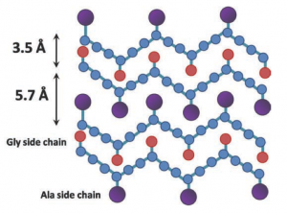
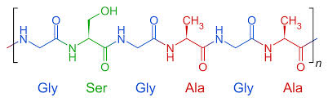
Fibrous proteins: Fibroin
Fibroin
Fibroins are the silk proteins. They also form the spider webs
Made with a β-sheet structures with Gly on one face and Ala/Ser on the other
Fibroins contain repeats of [Gly-Ala-Gly-Ala-Gly-Ser-Gly-Ala-Ala-Gly-(Ser-Gly-Ala-Gly-Ala-Gly)8]
The β-sheet structures stack on top of each other
Bulky regions with valine and tyrosine interrupt the β-sheet and allow the stretchiness

Slide 33
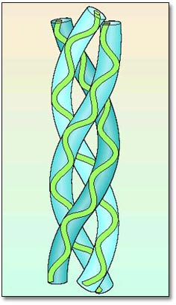
Fibrous proteins: Collagen is a Triple Helix
Collagen is formed from tropocollagen subunits. The triple helix in tropocollagen is highly extended and strong.
Features:
Three separate polypeptide chains arranged as a left-handed helix (note that an a-helix is right-handed).
3.3 residues per turn
Each chain forms hydrogen bonds with the other two: STRENGTH!
Nearly one residue out of three is Gly
Proline content is unusually high
Many modified amino acids present:
  4-hydroxyproline
  3-hydroxyproline
  5-hydroxylysine
Pro and HydroxyPro together make 30% of amino acids.
Collagen amino
acid composition:

Slide 34
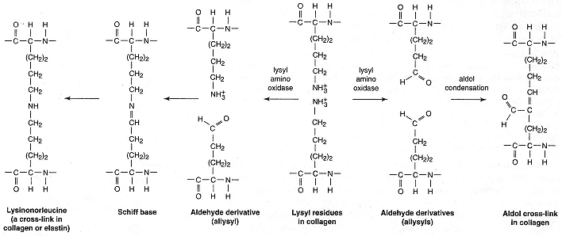
Covalent cross-links in collagen: alteration of mechanical properties of collagen
Catalyzed by lysyl amino oxidase

Slide 35
Globular proteins vs Fibrous proteins
1. Compact protein structure Extended protein structure
2. Soluble in water (or in lipid Insoluble in water (or in lipid bilayers) bilayers)
3. Secondary structure is а complex Secondary structure is simple
with a mixture of a-helix, b-sheet with predominant one type only
and loop structures
4. Quaternary structure is held Quaternary structure is usually together by noncovalent forces held together by covalent
bridges
5. Functions in all aspects of Structural function
metabolism (enzymes, transport, (tendons, bones, muscle, immune protection, hormones, etc). ligaments, hair, skin)

Slide 36
Quaternary structure of proteins
Monomeric proteins:
– built of a single polypeptide chain.
Oligomeric proteins:
– built of more than one polypeptide chains called subunits or monomers.

Slide 37
Quaternary structure describes the joining of two or more polypeptide subunits.
The subunits each have their own tertiary structure.
Bonds – non-covalent interactions.
Subunits can either function independently or work co-operatively.
Dissociation of a subunit results in loss of function.

Slide 38
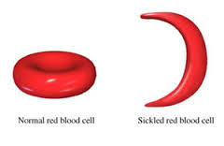
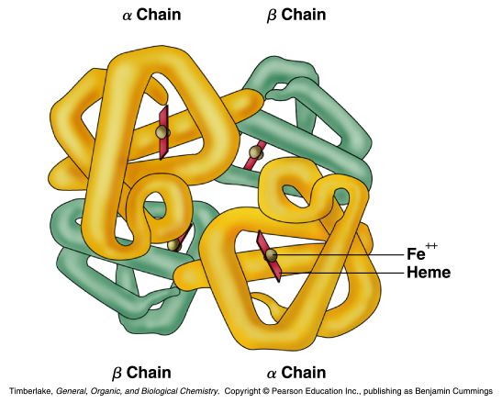
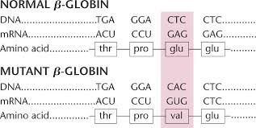
For example: Hemoglobin
A globular protein that consists of four subunits (2α and 2β, of two different types (α and β)
Each subunit contains a heme group for O₂ binding
Binding O₂ to one heme facilitates O₂ binding by other subunits
Replacement of even one amino acid in primary structure with another amino acid is critical for the function of the protein.

Slide 39
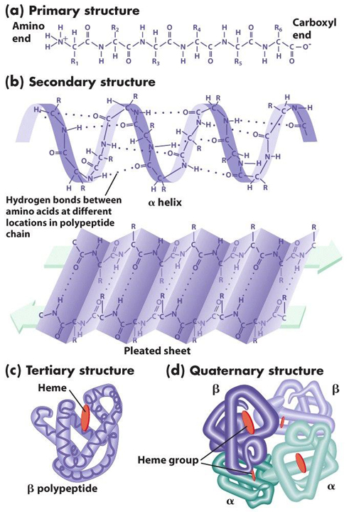
Structural organization of proteins: Summary

Slide 40


