Slide 1
Proteins. Chemical composition of the proteins. Properties of α- amino carboxylic acids.

Slide 2
Proteins.
General overview:
Major food macronutrients. Provide energy and building blocks for the development of body’s specific proteins.
Polymers with a high molecular weight.
Protein content in animal cells and microorganisms up to 40-50%, in plant cells – up to 35% dry weight.
Main protein sources: animals, plants, microorganisms. Quantitative and qualitative differences.

Slide 3
Chemical composition of proteins.
Proteins are composed of:
Carbon 50-55%
Oxygen 21-24%
Nitrogen 15-18%
Hydrogen 6.5-7.3%
Sulphur 0.0-2.4%
Some proteins may contain phosphorus and/or metals.
Complete hydrolysis results in amino acids (total of 20). Proteins are polymers composed of amino acids.

Slide 4
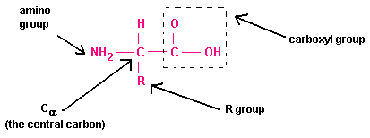
Structure of Amino Acid
Amino acids are the building blocks of proteins. Each amino acid contains :
1.Amino group (-NH2 group
2.Carboxyl group (-COOH group)
3.R group (side chain) which determines the type of an amino acid

Slide 5
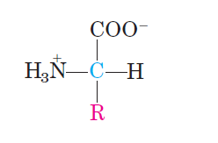
Amino acids.
A common amino acid structure with except for proline.
General characteristics:
20 common amino acids build all proteins in living cells.
All of them are α-amino acids.
All of them have a carboxyl and an amino group bonded to α-carbon atom.
α -amino acids differ from each other by their side chains, or R-groups.
R-groups are different in structure, size, and electric charge.

Slide 6
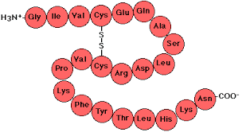
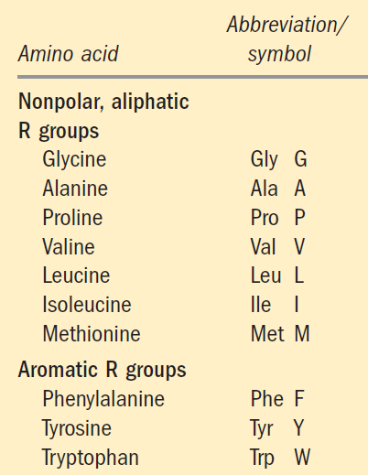
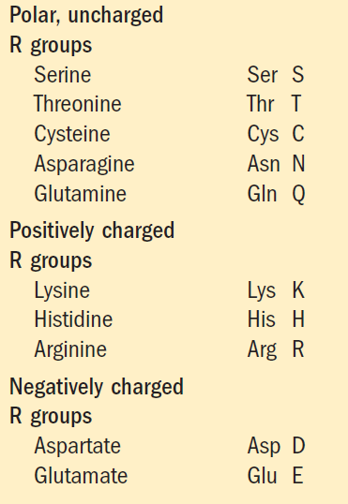
Amino acid’s name is a three-letter abbreviation and one letter symbol, which are used to indicate the sequence of the amino acids in a protein.

Slide 7
Classification of amino acids is based on the polarity of R-groups, or their tendency to interact with water at biological pH (near pH 7).

Slide 8
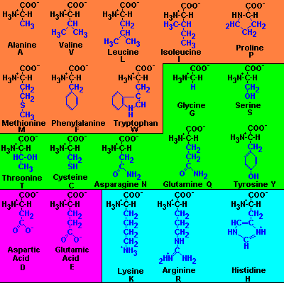
20 Amino Acids
Nonpolar,
hydrophobic
Polar,
uncharged
Polar,
charged
http://www.people.virginia.edu/~rjh9u/aminacid.html

Slide 9
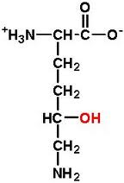
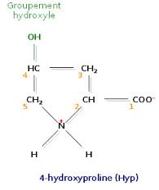
Some proteins may contain non-standard amino acids.
Examples:
5-hydroxylysine

Slide 10
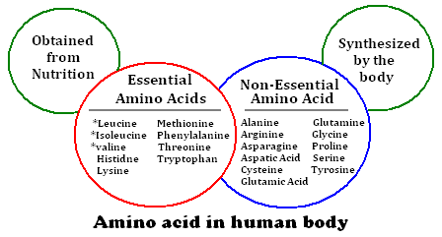
Essential Amino Acids

Slide 11
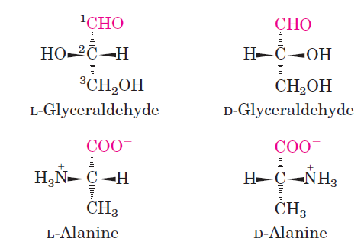
1. Physical properties of α – amino carboxylic acids
1.1 Stereochemistry:
For all amino acids except for glycine, α-carbon atom is chiral: bonded to four different groups - a carboxyl-, an amino-, a R- groups and a hydrogen atom.
Two stereoisomers: enantiomers
Mirror images: L- and D- forms
Carbons are lined up vertically, with the chiral atom in the center.
When α-amino group is on the left site of the vertical line, the AA is L-form.
When α-amino group is on the right site of the vertical line, the AA is D-form.

Slide 12
D- and L- forms of the AA have optical properties: rotate plane-polarized light.
The equal amounts of left- and right-handed enantiomers of AA is called racemate or racemic mixture. It does not have any optical properties.
All protein molecules are composed of the L-forms of AA.
D-forms of the AA have been found in small peptides in some microorganisms.

Slide 13
1.2 Amino acid solubility
Nonpolar, hydrophobic: tend to cluster together within proteins, stabilize protein structure by the means of hydrophobic interactions. They are not soluble in water.
Polar with uncharged and charged R-groups are hydrophilic and soluble in water because they contain functional groups that form hydrogen bonds with water.

Slide 14
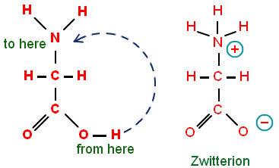
1.3 Amino acid dissociation:
At physiological pH (7.4):
Dipolar ion or zwitterion

Slide 15
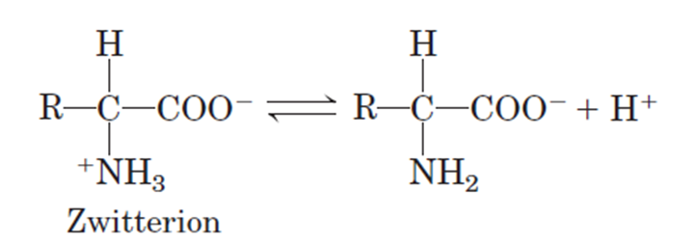
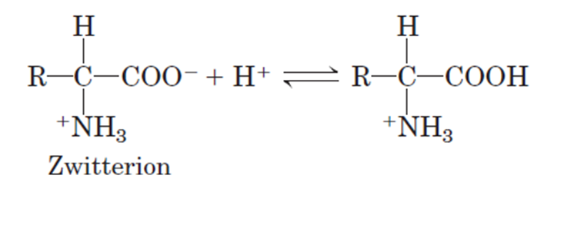
Amphoteric properties
A zwitterion can act as:
a proton donner (acid)
or as a proton acceptor (a base)

Slide 16
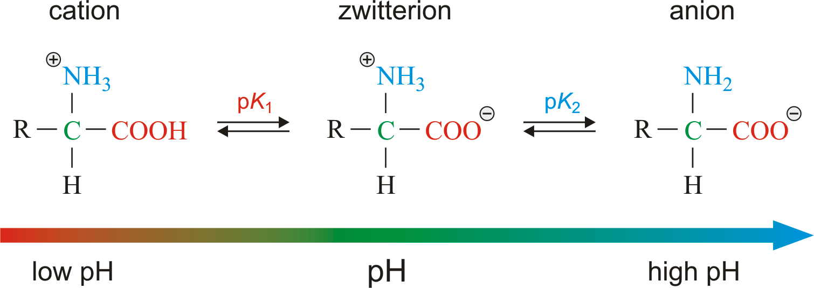

Slide 17
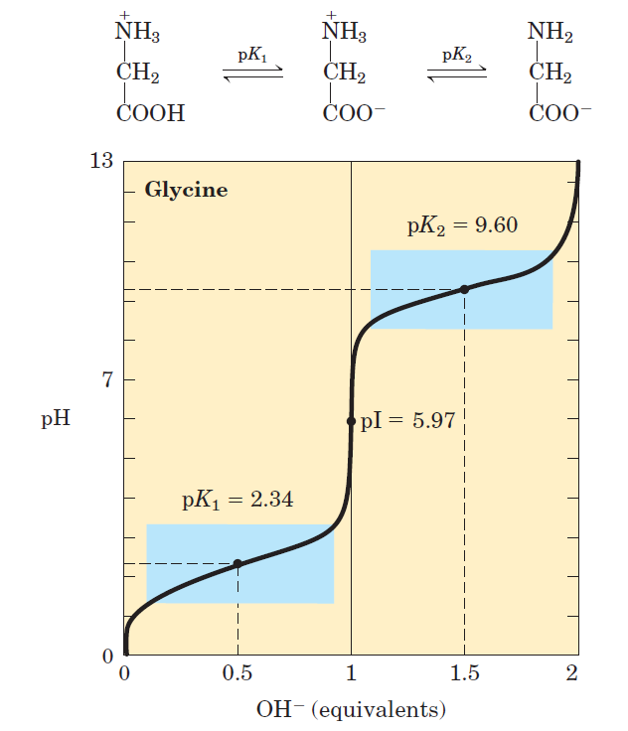

K – dissociation constant
pK – negative logarithm at a base 10
pK – a measure of the tendency of
a group to give up a proton
K₁ – dissociation of –COOH group
K₂ – dissociation of –NH3 group
pI – the pH at which the net
electric charge is zero –
- Isoelectric point
Dissociation curve:

Slide 18
Buffering capacity of amino acids
Buffers are aqueous systems that tend to resist changes in pH when small amounts of acid (H+) or base (OH-) are added.
Buffering region: extending from 1 pH unit on either side of the pKa.

Slide 19
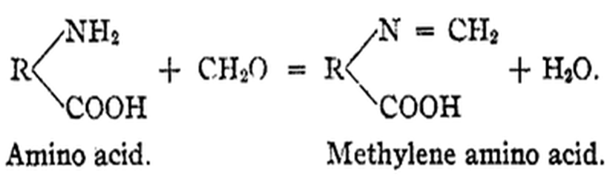
2. Chemical properties of α – amino carboxylic acids:
2.1Reactions typical for the amino group:
Interaction with formaldehyde.
Amino group is blocked. Amino acids react only as acids.
Application:
Quantitative determination of total amino acids by titration with a base.
Quantitative determination of α –amino nitrogen (Sørensen formol titration)

Slide 20
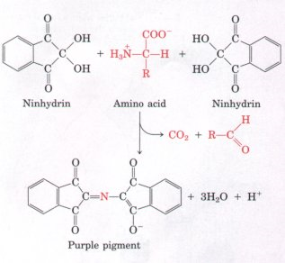
Interaction with ninhydrin.
Ruhemann's compound; Qualitative reaction

Slide 21
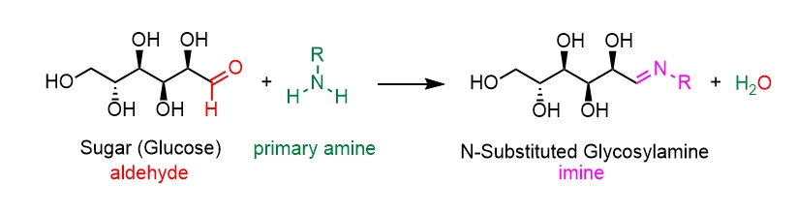
Interaction with carbonyl compounds (Maillard reaction)
Schiff base
….further isomerization, condensation and polymerization.
Formation of volatile compounds;
High molecular melanoidins

Slide 22
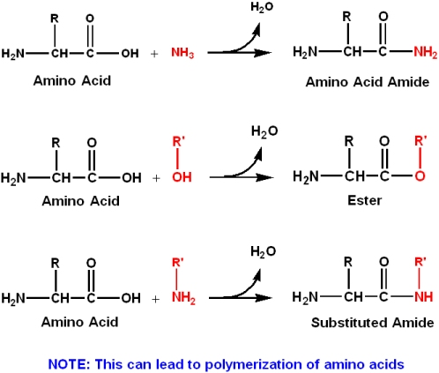
2. 2 Reactions typical for the carboxylic group:
Interaction with alcohols

Slide 23
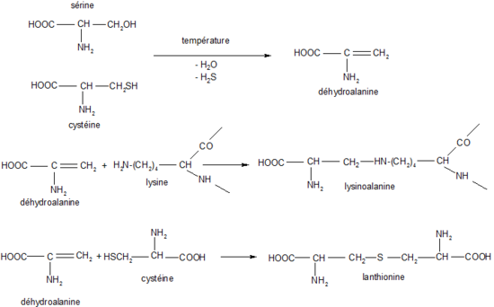
Reactions typical for R-groups:
Crosslinking

Slide 24


