Slide 1
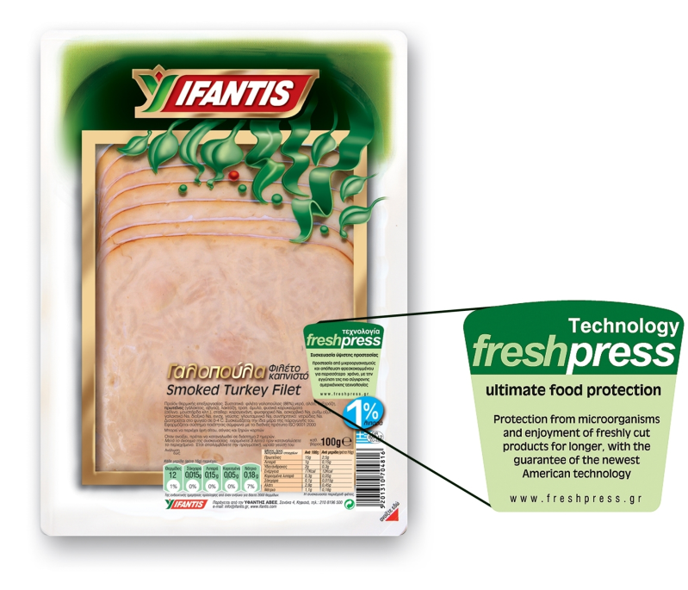

FOOD IRRADIATION
OBJECTIVES
1. Other alternative methods for food treatment;
2. Applications;
3. Benefits and changes of foodstuffs.

Slide 2
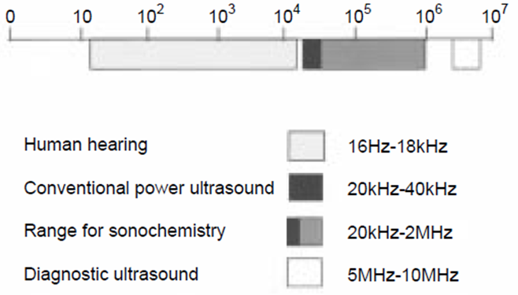
ALTERNATIVE METHODS FOR FOOD TREATMENT
1
1. Ultrasound treatment - sonication
Sound frequency ranges

Slide 3
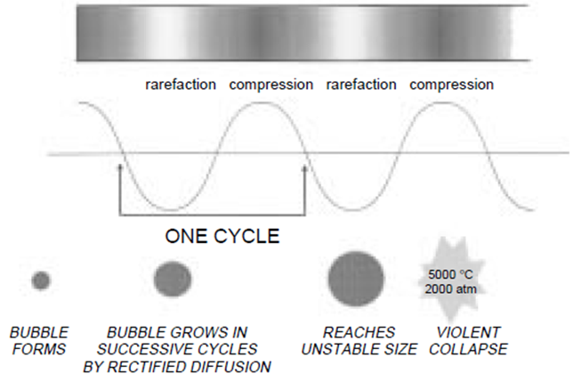
!
ALTERNATIVE METHODS FOR FOOD TREATMENT
2
1. Ultrasound treatment (sonication) - principle
Sound propagation in a liquid showing cavitation bubble formation and collapse

Slide 4
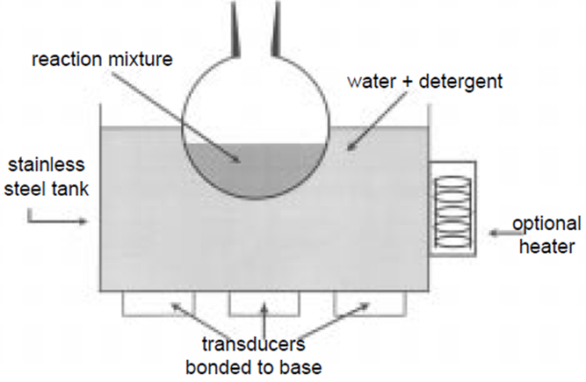
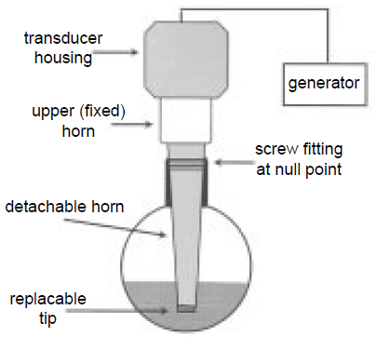
ALTERNATIVE METHODS FOR FOOD TREATMENT
3
1. Ultrasound treatment (sonication) - equipment
Simplest – ultrasonic baths
Ultrasonic probe system

Slide 5
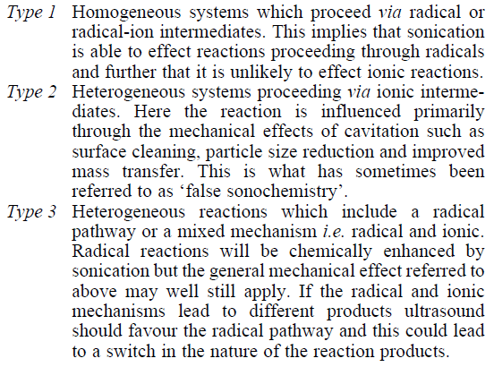
ALTERNATIVE METHODS FOR FOOD TREATMENT
4
1. Ultrasound treatment (sonication) - mechanism

Slide 6
!
ALTERNATIVE METHODS FOR FOOD TREATMENT
5
1. Ultrasound treatment (sonication) – food applications
Ultrasound in the food industry
The food industry as well as the pharmaceutical industry offer manifold possibilities for the use of sonication. Ultrasonic processors are used in food manufacturing for:
disintegration of cells
extracting (extract intracellular components or obtain cell-free bacterial enzyme)
activation (acceleration) of an enzyme reaction in liquid foods
acceleration of fermentation
mixing and homogenizing
dispersion of a dry powder in a liquid
emulsifying of oil/fat in a liquid stream
spraying
degassing
inspection, e.g. in the beverage industry
deactivation of enzymes
microbial inactivation (preservation)
crystallization
meat processing
stimulation of living cells
enhanced oxidation

Slide 7
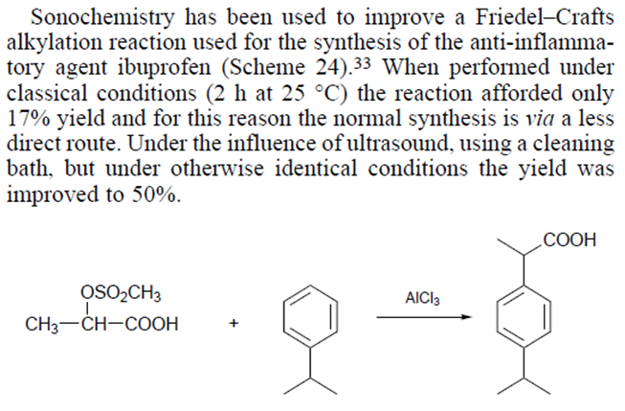
ALTERNATIVE METHODS FOR FOOD TREATMENT
6
1. Ultrasound treatment (sonication) – non-food applications

Slide 8
ALTERNATIVE METHODS FOR FOOD TREATMENT
7
2. Treatment with high pressure –
High hydrostatic pressure (HHP) or Hydrodynamic pressure processing (HDP)
1). A.M.Williams-Campbell, Morse Solomon, Reduction of spoilage microorganisms in fresh beef using
hydrodynamic pressure processing, 65(3), 2002, 571-574, Journal of food protection.
shockwave treatment
The effect of high pressure processing on food systems was first reported by Hite (Hite BH. 1899. The effect of pressure in the preservation of milk. Bull West Virginia Univ Agric Exp Stn 58:15–35.). However, few studies were published until the 1970s because of technical difficulties and costs associated with HHP processing units and packaging materials. HHP treatment – 100÷1000 MPa.
http://www.hiperbaric.com/en/hpp
http://freshpress.gr/index.cfm?action=video&lang=EN
3). Williams-Campbell, A.M., Solomon, M.B. New non-thermal postharvest technology to improve food safety:
hydrodynamic pressure processing. The International Society for Optical Engineering (SPIE).
2000. v. 4206. p. 167-173.

Slide 9
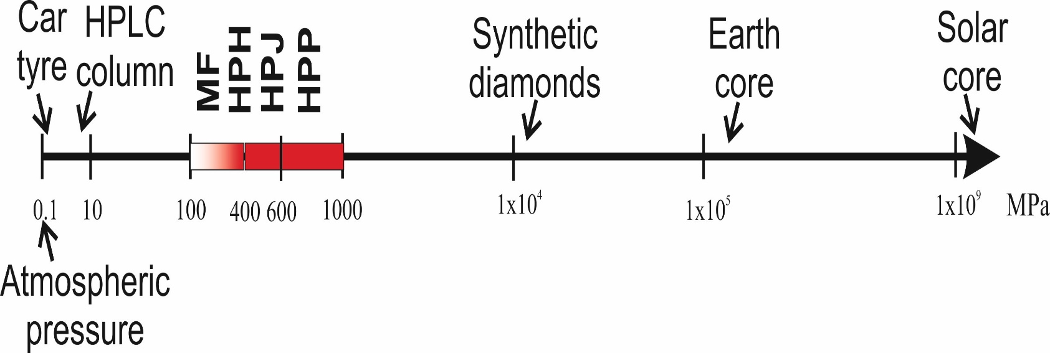
ALTERNATIVE METHODS FOR FOOD TREATMENT
7
2. Treatment with high pressure –
High hydrostatic pressure (HHP) or Hydrodynamic pressure processing (HDP)
Comparative scheme of the high pressure technologies and the pressures utilized. MF: microfluidization; HPH: high pressure homogenization; HPJ: high pressure jet processing; HPP – high pressure processing
3). Williams-Campbell, A.M., Solomon, M.B. New non-thermal postharvest technology to improve food safety:
hydrodynamic pressure processing. The International Society for Optical Engineering (SPIE).
2000. v. 4206. p. 167-173.

Slide 10
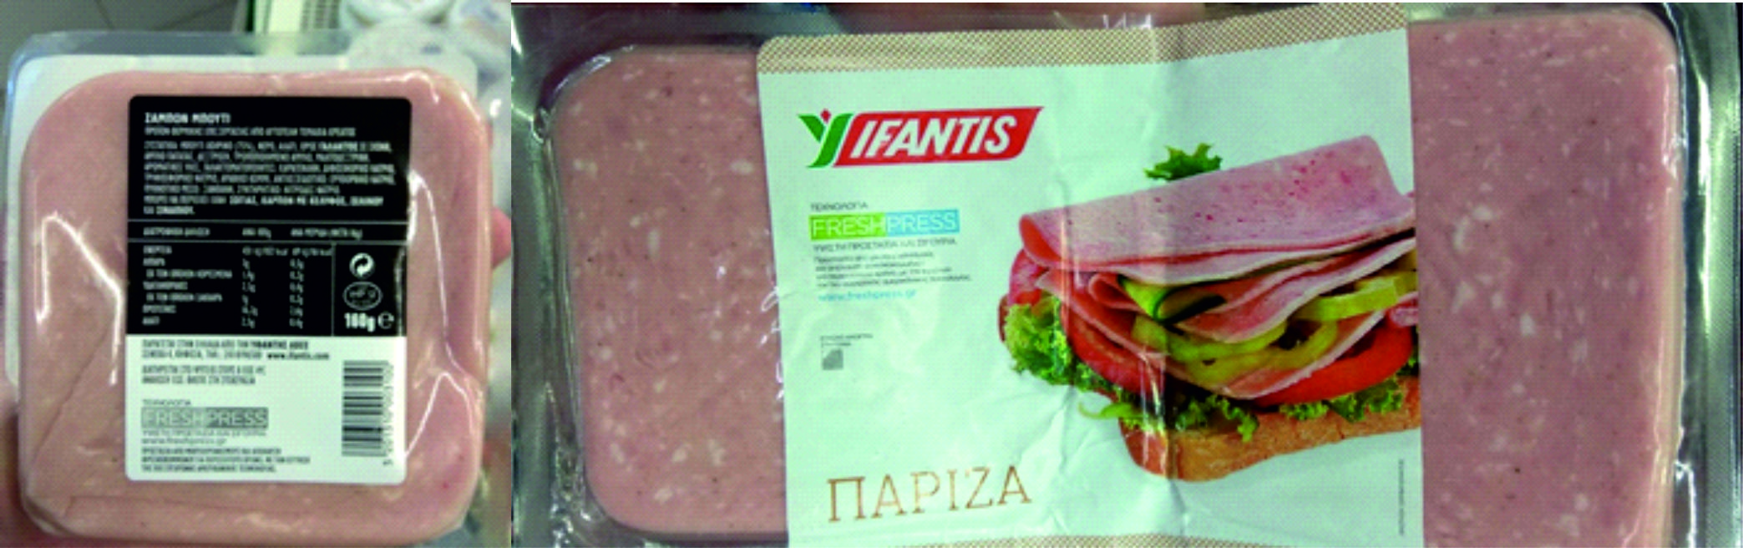
ALTERNATIVE METHODS FOR FOOD TREATMENT
7
2. Treatment with high pressure –
High hydrostatic pressure (HHP) or Hydrodynamic pressure processing (HDP)
3). Williams-Campbell, A.M., Solomon, M.B. New non-thermal postharvest technology to improve food safety:
hydrodynamic pressure processing. The International Society for Optical Engineering (SPIE).
2000. v. 4206. p. 167-173.

Slide 11
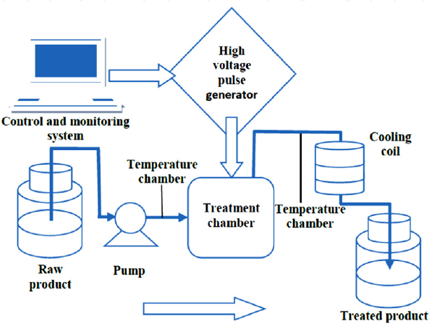
ALTERNATIVE METHODS FOR FOOD TREATMENT
8
3. Pulsed electric field (PEF) treatment
5-80 kV/cm generated by the application of short high voltage pulses (µs) between two electrodes
$450,000 to $2,000,000
https://www.youtube.com/watch?v=uSK-7dqaVLo

Slide 12
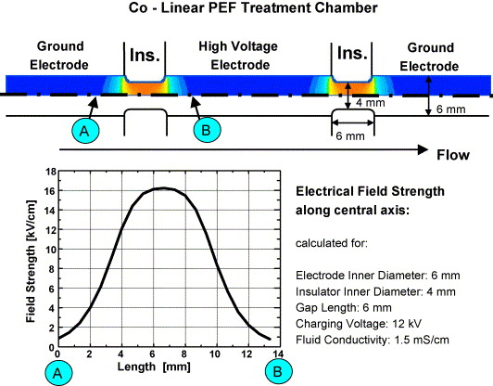
ALTERNATIVE METHODS FOR FOOD TREATMENT
9
3. Pulsed electric field (PEF) treatment
Features of co-linear PEF treatment chambers. Top: sectional view of the electrode configuration and the resulting electrical field. The central high voltage electrode is separated from two grounded electrodes on either side by an electrical insulator. One example is given which shows the field strength along the central axis at the treatment zone A–B. 5-100кV/cm
Pulsed Electric Fields for Food Processing Technology, M.E.A. Mohamed, A.H.A. Eissa in “Structure and Function of Food Engineering” (Ed. Ayman Amer Eissa), 2012, publisehd by InTech (DOI: 10.5772/1615)

Slide 13
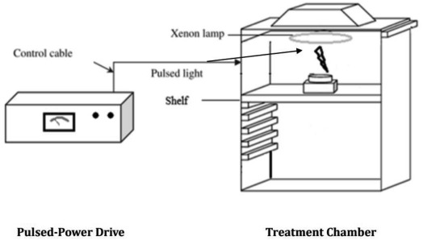
ALTERNATIVE METHODS FOR FOOD TREATMENT
10
4. Pulsed Light Technology
https://www.youtube.com/watch?v=AQ4BY93Ot8A
http://courses.washington.edu/eh451/articles/Pulsed-Light-Food.pdf

Slide 14
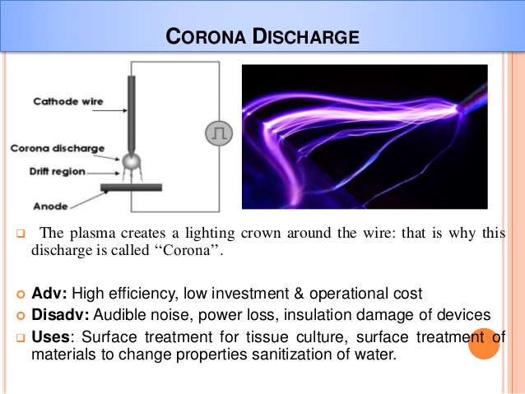
ALTERNATIVE METHODS FOR FOOD TREATMENT
10
5. Cold Plasma treatment
https://www.youtube.com/watch?v=HF3wVOfBVuQ

Slide 15
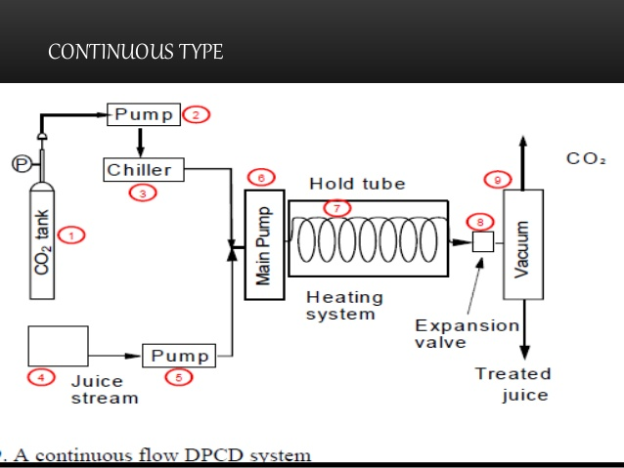
ALTERNATIVE METHODS FOR FOOD TREATMENT
10
6. Dense Phase CO₂ treatment
https://www.slideshare.net/mayasharma9026/maya-sharma-presentation

