Slide 1
Chapter 9
Financial Statement Analysis
Presenter’s name
Presenter’s title
dd Month yyyy

Slide 2
1. Introduction
Financial analysis is a process of selecting, evaluating, and interpreting financial data, along with other pertinent information, in order to formulate an assessment of a company’s present and future financial condition and performance.
Financial Disclosures
Market Data
Financial Analysis
Economic Data
Notes:
Pages 347–348
Introduction
Financial analysis is a process of selecting, evaluating, and interpreting financial data, along with other pertinent information, in order to formulate an assessment of a company’s present and future financial condition and performance.
Information needed:
Financial disclosures (e.g., 10-K, annual report, 10-Q, 8-K)
Market data (e.g., market price of stock, volume traded, value of bonds)
Economic data (e.g., GDP, consumer spending)

Slide 3
2. Common-Size Analysis
Common-size analysis is the restatement of financial statement information in a standardized form.
  Horizontal common-size analysis uses the amounts in accounts in a specified year as the base, and subsequent years’ amounts are stated as a percentage of the base value.
    Useful when comparing growth of different accounts over time.
  Vertical common-size analysis uses the aggregate value in a financial statement for a given year as the base, and each account’s amount is restated as a percentage of the aggregate.
    Balance sheet: Aggregate amount is total assets.
    Income statement: Aggregate amount is revenues or sales.
Notes:
LOS: Interpret common-size balance sheets and common-size income statements and demonstrate their use by applying either vertical analysis or horizontal analysis.
Pages 348–356
2. Common-Size Analysis
Common-size analysis is the restatement of financial statement information in a standardized form.
Horizontal common-size analysis uses the amounts in accounts in a specified year as the base, and subsequent years’ amounts are stated as a percentage of the base value.
Useful when comparing growth of different accounts over time.
When viewed graphically, reveals different growth patterns among accounts.
Vertical common-size analysis uses the aggregate value in a financial statement for a given year as the base, and each account’s amount is restated as a percentage of the aggregate.
Balance sheet: Aggregate amount is total assets.
Reveals proportion of asset investment among accounts.
Reveals capital structure (proportions of capital).
Income statement: Aggregate amount is revenues or sales.
Reveals profit margins.

Slide 4
Example: Common-size analysis
Consider the CS Company, which reports the following financial information:
Create the vertical common-size analysis for the CS Company’s assets.
Create the horizontal common-size analysis for CS Company’s assets, using 2008 as the base year.
Year | 2008 | 2009 | 2010 | 2011 | 2012 | 2013
Cash | $400.00 | $404.00 | $408.04 | $412.12 | $416.24 | $420.40
Inventory | 1,580.00 | 1,627.40 | 1,676.22 | 1,726.51 | 1,778.30 | 1,831.65
Accounts receivable | 1,120.00 | 1,142.40 | 1,165.25 | 1,188.55 | 1,212.32 | 1,236.57
Net plant and equipment | 3,500.00 | 3,640.00 | 3,785.60 | 3,937.02 | 4,094.50 | 4,258.29
Intangibles | 400.00 | 402.00 | 404.01 | 406.03 | 408.06 | 410.10
Total assets | $6,500.00 | $6,713.30 | $6,934.12 | $7,162.74 | $7,399.45 | $7,644.54
Notes:
LOS: Interpret common-size balance sheets and common-size income statements and demonstrate their use by applying either vertical analysis or horizontal analysis.
Pages 348–356
Example: Common-Size Analysis
Vertical common-size analysis: Take each account in a given year, and divide it by the total assets.
Horizontal common-size analysis: Take each account, and compare a given year’s value with the base year’s value (2008 in this case).

Slide 5
Example: Common-size analysis
Vertical Common-Size Analysis:
Graphically:
Year | 2008 | 2009 | 2010 | 2011 | 2012 | 2013
Cash | 6% | 6% | 5% | 5% | 5% | 5%
Inventory | 23% | 23% | 23% | 23% | 22% | 22%
Accounts receivable | 16% | 16% | 16% | 15% | 15% | 15%
Net plant and equipment | 50% | 50% | 51% | 51% | 52% | 52%
Intangibles | 6% | 6% | 5% | 5% | 5% | 5%
Total assets | 100% | 100% | 100% | 100% | 100% | 100%
Notes:
LOS: Interpret common-size balance sheets and common-size income statements and demonstrate their use by applying either vertical analysis or horizontal analysis.
Pages 348–356
Example: Common-Size Analysis
Interpretation:
The relative investment in fixed assets (currently around 52% of assets), when compared with current assets, has increased since 2008.
The proportion of assets that are current assets have decreased slightly over time.

Slide 6
Example: Common-Size Analysis
Horizontal Common-Size Analysis (base year is 2008):
Graphically:
Year | 2008 | 2009 | 2010 | 2011 | 2012 | 2013
Cash | 100.00% | 101.00% | 102.01% | 103.03% | 104.06% | 105.10%
Inventory | 100.00% | 103.00% | 106.09% | 109.27% | 112.55% | 115.93%
Accounts receivable | 100.00% | 102.00% | 104.04% | 106.12% | 108.24% | 110.41%
Net plant and equipment | 100.00% | 104.00% | 108.16% | 112.49% | 116.99% | 121.67%
Intangibles | 100.00% | 100.50% | 101.00% | 101.51% | 102.02% | 102.53%
Total assets | 100.00% | 103.08% | 106.27% | 109.57% | 112.99% | 116.53%
Notes:
LOS: Interpret common-size balance sheets and common-size income statements and demonstrate their use by applying either vertical analysis or horizontal analysis.
Pages 348–356
Example: Common-Size Analysis
Interpretation:
Net plant and equipment has increased more than other assets since 2008 (annual rate of 4%).
Intangibles have increased the least over time.

Slide 7
3. Financial Ratio Analysis
Financial ratio analysis is the use of relationships among financial statement accounts to gauge the financial condition and performance of a company.
We can classify ratios based on the type of information the ratio provides:
Activity Ratios
Effectiveness in putting its asset investment to use.
Liquidity Ratios
Ability to meet short-term, immediate obligations.
Solvency Ratios
Ability to satisfy debt obligations.
Profitability Ratios
Ability to manage expenses to produce profits from sales.
Notes:
LOS: Calculate and interpret measures of a company’s operating efficiency, internal liquidity (liquidity ratios), solvency, and profitability, and demonstrate the use of these measures in company analysis.
Pages 356–357
3. Financial Ratio Analysis
Classifying ratios:
Activity ratios
Effectiveness in putting asset investment to use.
Liquidity ratios
Ability to meet short-term, immediate obligations.
Solvency ratios
Ability to satisfy debt obligations.
Profitability ratios
Ability to manage expenses to produce profits from sales.

Slide 8
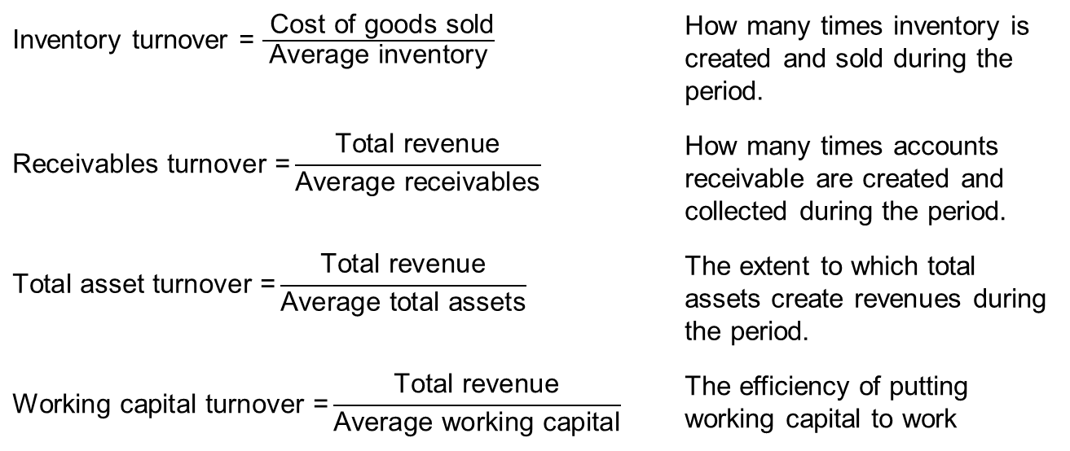
Activity Ratios
Turnover ratios reflect the number of times assets flow into and out of the company during the period.
A turnover is a gauge of the efficiency of putting assets to work.
Ratios:
Inventory turnover = $\frac{ \text{Cost} \text{of} \text{goods} \text{sold}}{\text{Average} \text{inventory}}$ | How many times inventory is created and sold during the period.
$$\text{Receivables} \text{turnover}\text{ =}\frac{\text{Total} \text{revenue}}{\text{Average} \text{receivables}}$$ | How many times accounts receivable are created and collected during the period.
$$\text{Total} \text{asset} \text{turnover}\text{ =}\frac{\text{Total} \text{revenue}}{\text{Average} \text{total} \text{assets}}$$ | The extent to which total assets create revenues during the period.
$$\text{Working} \text{capital} \text{turnover}\text{ =}\frac{\text{Total} \text{revenue}}{\text{Average} \text{working} \text{capital}}$$ | The efficiency of putting working capital to work
Notes:
LOS: Calculate and interpret measures of a company’s operating efficiency, internal liquidity (liquidity ratios), solvency, and profitability, and demonstrate the use of these measures in company analysis.
Pages 358–360
Activity Ratios
Turnover ratios reflect the number of times assets flow into and out of the company during the period.
A turnover is a gauge of the efficiency of putting assets to work.
Inventory turnover: How many times inventory is created and sold during the period.
Receivables turnover: How many times accounts receivable are created and collected during the period.
Total asset turnover: The extent to which total assets create revenues during the period.
Working capital turnover: The efficiency of putting working capital to work.
Note: A way of looking at turnover ratios is to consider that the denominator is the investment that is being put to work and the numerator is the result of that effort.

Slide 9
Operating cycle components
The operating cycle is the length of time from when a company makes an investment in goods and services to the time it collects cash from its accounts receivable.
The net operating cycle is the length of time from when a company makes an investment in goods and services, considering the company makes some of its purchases on credit, to the time it collects cash from its accounts receivable.
The length of the operating cycle and net operating cycle provides information on the company’s need for liquidity: The longer the operating cycle, the greater the need for liquidity.
Number of Days of Inventory |  |  |  | Number of Days of Receivables
| |  | | |  | | |  | |
Buy Inventory on Credit |  | Pay Accounts Payable |  | Sell Inventory on Credit |  | Collect Accounts Receivable
Number of Days of Payables |  |  | Net Operating Cycle
Operating Cycle
Notes:
LOS: Calculate and interpret measures of a company’s operating efficiency, internal liquidity (liquidity ratios), solvency, and profitability, and demonstrate the use of these measures in company analysis.
Pages 360–362
Operating Cycle Components
The operating cycle is the length of time from when a company makes an investment in goods and services to the time it collects cash from its accounts receivable.
The net operating cycle is the length of time from when a company makes an investment in goods and services, considering the company makes some of its purchases on credit, to the time it collects cash from its accounts receivable.
The length of the operating cycle and net operating cycle provides information on the company’s need for liquidity: The longer the operating cycle, the greater the need for liquidity.
Note: The operating cycle is also covered in Chapter 8, along with the formulas.
Discussion question: Why do we say that a company with a long operating cycle has a greater need for liquidity?

Slide 10
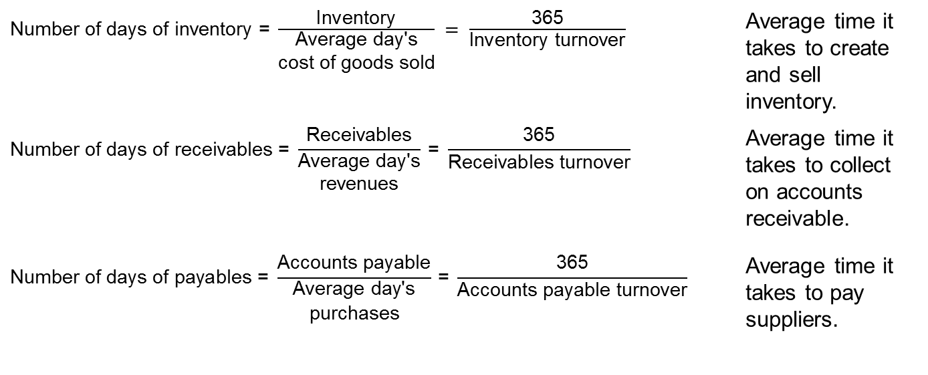
Operating Cycle Formulas
$\text{Number} \text{of} \text{days} \text{of} \text{inventory}\text{ = }\frac{\text{Inventory}}{\begin{matrix}\text{A}\text{verage} \text{da}\text{y}\text{′}\text{s} \\ \text{cost} \text{of} \text{goods} \text{sold}\end{matrix}} = \frac{\text{365}}{\text{Inventory} \text{turnover}}$ |  | Average time it takes to create and sell inventory.
$$\text{Number} \text{of} \text{days} \text{of} \text{receivables}\text{ = }\frac{\text{Receivables}}{\begin{matrix}\text{A}\text{verage} \text{da}\text{y}\text{′}\text{s} \\ \text{revenues}\end{matrix}} \text{= }\frac{\text{365}}{\text{Receivables} \text{turnover}}$$ |  | Average time it takes to collect on accounts receivable.
$$\text{Number} \text{of} \text{days} \text{of} \text{payables}\text{ = }\frac{\text{Accounts} \text{payable}}{\begin{matrix}\text{A}\text{verage} \text{da}\text{y}\text{′}\text{s} \\ \text{purchases}\end{matrix}} \text{=} \frac{\text{365}}{\text{Accounts} \text{payable} \text{turnover}}$$ |  | Average time it takes to pay suppliers.
Notes:
LOS: Calculate and interpret measures of a company’s operating efficiency, internal liquidity (liquidity ratios), solvency, and profitability, and demonstrate the use of these measures in company analysis.
Pages 360–362
Operating Cycle Formulas
Number of days of inventory: Average time it takes to create and sell inventory.
Number of days of receivables: Average time it takes to collect on accounts receivable.
By using average day’s revenues, we are assuming that all sales are on credit. If not, this would be modified to reflect only credit sales.
Number of days of payables: Average time it takes to pay suppliers.
Key: The numerator is the “stock” of the denominator’s “flow.”

Slide 11
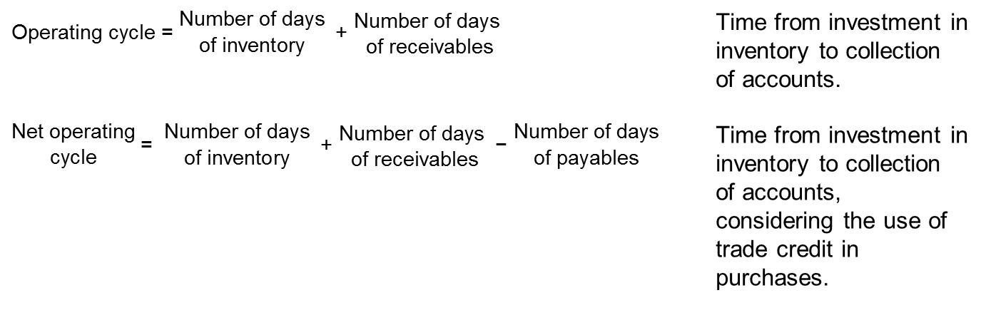
Operating Cycle Formulas
$$\text{Operating} \text{cycle}\text{ = }\begin{matrix}\text{N}\text{umber} \text{of} \text{days} \\ \text{of} \text{inventory} \end{matrix} \text{+ }\begin{matrix}\text{N}\text{umber} \text{of} \text{days} \\ \text{of} \text{receivables}\end{matrix}$$ |  | Time from investment in inventory to collection of accounts.
$$\begin{matrix}\text{N}\text{et} \text{operating} \\ \text{cycle}\end{matrix} \text{= }\begin{matrix}\text{N}\text{umber} \text{of} \text{days} \\ \text{of} \text{inventory} \end{matrix} \text{+ }\begin{matrix}\text{N}\text{umber} \text{of} \text{days} \\ \text{of} \text{receivables}\end{matrix} \text{− }\begin{matrix}\text{N}\text{umber} \text{of} \text{days} \\ \text{of} \text{payables}\end{matrix}$$ |  | Time from investment in inventory to collection of accounts, considering the use of trade credit in purchases.
Notes:
LOS: Calculate and interpret measures of a company’s operating efficiency, internal liquidity (liquidity ratios), solvency, and profitability, and demonstrate the use of these measures in company analysis.
Pages 360–362
Operating Cycle Formulas
Operating cycle: Time from investment in inventory to collection of accounts.
$$\text{Operating} \text{cycle}\text{ = }\begin{matrix}\text{N}\text{umber} \text{of} \text{days} \\ \text{of} \text{inventory} \end{matrix} \text{+} \begin{matrix}\text{N}\text{umber} \text{of} \text{days} \\ \text{of} \text{receivables}\end{matrix}$$
Net operating cycle: Time from investment in inventory to collection of accounts, considering the use of trade credit in purchases.
$$\begin{matrix}\text{N}\text{et} \text{operating} \\ \text{cycle}\end{matrix} \text{=} \begin{matrix}\text{N}\text{umber} \text{of} \text{days} \\ \text{of} \text{inventory} \end{matrix} \text{+} \begin{matrix}\text{N}\text{umber} \text{of} \text{days} \\ \text{of} \text{receivables}\end{matrix} \text{−} \begin{matrix}\text{N}\text{umber} \text{of} \text{days} \\ \text{of} \text{payables}\end{matrix}$$

Slide 12
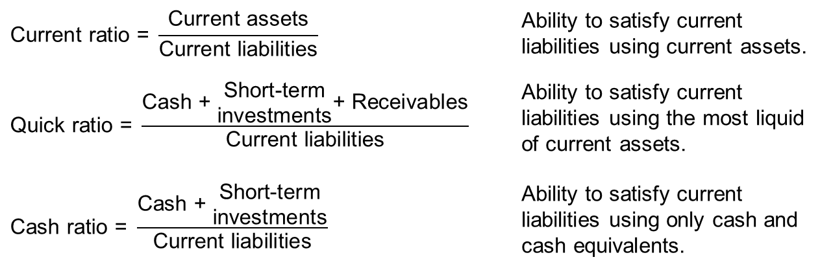
Liquidity
Liquidity is the ability to satisfy the company’s short-term obligations using assets that can be most readily converted into cash.
Liquidity ratios:
$$\text{Current} \text{ratio}\text{ = }\frac{\text{Current} \text{assets}}{\text{Current} \text{liabilities}}$$ |  | Ability to satisfy current liabilities using current assets.
$$\text{Quick} \text{ratio}\text{ = }\frac{\text{Cash}\text{ + }\begin{matrix}\text{S}\text{hort}\text{−}\text{term} \\ \text{investments}\end{matrix}\text{+ }\text{Receivables}}{\text{Current} \text{liabilities}}$$ |  | Ability to satisfy current liabilities using the most liquid of current assets.
$$\text{Cash} \text{ratio}\text{ = }\frac{\text{Cash}\text{ + }\begin{matrix}\text{S}\text{hort}\text{−}\text{term} \\ \text{investments}\end{matrix}}{\text{Current} \text{liabilities}}$$ |  | Ability to satisfy current liabilities using only cash and cash equivalents.
Notes:
LOS: Calculate and interpret measures of a company’s operating efficiency, internal liquidity (liquidity ratios), solvency, and profitability, and demonstrate the use of these measures in company analysis.
Pages 363–365
Liquidity
Liquidity is the ability to satisfy the company’s short-term obligations using assets that can be most readily converted into cash.
Liquidity ratios:
Current ratio: Ability to satisfy current liabilities using current assets.
Quick ratio: Ability to satisfy current liabilities using the most liquid of current assets.
Cash ratio: Ability to satisfy current liabilities using only cash and cash equivalents.

Slide 13
Solvency Analysis
A company’s business risk is determined, in large part, from the company’s line of business.
Financial risk is the risk resulting from a company’s choice of how to finance the business using debt or equity.
We use solvency ratios to assess a company’s financial risk.
There are two types of solvency ratios: component percentages and coverage ratios.
  Component percentages involve comparing the elements in the capital structure.
  Coverage ratios measure the ability to meet interest and other fixed financing costs.
Risk
Business Risk
Financial Risk
Sales Risk
Operating Risk
Notes:
LOS: Calculate and interpret measures of a company’s operating efficiency, internal liquidity (liquidity ratios), solvency, and profitability, and demonstrate the use of these measures in company analysis.
Pages 365–369
Solvency Analysis
A company’s business risk is determined, in large part, from the company’s line of business.
Financial risk is the risk resulting from a company’s choice of how to finance the business using debt or equity.
We use solvency ratios to assess a company’s financial risk.
There are two types of solvency ratios: component percentages and coverage ratios.
Component percentages involve comparing the elements in the capital structure.
Coverage ratios measure the ability to meet interest and other fixed financing costs.

Slide 14
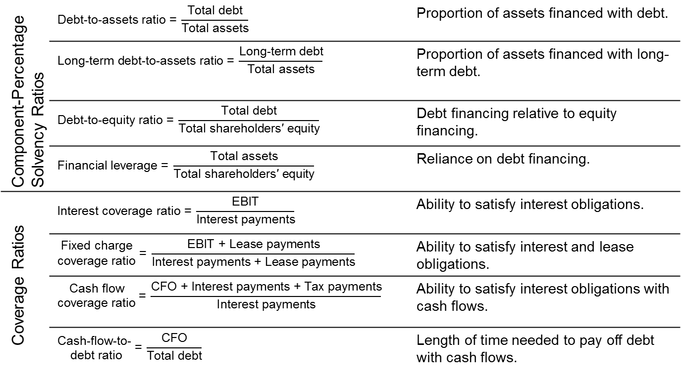
Solvency ratios
Component-Percentage Solvency Ratios | $$\text{Debt}\text{−}\text{to}\text{−}\text{assets} \text{ratio}\text{ = }\frac{\text{Total} \text{debt}}{\text{Total} \text{assets}}$$ |  | Proportion of assets financed with debt.
 | $$\text{Long}\text{−}\text{term} \text{debt}\text{−}\text{to}\text{−}\text{assets} \text{ratio}\text{ = }\frac{\text{Long}\text{−}\text{term} \text{debt}}{\text{Total} \text{assets}}$$ |  | Proportion of assets financed with long-term debt.
 | $$\text{Debt}\text{−}\text{to}\text{−}\text{equity} \text{ratio}\text{ = }\frac{\text{Total} \text{debt}}{\text{Total} \text{shareholders}\text{′ }\text{equity}}$$ |  | Debt financing relative to equity financing.
 | $$\text{Financial} \text{leverage}\text{ = }\frac{\text{Total} \text{assets}}{\text{Total} \text{shareholders}\text{′ }\text{equity}}$$ |  | Reliance on debt financing.
Coverage Ratios | $$\text{Interest} \text{coverage} \text{ratio}\text{ = }\frac{\text{EBIT}}{\text{Interest} \text{payments}}$$ |  | Ability to satisfy interest obligations.
 | $$\begin{matrix}\text{F}\text{ixed} \text{charge} \\ \text{coverage} \text{ratio}\end{matrix}\text{ = }\frac{\text{EBIT}\text{ + }\text{Lease} \text{payments}}{\text{Interest} \text{payments}\text{ + }\text{Lease} \text{payments}}$$ |  | Ability to satisfy interest and lease obligations.
 | $$\begin{matrix}\text{C}\text{ash} \text{flow} \\ \text{coverage} \text{ratio}\end{matrix} \text{= }\frac{\text{CFO}\text{ + }\text{Interest} \text{payments}\text{ + }\text{Tax} \text{payments}}{\text{Interest} \text{payments}}$$ |  | Ability to satisfy interest obligations with cash flows.
 | $$\begin{matrix}\text{C}\text{ash}\text{−}\text{flow}\text{−}\text{to}\text{− } \\ \text{debt} \text{ratio}\end{matrix}\text{= }\frac{\text{CFO}}{\text{Total} \text{debt}}$$ |  | Length of time needed to pay off debt with cash flows.
Notes:
LOS: Calculate and interpret measures of a company’s operating efficiency, internal liquidity (liquidity ratios), solvency, and profitability, and demonstrate the use of these measures in company analysis.
Pages 366–368
Solvency Ratios
Component-Percentage Solvency Ratios
Debt-to-assets ratio
$$\text{Debt}\text{−}\text{to}\text{−}\text{assets} \text{ratio}\text{ = }\frac{\text{Total} \text{debt}}{\text{Total} \text{assets}}$$
Proportion of assets financed with debt.
Long-term debt-to-assets ratio
$$\text{Long}\text{−}\text{term} \text{debt}\text{−}\text{to}\text{−}\text{assets} \text{ratio}\text{ = }\frac{\text{Long}\text{−}\text{term} \text{debt}}{\text{Total} \text{assets}}$$
Proportion of assets financed with long-term debt.
Debt-to-equity ratio
$\text{Debt}\text{−}\text{to}\text{−}\text{equity} \text{ratio}\text{ = }\frac{\text{Total} \text{debt}}{\text{Total} \text{shareholders}\text{′ }\text{equity}}$
Debt financing relative to equity financing.
Financial leverage (also referred to as the equity multiplier)
$$\text{Financial} \text{leverage}\text{ = }\frac{\text{Total} \text{assets}}{\text{Total} \text{shareholders}\text{′ }\text{equity}}$$
Reliance on debt financing.
Coverage ratios
Interest coverage ratio
$\text{Interest} \text{coverage} \text{ratio}\text{ = }\frac{\text{EBIT}}{\text{Interest} \text{payments}}$
Ability to satisfy interest obligations.
Fixed charge coverage ratio
$\begin{matrix}\text{Fixed} \text{charge} \\ \text{coverage} \text{ratio}\end{matrix}\text{ = }\frac{\text{EBIT} \text{+} \text{Lease} \text{payments}}{\text{Interest} \text{payments} \text{+} \text{Lease} \text{payments}}$
Ability to satisfy interest and lease obligations.
Cash flow coverage ratio
$$\begin{matrix}\text{Cash} \text{flow} \\ \text{coverage} \text{ratio}\end{matrix} \text{= }\frac{\text{CFO} \text{+} \text{Interest} \text{payments} \text{+} \text{Tax} \text{payments}}{\text{Interest} \text{payments}}$$
Ability to satisfy interest obligations with cash flows.
Cash-flow-to-debt ratio
$\begin{matrix}\text{Cash}\text{−}\text{flow}\text{−}\text{to}\text{−} \\ \text{debt} \text{ratio}\end{matrix}\text{=} \frac{\text{CFO}}{\text{Total} \text{debt}}$
Length of time needed to pay off debt with cash flows.
Discussion question: Is it possible for a company to have solvency ratios, such as the debt-to-assets and debt-to-equity ratios, that are increasing over time, yet the coverage ratios are not increasing?

Slide 15
Profitability
Margins and return ratios provide information on the profitability of a company and the efficiency of the company.
A margin is a portion of revenues that is a profit.
A return is a comparison of a profit with the investment necessary to generate the profit.
Notes:
LOS: Calculate and interpret measures of a company’s operating efficiency, internal liquidity (liquidity ratios), solvency, and profitability, and demonstrate the use of these measures in company analysis.
Pages 369–372
Profitability
Margins and return ratios provide information on the profitability of a company and the efficiency of the company.
A margin is a portion of revenues that is a profit.
A return is a comparison of a profit with the investment necessary to generate the profit.

Slide 16
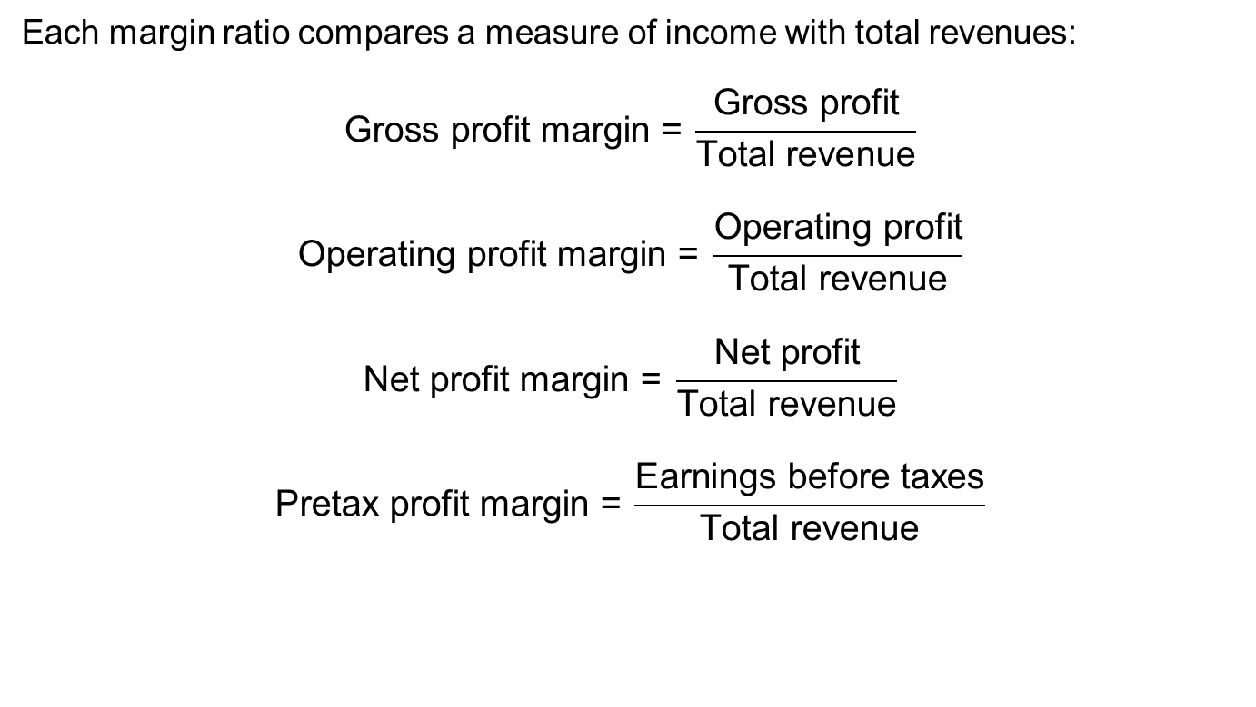
Profitability ratios: Margins
Each margin ratio compares a measure of income with total revenues:
$$\text{Gross} \text{profit} \text{margin}\text{ =} \frac{\text{Gross} \text{profit}}{\text{Total} \text{revenue}}$$
$$\text{Operating} \text{profit} \text{margin}\text{ = }\frac{\text{Operating} \text{profit}}{\text{Total} \text{revenue}}$$
$$\text{Net} \text{profit} \text{margin}\text{ = }\frac{\text{Net} \text{profit}}{\text{Total} \text{revenue}}$$
$$\text{Pretax} \text{profit} \text{margin}\text{ =} \frac{\text{Earnings} \text{before} \text{taxes}}{\text{Total} \text{revenue}}$$
Notes:
LOS: Calculate and interpret measures of a company’s operating efficiency, internal liquidity (liquidity ratios), solvency, and profitability, and demonstrate the use of these measures in company analysis.
Pages 369–370
Profitability Ratios: Margins
Each margin ratio compares a measure income with total revenues:
$\text{Gross} \text{profit} \text{margin}\text{ = }\frac{\text{Gross} \text{profit}}{\text{Total} \text{revenue}}$
$\text{Operating} \text{profit} \text{margin}\text{ = }\frac{\text{Operating} \text{profit}}{\text{Total} \text{revenue}}$
$\text{Net} \text{profit} \text{margin}\text{ = }\frac{\text{Net} \text{profit}}{\text{Total} \text{revenue}}$
$\text{Pretax} \text{profit} \text{margin}\text{ = }\frac{\text{Earnings} \text{before} \text{taxes}}{\text{Total} \text{revenue}}$

Slide 17
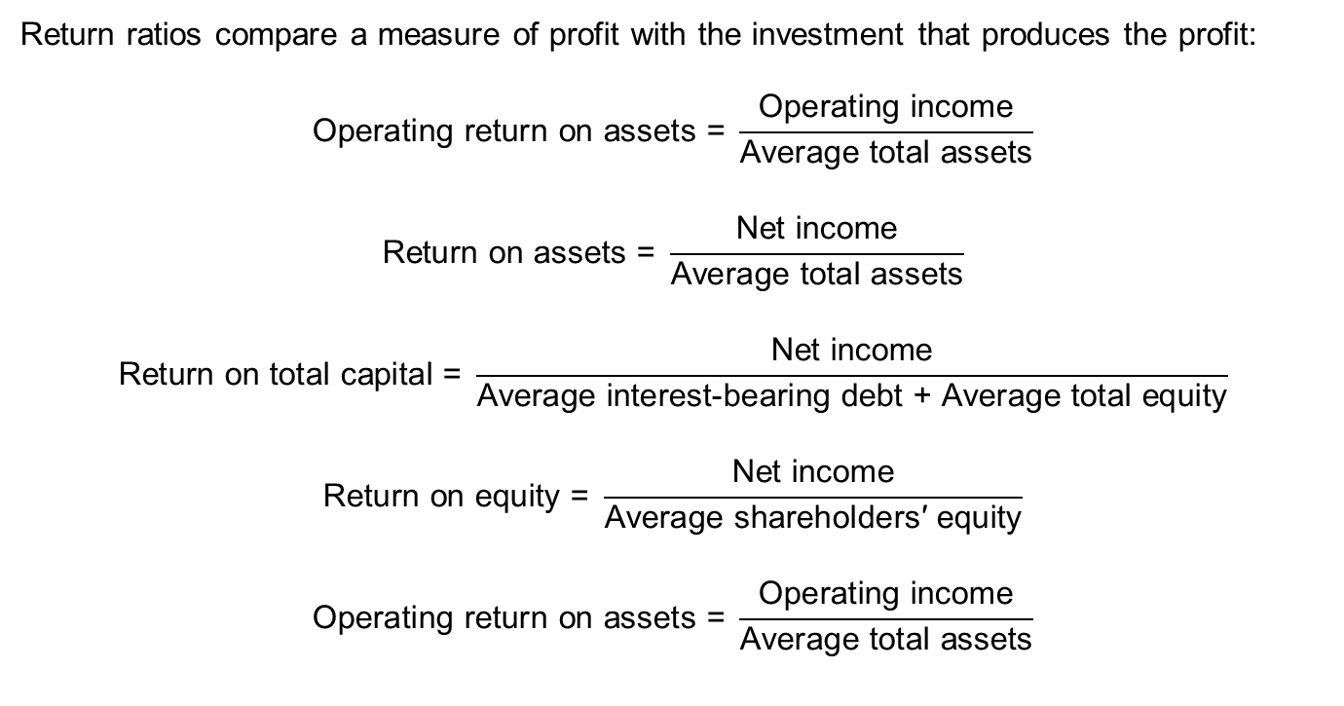
Profitability Ratios: Returns
Return ratios compare a measure of profit with the investment that produces the profit:
$$\text{Operating} \text{return} \text{on} \text{assets}\text{ = }\frac{\text{Operating} \text{income}}{\text{Average} \text{total} \text{assets}}$$
$$\text{Return} \text{on} \text{assets} \text{= }\frac{\text{Net} \text{income}}{\text{Average} \text{total} \text{assets}}$$
$$\text{Return} \text{on} \text{total} \text{capital}\text{ = }\frac{\text{Net} \text{income}}{\text{Average} \text{interest}\text{−}\text{bearing} \text{debt}\text{ + }\text{Average} \text{total} \text{equity}}$$
$$\text{Return} \text{on} \text{equity}\text{ = }\frac{\text{Net} \text{income}}{\text{Average} \text{shareholders}\text{′ }\text{equity}}$$
$$\text{Operating} \text{return} \text{on} \text{assets} \text{= }\frac{\text{Operating} \text{income}}{\text{Average} \text{total} \text{assets}}$$
Notes:
LOS: Calculate and interpret measures of a company’s operating efficiency, internal liquidity (liquidity ratios), solvency, and profitability, and demonstrate the use of these measures in company analysis.
Pages 371–372
Profitability Ratios: Returns
Each margin ratio compares a measure income with total revenues:
$$\text{Operating} \text{return} \text{on} \text{assets}\text{ = }\frac{\text{Operating} \text{income}}{\text{Average} \text{total} \text{assets}}$$
$$\text{Return} \text{on} \text{assets} \text{= }\frac{\text{Net} \text{income}}{\text{Average} \text{total} \text{assets}}$$
$$\text{Return} \text{on} \text{total} \text{capital}\text{ = }\frac{\text{Net} \text{income}}{\text{Average} \text{interest}\text{−}\text{bearing} \text{debt}\text{ + }\text{Average} \text{total} \text{equity}}$$
$$\text{Return} \text{on} \text{equity}\text{ = }\frac{\text{Net} \text{income}}{\text{Average} \text{shareholders}\text{′ }\text{equity}}$$
$$\text{Operating} \text{return} \text{on} \text{assets} \text{= }\frac{\text{Operating} \text{income}}{\text{Average} \text{total} \text{assets}}$$

Slide 18
The DuPont Formulas
Return on Equity
Net Profit
Margin
Total Asset
Turnover
Financial
Leverage
Operating Profit Margin
Effect of Nonoperating
Items
Tax
Effect
The DuPont formula uses the relationship among financial statement accounts to decompose a return into components.
Three-factor DuPont for the return on equity:
  Total asset turnover
  Financial leverage
  Net profit margin
Five-factor DuPont for the return on equity:
  Total asset turnover
  Financial leverage
  Operating profit margin
  Effect of nonoperating items
  Tax effect
Notes:
LOS: Calculate and interpret variations of the DuPont expression and demonstrate use of the DuPont approach in corporate analysis.
Pages 372–382
The DuPont Formulas
Return on equity
Net profit margin
Operating profit margin
Effect of nonoperating items
Tax effect
Total asset turnover
Financial leverage

Slide 19
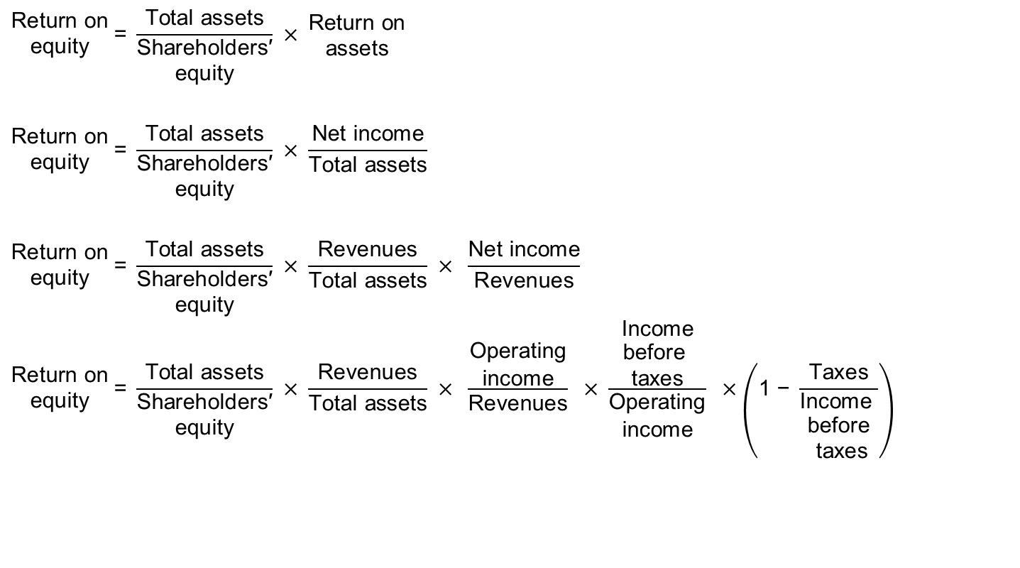
Five-Component DuPont Model
$$\begin{matrix}\text{R}\text{eturn} \text{on} \\ \text{equity}\end{matrix} \text{=} \frac{\text{Total} \text{assets}}{\begin{matrix}\text{S}\text{hareholders}\text{′} \\ \text{equity}\end{matrix}} × \begin{matrix}\text{R}\text{eturn} \text{on} \\ \text{assets}\end{matrix}$$
$$\begin{matrix}\text{R}\text{eturn} \text{on} \\ \text{equity}\end{matrix} \text{=} \frac{\text{Total} \text{assets}}{\begin{matrix}\text{S}\text{hareholders}\text{′} \\ \text{equity}\end{matrix}} × \frac{\text{Net} \text{income}}{\text{Total} \text{assets}}$$
$$\begin{matrix}\text{R}\text{eturn} \text{on} \\ \text{equity}\end{matrix} \text{=} \frac{\text{Total} \text{assets}}{\begin{matrix}\text{S}\text{hareholders}\text{′} \\ \text{equity}\end{matrix}} × \frac{\text{Revenues}}{\text{Total} \text{assets}} × \frac{\text{Net} \text{income}}{\text{Revenues}}$$
$$\begin{matrix}\text{R}\text{eturn} \text{on} \\ \text{equity}\end{matrix} \text{= }\frac{\text{Total} \text{assets}}{\begin{matrix}\text{S}\text{hareholders}\text{′} \\ \text{equity}\end{matrix}} × \frac{\text{Revenues}}{\text{Total} \text{assets}} × \frac{\begin{matrix}\text{O}\text{perating} \\ \text{income}\end{matrix}}{\text{Revenues}} × \frac{\begin{matrix}\text{I}\text{ncome} \\ \begin{aligned}\text{before} \\ \text{taxes}\end{aligned}\end{matrix}}{\begin{aligned}\text{Operating} \\ \text{income}\end{aligned}} ×\left(\text{1 − }\frac{\text{Taxes}}{\begin{matrix}\text{I}\text{ncome} \\ \begin{aligned}\text{before} \\ \text{taxes}\end{aligned}\end{matrix}}\right)$$
Notes:
LOS: Calculate and interpret variations of the DuPont expression and demonstrate use of the DuPont approach in corporate analysis.
Pages 378–379
Five-Component DuPont Model
The DuPont formulas involve the income statement and balance sheet relationships.
Starting with the return on equity, we can break the return on assets component into its own components to get a better idea of what drives the return.

Slide 20
Example: The DuPont Formula
Suppose that an analyst has noticed that the return on equity of the D Company has declined from FY2012 to FY2013. Using the DuPont formula, explain the source of this decline.
(millions) | 2013 | 2012
Revenues | $1,000 | $900
Earnings before interest and taxes | $400 | $380
Interest expense | $30 | $30
Taxes | $100 | $90
Total assets | $2,000 | $2,000
Shareholders’ equity | $1,250 | $1,000
Notes:
LOS: Calculate and interpret variations of the DuPont expression and demonstrate use of the DuPont approach in corporate analysis.
Pages 372–382
Example: The DuPont Formula
Suppose that an analyst has noticed that the return on equity of the D Company has declined from FY2012 to FY2013. Using the DuPont formula, explain the source of this decline.
(millions) 2013 2012
Revenues $1,000 $900
Earnings before interest and taxes 400 380
Interest expense 30 30
Taxes 100 90
Total assets $2,000 $2,000
Shareholders’ equity $1,250 $1,000

Slide 21
Example: the DuPont Formula
 | 2013 |  | 2012
Return on equity | 0.20 |  | 0.22
Return on assets | 0.13 |  | 0.11
Financial leverage | 1.60 |  | 2.00
Total asset turnover | 0.50 |  | 0.45
Net profit margin | 0.25 |  | 0.24
Operating profit margin | 0.40 |  | 0.42
Effect of nonoperating items | 0.83 |  | 0.82
Tax effect | 0.76 |  | 0.71
Notes:
LOS: Calculate and interpret variations of the DuPont expression and demonstrate use of the DuPont approach in corporate analysis.
Pages 372–382
Example: The DuPont Formula
2013 2012
Return on equity 0.20 0.22
Return on assets 0.13 0.11
Financial leverage 1.60 2.00
Total asset turnover 0.50 0.45
Net profit margin 0.25 0.24
Operating profit margin 0.40 0.42
Effect of nonoperating items 0.83 0.82
Tax effect 0.76 0.71
Notes for discussion:
Return on equity fell from 22% to 20%.
This change is a result of the drop in the financial leverage (from 2 to 1.6); the return on assets increased.
The return on assets increased from 11% to 13%.
The net profit margin improved (24% to 25%).
The asset turnover improved (0.45 times to 0.50 times).
The change in the net profit margin improved because of taxes taking a smaller portion of income (although operating profit margin declined from 42% to 40%).

Slide 22
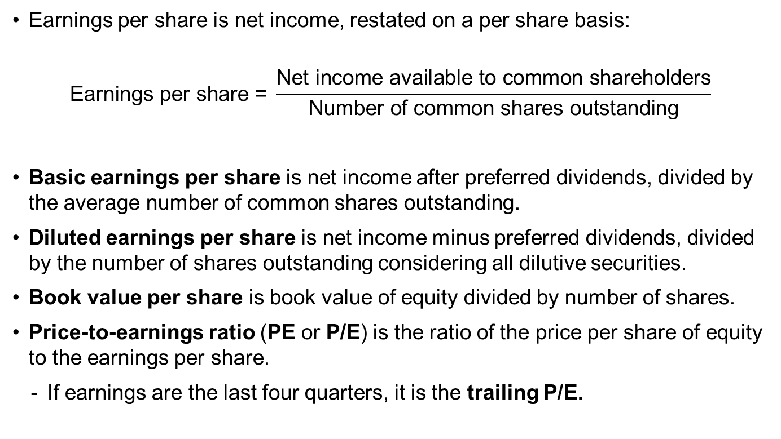
Other Ratios
Earnings per share is net income, restated on a per share basis:
$$\text{Earnings} \text{per} \text{share}\text{ = }\frac{\text{Net} \text{income} \text{available} \text{to} \text{common} \text{shareholders}}{\text{Number} \text{of} \text{common} \text{shares} \text{outstanding}}$$
Basic earnings per share is net income after preferred dividends, divided by the average number of common shares outstanding.
Diluted earnings per share is net income minus preferred dividends, divided by the number of shares outstanding considering all dilutive securities.
Book value per share is book value of equity divided by number of shares.
Price-to-earnings ratio (PE or P/E) is the ratio of the price per share of equity to the earnings per share.
  If earnings are the last four quarters, it is the trailing P/E.
Notes:
LOS: Calculate and interpret basic earnings per share and diluted earnings per share.
LOS: Calculate and interpret book value of equity per share, price-to-earnings ratio, dividends per share, dividend payout ratio, and plowback ratio.
Pages 383–385
Other Ratios
Earnings per share is net income, restated on a per share basis:
$$\text{Earnings} \text{per} \text{share}\text{ = }\frac{\text{Net} \text{income} \text{available} \text{to} \text{common} \text{shareholders}}{\text{Number} \text{of} \text{common} \text{shares} \text{outstanding}}$$
Basic earnings per share is net income after preferred dividends, divided by the average number of common shares outstanding.
Diluted earnings per share is net income minus preferred dividends, divided by the number of shares outstanding considering all dilutive securities.
Book value per share is book value of equity divided by number of shares.
Price-to-earnings ratio (PE or P/E) is the ratio of the price per share of equity to the earnings per share.
If earnings are the last four quarters, it is the trailing P/E.

Slide 23
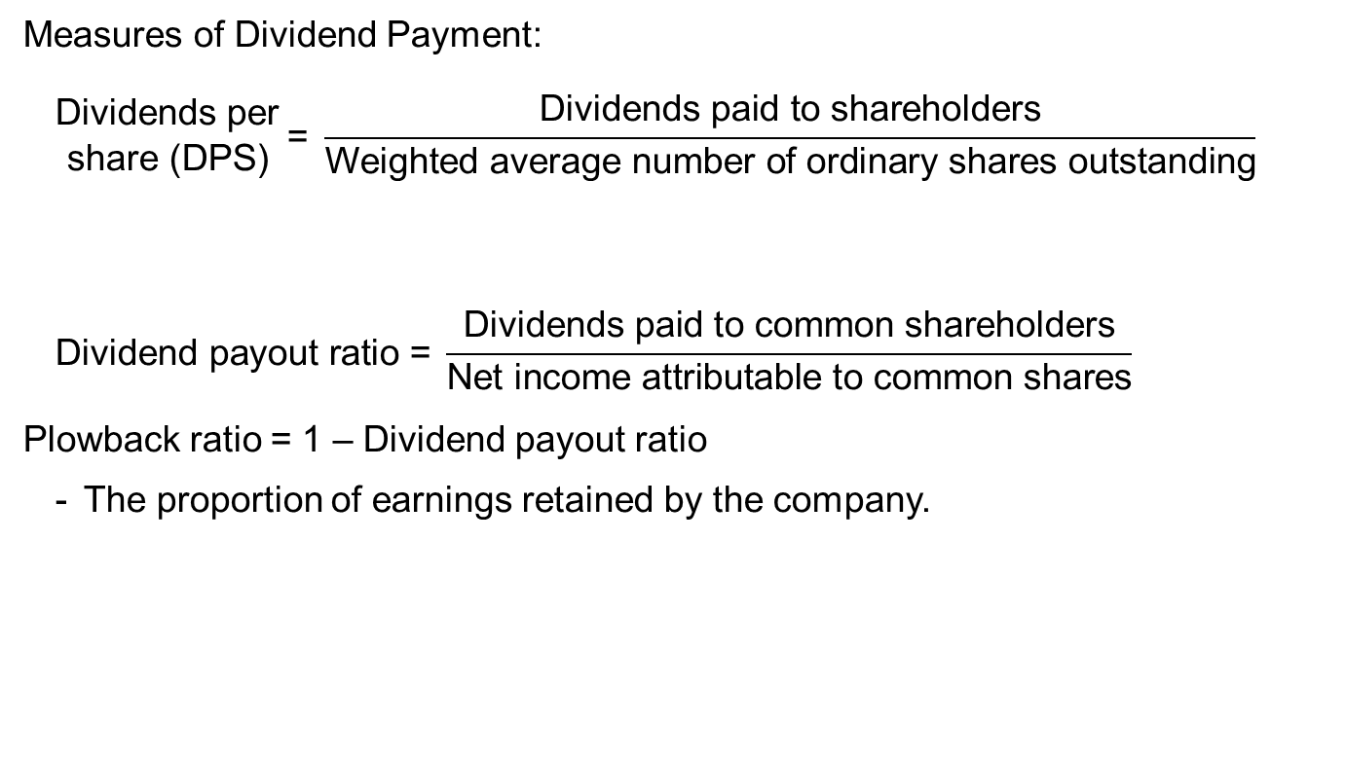
Other Ratios
Measures of Dividend Payment:
  $$\begin{matrix}\text{D}\text{ividends} \text{per} \\ \text{share}\text{ (}\text{DPS}\text{)}\end{matrix} \text{= }\frac{\text{Dividends} \text{paid} \text{to} \text{shareholders}}{\text{Weighted} \text{average} \text{number} \text{of} \text{ordinary} \text{shares} \text{outstanding}}$$
  $$\text{Dividend} \text{payout} \text{ratio}\text{ = }\frac{\text{Dividends} \text{paid} \text{to} \text{common} \text{shareholders}}{\text{Net} \text{income} \text{attributable} \text{to} \text{common} \text{shares}}$$
Plowback ratio = 1 – Dividend payout ratio
  The proportion of earnings retained by the company.
Notes:
LOS: Calculate and interpret book value of equity per share, price-to-earnings ratio, dividends per share, dividend payout ratio, and plowback ratio.
Pages 383–385
Other Ratios
Measures of Dividend Payment:
$$\begin{matrix}\text{D}\text{ividends} \text{per} \\ \text{share}\text{ (}\text{DPS}\text{)}\end{matrix}\text{= }\frac{\text{Dividends} \text{paid} \text{to} \text{shareholders}}{\text{Weighted} \text{average} \text{number} \text{of} \text{ordinary} \text{shares} \text{outstanding}}$$
$$\text{Dividend} \text{payout} \text{ratio}\text{= }\frac{\text{Dividends} \text{paid} \text{to} \text{common} \text{shareholders}}{\text{Net} \text{income} \text{attributable} \text{to} \text{common} \text{shares}}$$
Plowback ratio = 1 – Dividend payout ratio
The proportion of earnings retained by the company.

Slide 24
Example: Shareholder ratios
Calculate the book value per share, P/E, dividends per share, dividend payout, and plowback ratio based on the following financial information:
Book value of equity | $100 million
Market value of equity | $500 million
Net income | $30 million
Dividends | $12 million
Number of shares | 100 million
Notes:
LOS: Calculate and interpret book value of equity per share, price-to-earnings ratio, dividends per share, dividend payout ratio, and plowback ratio.
Pages 383–385
Example: Shareholder Ratios
Calculate the book value per share, P/E, dividends per share, dividend payout, and plowback ratio based on the following financial information:
Book value of equity $100 million
Market value of equity $500 million
Net income $30 million
Dividends $12 million
Number of shares 100 million

Slide 25
Example: Shareholder Ratios
Book value per share | $1.00 | There is $1 of equity, per the books, for every share of stock.
P/E | 16.67 | The market price of the stock is 16.67 times earnings per share.
Dividends per share | $0.12 | The dividends paid per share of stock.
Dividend payout ratio | 40% | The proportion of earnings paid out in the form of dividends.
Plowback ratio | 60% | The proportion of earnings retained by the company.
Notes:
LOS: Calculate and interpret book value of equity per share, price-to-earnings ratio, dividends per share, dividend payout ratio, and plowback ratio.
Pages 383–385
Example: Shareholder Ratios
Book value per share = $1.00
There is $1 of equity, per the books, for every share of stock.
P/E = 16.67
The market price of the stock is 16.67 times earnings per share.
Dividends per share = $0.12
The dividends paid per share of stock.
Dividend payout ratio = 40%
The proportion of earnings paid out in the form of dividends.
Plowback ratio = 60%
The proportion of earnings retained by the company.

Slide 26
Effective Use of Ratio Analysis
In addition to ratios, an analyst should describe the company (e.g., line of business, major products, major suppliers), industry information, and major factors or influences.
Effective use of ratios requires looking at ratios
  Over time.
  Compared with other companies in the same line of business.
  In the context of major events in the company (for example, mergers or divestitures), accounting changes, and changes in the company’s product mix.
Notes:
LOS: Calculate and interpret book value of equity per share, price-to-earnings ratio, dividends per share, dividend payout ratio, and plowback ratio.
Page 386
Effective Use of Ratio Analysis
In addition to ratios, an analyst should describe the company (e.g., line of business, major products, major suppliers), industry information, and major factors or influences.
Effective use of ratios requires looking at ratios
Over time.
Compared with other companies in the same line of business.
In the context of major events in the company (for example, restructuring, mergers, or divestitures), accounting changes, and changes in the company’s product mix.

Slide 27
4. Pro Forma Analysis
Estimate typical relation between revenues and sales-driven accounts.
Estimate fixed burdens, such as interest and taxes.
Forecast revenues.
Estimate sales-driven accounts based on forecasted revenues.
Estimate fixed burdens.
Construct future period income statement and balance sheet.
Notes:
LOS: Demonstrate the use of pro forma income and balance sheet statements.
Pages 392–394
4. Pro Forma Analysis
(Information from Exhibit 9-20, p. 394)
Estimate typical relation between revenues and sales-driven accounts.
Estimate fixed burdens, such as interest and taxes.
Forecast revenues.
Estimate sales-driven accounts based on forecasted revenues.
Estimate fixed burdens.
Construct future period income statement and balance sheet.

Slide 28
Pro Forma Income Statement
Imaginaire Company Income Statement (in millions)
 | Year 0 |  | One Year Ahead
Sales revenues | €1,000.0 |  | €1,050.0 | ⇦ Growth at 5%
Cost of goods sold | 600.0 |  | 630.0 | ⇦ 60% of revenues
Gross profit | €400.0 |  | €420.0 | ⇦ Revenues less COGS
SG&A | 100.0 |  | 105.0 | ⇦ 10% of revenues
Operating income | €300.0 |  | €315.0 | ⇦ Gross profit less operating exp.
Interest expense | 32.0 |  | 33.6 | ⇦ 8% of long-term debt
Earnings before taxes | €268.0 |  | €281.4 | ⇦ Operating income less interest exp.
Taxes | 93.8 |  | 98.5 | ⇦ 35% of earnings before taxes
Net income | €174.2 |  | €182.9 | ⇦ Earnings before taxes less taxes
Dividends | €87.1 |  | €91.5 | ⇦ Dividend payout ratio of 50%
Notes:
LOS: Demonstrate the use of pro forma income and balance sheet statements.
Pages 398–400
Pro Forma Income Statement
(Example from pages 398–400)
Accounts that vary directly with sales:
Cost of goods sold (COGS)
Selling, general, and administrative expenses (SG&A)
Calculated:
Gross profit
Operating income
Earnings before taxes
Taxes
Net income
Accounts that depend on other accounts:
Interest expense (depends on long-term debt)

Slide 29
Pro Forma Balance Sheet
Imaginaire Company Balance Sheet, End of Year (in millions)
 | Year 0 |  | One Year Ahead
Current assets | €600.0 |  | €630.0 | ⇦ 60% of revenues
Net plant and equipment | 1,000.0 |  | 1,050.0 | ⇦ 100% of revenues
Total assets | €1,600.0 |  | €1,680.0
Current liabilities | €250.0 |  | €262.5 | ⇦ 25% of revenues
Long-term debt | 400.0 |  | 420.0 | ⇦ Debt increased by €20 million to maintain the same capital structure
Common stock and paid-in capital | 25.0 |  | 25.0 | ⇦ Assume no change
Treasury stock |  |  | (44.0) | ⇦ Repurchased shares
Retained earnings | 925.0 |  | 1,016.5 | ⇦ Retained earnings in Year 0, plus net income, less dividends
Total liabilities and equity | €1,600.0 |  | €1,680.0
Notes:
LOS: Demonstrate the use of pro forma income and balance sheet statements.
Pages 398–400
Pro Forma Balance Sheet
Accounts that are a percentage of revenues:
Current assets
Current liabilities
Net plant and equipment (can be based on a specific fixed asset turnover relationship)
Accounts that are assumed not to change
Common stock and paid-in capital
Accounts that are determined by other accounts:
Retained earnings
Accounts that are the direct result of decisions:
Treasury stock
Long-term debt (capital structure decision)

Slide 30
5. Summary
Financial ratio analysis and common-size analysis help gauge the financial performance and condition of a company through an examination of relationships among these many financial items.
A thorough financial analysis of a company requires examining its efficiency in putting its assets to work, its liquidity position, its solvency, and its profitability.
We can use the tools of common-size analysis and financial ratio analysis, including the DuPont model, to help understand where a company has been.
We then use relationships among financial statement accounts in pro forma analysis, forecasting the company’s income statements and balance sheets for future periods, to see how the company’s performance is likely to evolve.
Notes:
5. Summary

