Slide 1
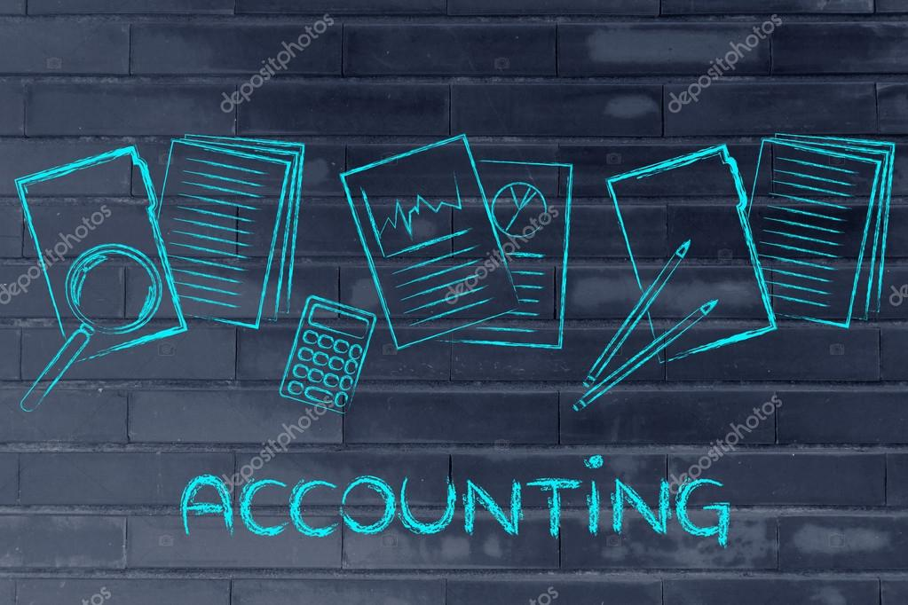

ENGLISH TERMS FOR ACCOUNTING & AUDITING

Slide 2
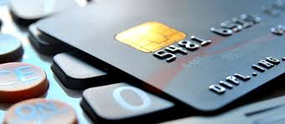
1. Assets
Definition: Everything a company owns, including cash, accounts receivable (money a company is going to receive), property and goods.
Example: The company’s assets were easy to calculate, but it was difficult to quantify the value of the employees’ expertise.

Slide 3
2. Liabilities
Definition: Everything that a company owes to others, like loans and mortgages.
Example: Liabilities are recorded on the right side of the balance sheet, while assets are listed on the left.

Slide 4
3. Balance Sheet
Definition: A document that records a company’s assets and liabilities at a certain moment in time. If we αre talking about a public company, it also shows the shareholders’ equity. The balance sheet is based on the accounting equation: assets = liabilities + owner’s equity. It is important for potential investors because they can see how the company is doing.
Example: We studied the balance sheet carefully to see if the assets exceeded the liabilities and shareholders’ equity.

Slide 5
4. Profit
Definition: The money a business is left with after deducting all the expenses.
Example: In order to decide if the company was worth investing in, they wanted to look at the profit it had been making over the previous year.

Slide 6
5. Revenue
Definition: The total amount of money a company receives from the services or products it sells. The revenue is higher than the profit, because in order to calculate the profit, you need to first see the costs of doing business.
Example: Our company has experienced a decrease in revenue due to the financial crisis.

Slide 7
6. Capital
Definition: Cash and funds, but also machinery and tangible assets that can contribute to earning more money, like computers, company vehicles, etc. Intangible assets like expertise or reputation are not considered to be capital.
Example: He couldn’t start a business because he didn’t have enough capital, so he decided to work as a freelancer for the time being.

Slide 8
7. Cash Flow
Definition: Money coming in (inflows) and going out (outflows) of a company.
Example: They had a cash flow problem because only a small percentage of their customers decided to use early settlement discounts, which meant that they had very high financing costs.

Slide 9
8. Accounts Payable
Definition: Money that a company owes to other parties—companies or people—called creditors. Accounts payable are considered liabilities.
Example: All of the accounts payable need to be cleared before we can invest in new software.

Slide 10
9. Accounts Receivable
Definition: Money that a company has to receive for products or services bought by customers or clients.
Example: You can calculate the accounts receivable by adding up all the invoices the company generated.

Slide 11
10. Appreciation
Definition: The increase in the value of a company’s assets. Appreciation can be the result of an increase in demand for a product or service. The verb form is to appreciate.
Example: Although their balance sheet didn’t look very promising, the company seemed worth investing in because of an anticipated appreciation in the value of their product.

Slide 12
11. Depreciation
Definition: The decrease in the value of products or services a company offers. Depreciation can be due to a high supply of similar products or services offered by competitors. The verb form is to depreciate.
Example: Because the company had almost no competitors just a year ago, nobody would have thought that their products would depreciate so much.

Slide 13
12. Financial Statements
Definition: Documents that show the financial situation of a company. They include the balance sheet, the income statement (showing revenues and expenses) and statement of cash flows.
Example: The accountants were all busy working on the financial statements as the company was planning to refinance its loans.
.

Slide 14
13. Share
Definition: A unit of ownership in a company. The person or organization who owns shares is entitled to dividends (usually cash), but they also share the responsibility if there are losses.
Example: He decided to invest in shares of a very profitable company instead of considering a savings account, because he was sure he could make money fast and he enjoyed taking risks.

Slide 15
14. Shareholder
Definition: A person or organization that owns shares in a company. Shareholders are, in a way, the owners of a company. If the company is doing well, the value of the shares goes up. If, on the contrary, the company is not profitable, the value of its shares decreases.
Example: Because he was a shareholder in the company, he had to attend annual General Meetings in order to keep up with the latest news and to vote for new members of the Board of Directors.

Slide 16
15. Owner’s Equity
Definition: A part of a company’s assets that the owner has. It’s calculated as assets minus liabilities.
Example: Unfortunately, in his company’s case, the owner’s equity didn’t amount to much: they had a lot of liabilities and not enough assets.

Slide 17
16. Income Tax
Definition: Money that individuals and companies owe to the government, based on the income they make.
Example: She was a sole proprietor and she hired an accountant to file her income tax return every year.

Slide 18
17. Value Added Tax (VAT)
Definition: A tax that consumers pay on most products and services, except most food and drugs. Not all countries have a VAT system. In the US, most states have something similar, called a sales tax.
Example: The bookkeeper had to calculate the Value Added Tax in order to issue the invoice.

Slide 19
18. Return on Investment (ROI)
Definition: The profitability ratio of a certain investment. The return on investment is calculated as the benefit gained from the investment divided by the cost of the investment.
Example: As their return on investment hit the lowest point in the last 5 years, they decided to stop investing in our company.

Slide 20
19. Auditor
Definition: A person whose job is to evaluate accounting records in order to make sure they have been done properly and to check if the company is being run efficiently.
Example: When the auditors asked for additional information about the financial statements, our accountants complied without delay.

Slide 21
20. Chartered Accountant
Definition: An accountant who has a certain amount of experience and who has passed certain exams that qualify them to be a member of an institution, such as the Institute of Chartered Accountants in the UK. In the US a similar title is that of Certified Public Accountant (CPA).
Example: She’s been studying to become a chartered accountant for a few years, but she couldn’t manage to pass the final exam.

