Slide 1




BUSINESS ENGLISH
First Steps at work

Slide 2
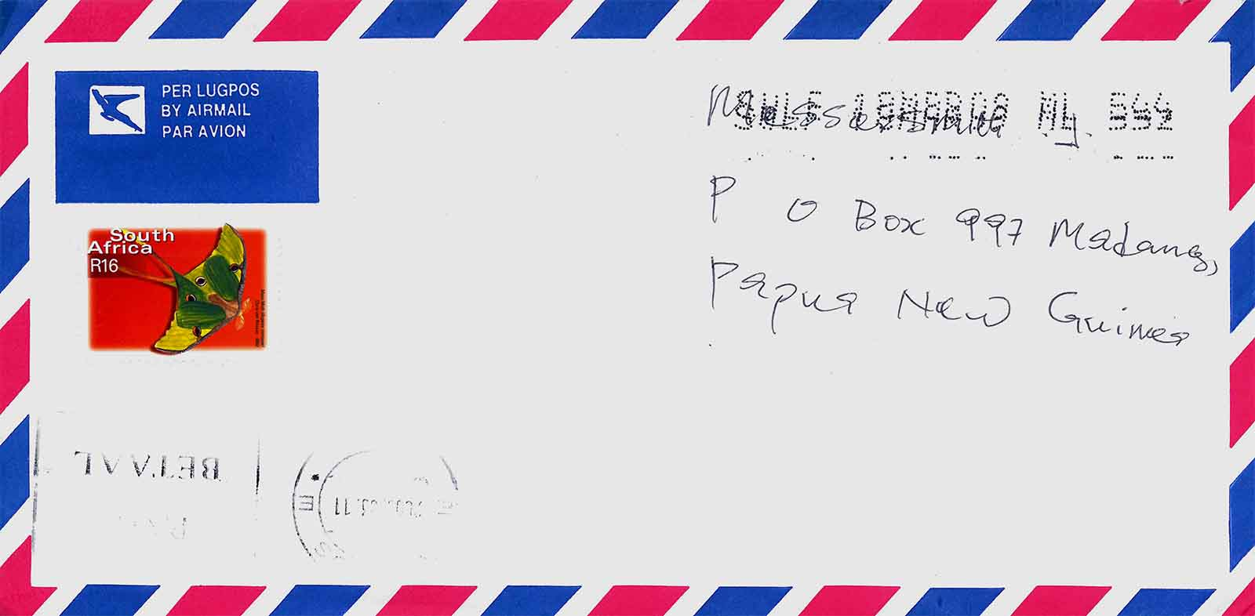
UNIT 4
Business Letter Writing

Slide 3

A. Exploring Language
QUESTIONS (ΕΡΩΤΗΣΕΙΣ)
Yes/No Questions Wh- Questions

Slide 4
1.Yes/No Questions
Οι ερωτήσεις γίνονται με τα βοηθητικά ρήματα (be, have, do, must, can etc.) και συνήθως απαντάμε με Yes ή No.
Are you a student? Yes, I am. - No, I am not.
Has George got a car? Yes, he has. - No, he hasn’t.
Do you work in this company? Yes, I do. – No, I don’t.

Slide 5
2. Wh- Questions
Οι ερωτήσεις αυτές αρχίζουν με ερωτηματικές λέξεις και το ρήμα που ακολουθεί είναι σε ερωτηματική μορφή. Μερικές από τις ερωτηματικές λέξεις που χρησιμοποιούνται είναι:
Who (ποιός,-α-ο;) για πρόσωπα.
Who is this man? He is George Jones.
What (τι;) για πράγματα, ζώα, επάγγελμα, όνομα, εθνικότητα.
What’s your job? I am an accountant.
What’s your name? My name is Helen.
What’s your nationality? I am Greek.

Slide 6
What time (τι ώρα;)
What time is the meeting? It’s at 7 o’clock.
Where (πού;) για τόπο.
Where is John? He is at home.
Whose (τίνος;) για ιδιοκτησία.
Whose is the car? It’s mine.
Which (ποιός -α -ο;) για πρόσωπα ή πράγματα όταν έχουμε περιορισμένη επιλογή.
Which folder is yours? The yellow one.

Slide 7
Why (γιατί;) για αιτία. Συνήθως απαντάμε με την λέξη because.
Why are you at home? Because I am sick.
How (πώς;) για τρόπο ή ποσότητα.
How are you? Very well, thank you.
How long (Πόσο καιρό;) για χρονική διάρκεια.
How long has Anna got her car? Three years.
How often (πόσο συχνά;) για συχνότητα.
How often is George here? Three times a week.

Slide 8
B. Developing Language
Nowadays, it is becoming less and less common to write letters because of the extensive use of e-mail. However, the few letters that you need to write, such as cover/application letters, may be very important. Therefore, it is crucial that your letters have the desired effect on the reader. A business letter reflects professionalism.

Slide 9
In order to achieve this, letters should have the right layout and be short, relevant, polite and without mistakes. The layout of a formal letter, as shown below, should include the following parts:

Slide 10

Letter Writing Guide

Slide 11
1. Sender’s address line space 2. Date Line spaces (1 to 4) 3. Recipient’s address (double space) 4. Salutation/Greeting (double space) 5. Subject Line/References (double space) 6. Body of the Letter (2-3 paragraphs) a. Introduction (line space) b. Main message (line space) c. Conclusion (line space) (double space) 7. Complimentary close (double space) 8. Signature Xxxxxxxxxxx Full name typed (Occupation optional) (double space) 9. Enclosures (if there are any)

Slide 12
1 If there is no printed letterhead, the sender’s address
includes street, city, postcode, country if sent abroad,
but no sender’s name.
2 Current date in full and not abbreviated.
3 Full name and address as it appears on the envelope.
4 Dear Mr/Mrs/Miss/Dr… if you know the name of
the person, Dear Sir/ Madam if you don’t.
5 The topic of the letter underlined or bold. It may
be omitted.

Slide 13
6 a Reason and purpose for writing.
1st paragraph Expressions:
I am writing to apply for the position .....
I am writing in connection with your advertisement ....
b Brief presentation of qualifications, experience and
skills.
2nd paragraph Expressions
I am .....
As you can see from my CV .....
At present .....

Slide 14
c Request for action. What you want the
reader to do.
3rd paragraph Closing Expressions
I would be grateful if you .......
Please contact me ……
I am available for an interview .......
I hope ......
I look forward to .......

Slide 15
7. The way you close the letter depends on the way you open it.
Dear Sir or Madam Yours faithfully
Dear Mr/Ms/Mrs/Miss…… Yours sincerely

Slide 16
ANSWER KEY 4
Notes:
ANSWER KEY 4

Slide 17
crucial = very important, basic

Slide 18
effect=result, outcome

Slide 19
layout= the way in which the parts of something are arranged

Slide 20
formal ≠ informal

Slide 21
recipient= the person who receives sth

Slide 22
letterhead= a printed heading

Slide 23
current = present, of today

Slide 24
Thank You
Back to top
Notes:
Back to top

